Slide 1
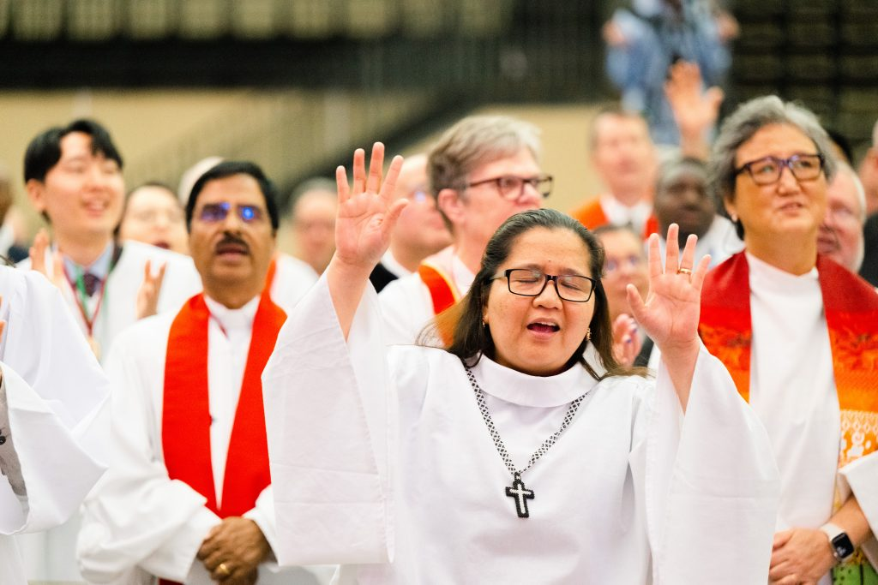
Annual Conference Orientation
April 29th
7pm
Zoom

Slide 2
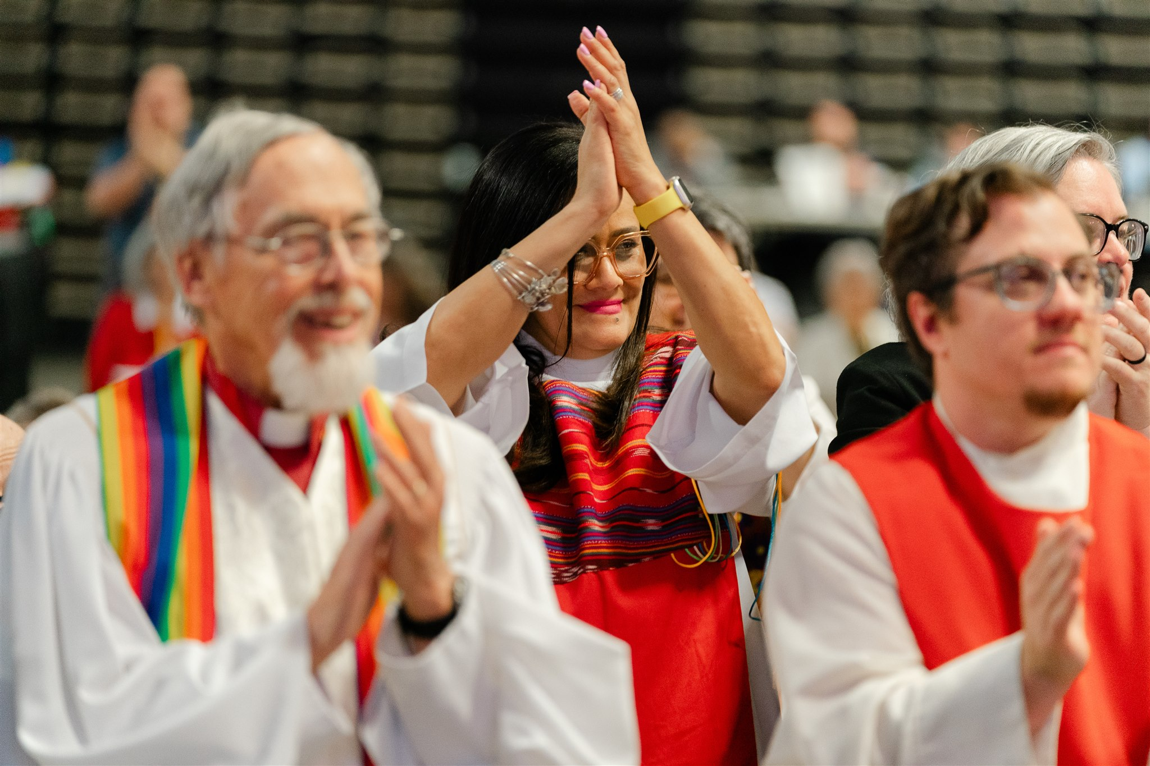
Agenda
Welcome & Opening Prayer: Rev. Shelley Smith, GNJ Conference Secretary
Annual Conference Theme
Navigating Wildwood
Safety Plans
Robert's Rules & How to Engage: Lynn Caterson, Esq. & Rev. Mark Salvacion, Esq.
Q&A
Closing Prayer: Rev. Joong Hyuk Kim, EPA Conference Secretary

Slide 3

GNJ May 17-19; EPA May 19-21
Theme: Prayer
28 Days of Prayer Every Morning M-F 7-7:20 AM

Slide 4
Navigating Wildwood, NJ & The Wildwood Convention Center
Convention Center Address:
4501 Boardwalk, Wildwood, NJ 08260
PARKING: Free; on site; let the attendant know you are with the UMC; Carts in parking lots
RESTAURANTS: Open Table; many available near the convention center
BEACH ACCESS: Free
BOARDWALK: 38 Blocks
VENDORS: Enjoy the 50+ vendor tables

Slide 5
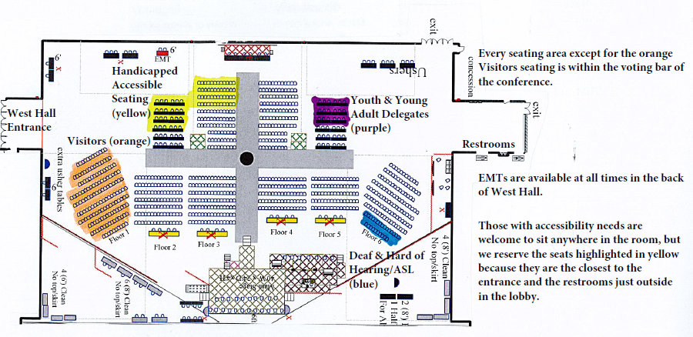
West Hall Reserved Seating
Band
Stage & Screen

Slide 6
Accessibility
ASL Interpreters
Seating Areas & Accessibility
Disability Support from our Boards/Agencies
Dietary Concerns – please note in registration
Other Needs? Please alert us.
Monitoring Report and Why It Matters

Slide 7
Safety Protocols
ESSENTIAL INFORMATION:
All Emergencies dial 911
Cape Regional Medical Center 609.463.2000
BEACH PATROLS/HANDICAP TRANSPORT AND FIRST AID
North Wildwood: 609.522.7500
Transport via surf chairs at First Aid Station at 15th Avenue
PRIVATE SPACES will be available and announced by our conference secretary

Slide 8

Monitoring Annual Conference
Book of Discipline Paragraph 2102: The primary purpose of the General Commission on the Status and Role of Women shall be to challenge The United Methodist Church, including its general agencies, institutions, and connectional structures to a continuing commitment to the full and equal responsibility and participation of women in the total life and mission of the Church, sharing fully in the power and policy-making at all levels of the Church’s life. [...and shall function...] as a monitor to ensure inclusiveness in the programmatic and administrative functioning of The United Methodist Church
2103: Responsibility: (2) The commission, through its various research and monitoring processes, shall continue to gather data, make recommendations, and suggest guidelines for action as appropriate to eradicate discriminatory policies and practices in any form or discriminatory language and images wherever found in documents, pronouncements, publications, and general resources.
What we monitor:
Gender, Age, Race, Ethnicity, Status, and Disability
Provide Feedback: Feedback Cards can be found at the entrance, on tables, and at the COSROW and CORR tables.
Share your feedback and drop it in the box on the table.
Commission on the Status and Role of Women
Commission on Religion and Race

Slide 9
Preparing well for Annual Conference
Rest & Hydration
Know your voice matters
Review Robert's Rules of Order
Snacks for Hotel; Small Snack Station Available in WCC; Sessions may run long
Review Resolutions: PCWB
It's COLD in WWCC – Dress Accordingly
Meals Provided: Dinner Day 1; Lunch Day 2 (For dietary needs, please alert staff)

Slide 10
Who is Robert, anyway?
Understanding Robert's Rules of Order and How to Engage Annual Conference led by:
Lynn Caterson, Esq.
Greater New Jersey Annual Conference Chancellor
Rev. Mark Salvacion, Esq.
Eastern PA Annual Conference Chancellor

