Slide 1

2025 STATISTICAL TRAINING
December 2025

Slide 2

2025 STATISTICAL REPORTS
Key Points:
The 2025 report is the same as last year’s with one difference.
  Suggestion: Before entering any data print your Church Report with prior year comparison.
You will be prompted to change your password at the first login. Please note the conference office does not have access to your new password.
Keep the username and password available for all users.
Reports cannot be changed after they have been vetted and submitted to GCFA.

Slide 3
2025 STATISTICAL REPORTS
Login Information:
Website: http://stats.gcfa.org
Username: Six-digit GCFA Number
Password: gnjchurch25!
Due Date:
January 31, 2026 (2025 Tables Available on December 22nd )

Slide 4
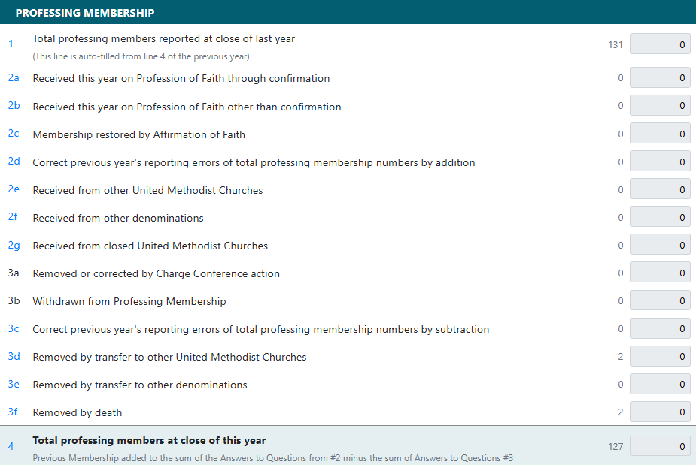
Table 1: Membership & Participation
Line 1 auto populates based on last year’s ending total.

Slide 5
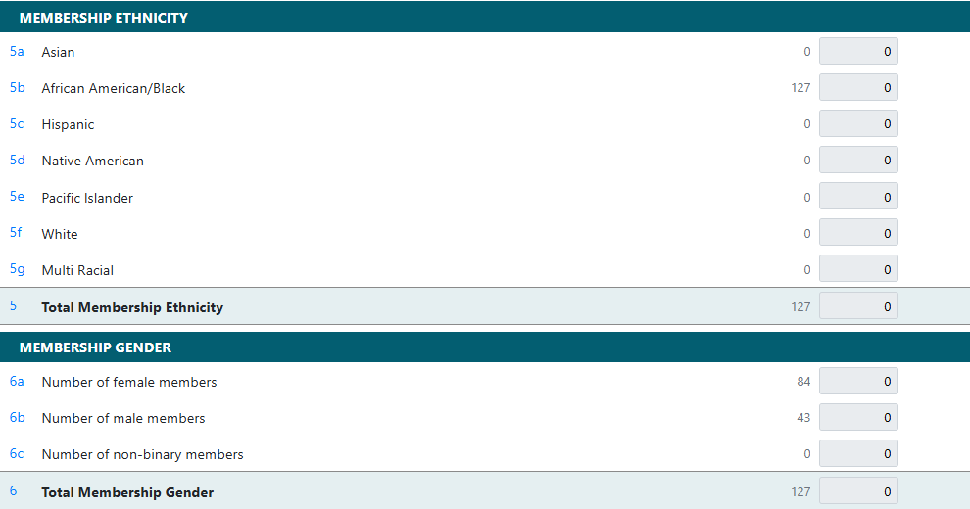
Table 1: Membership & Participation
The Total in Line 5 & 6 must equal total membership in Line 4.

Slide 6
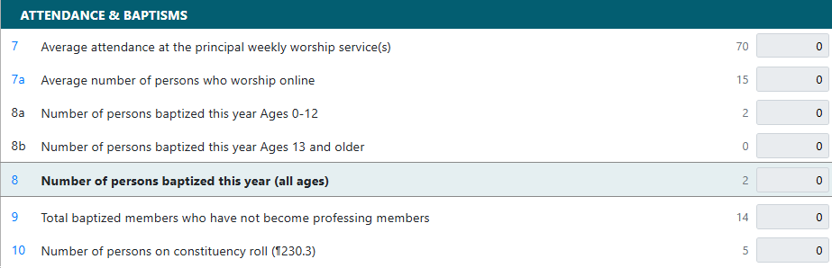
Table 1: Membership & Participation

Slide 7
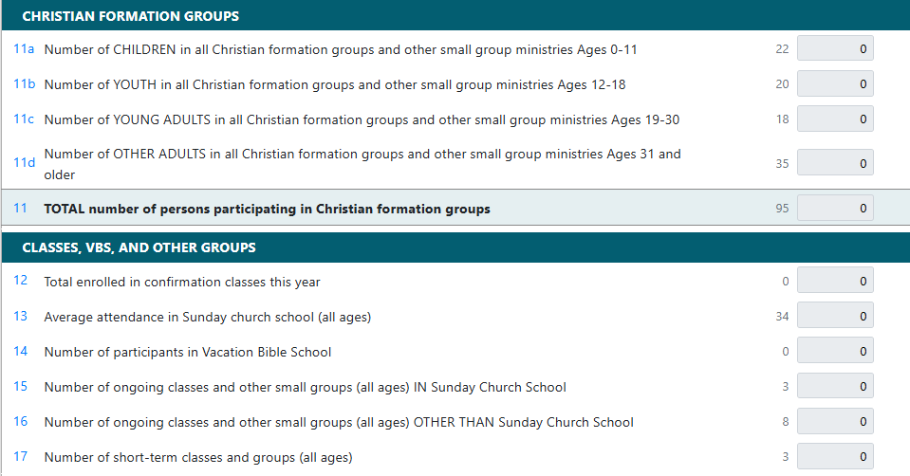
Table 1: Membership & Participation
Count all those who have participated in any church groups.

Slide 8
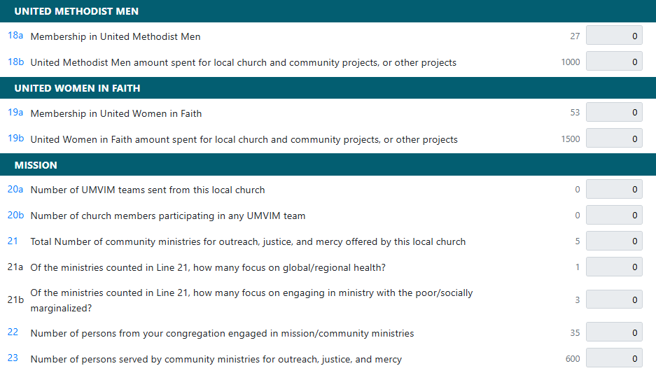
Table 1: Membership & Participation
If your ministry fits in both categories, count it in twice.

Slide 9
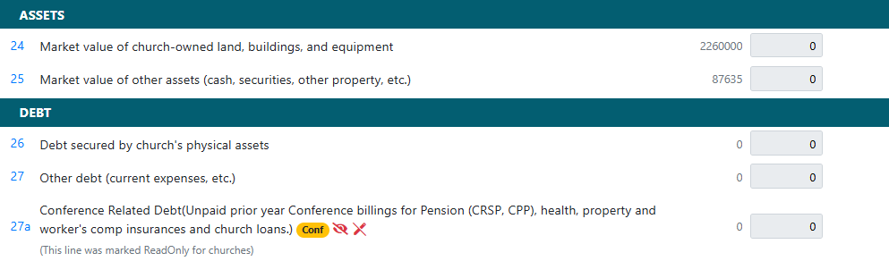
Table 2: Assets & Expenses

Slide 10
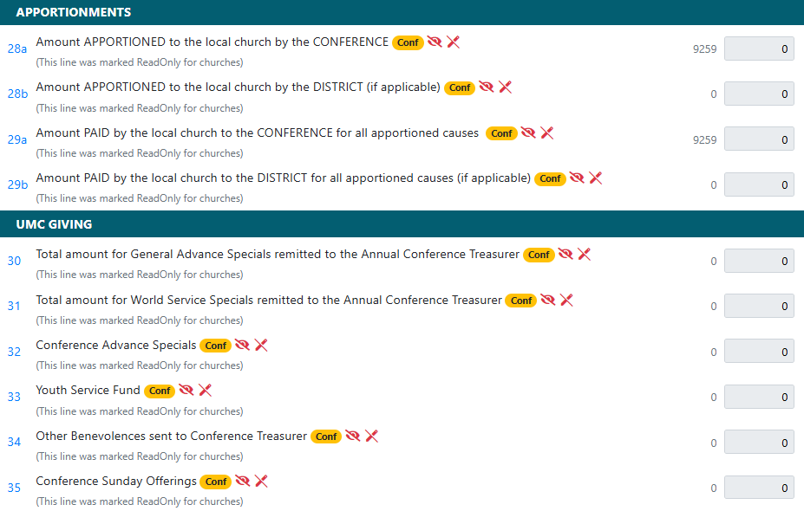
Table 2: Assets & Expenses

Slide 11
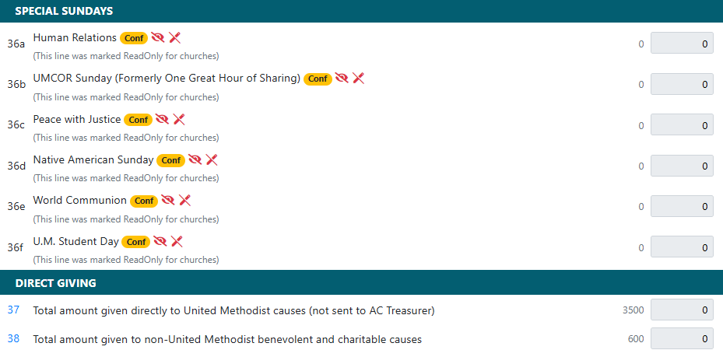
Table 2: Assets & Expenses

Slide 12
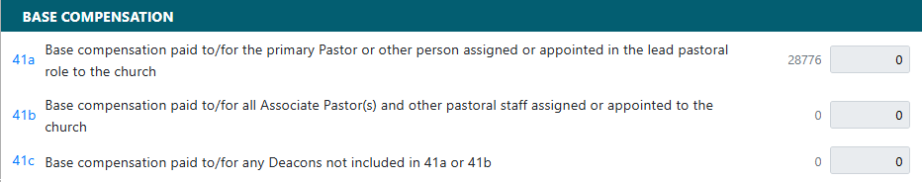
Table 2: Assets & Expenses
NOTE: Senior/Lead pastor compensation includes any clergy status in the lead/primary role. If a church has a supply pastor, their salary including any applicable FICA taxes should be included on that line.

Slide 13
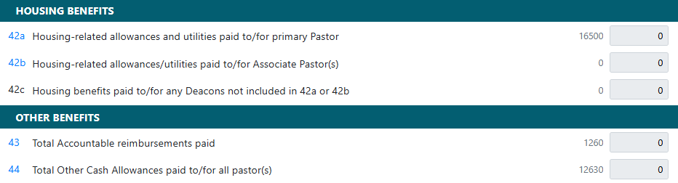
Table 2: Assets & Expenses
Included in Shared Ministry Calculation

Slide 14
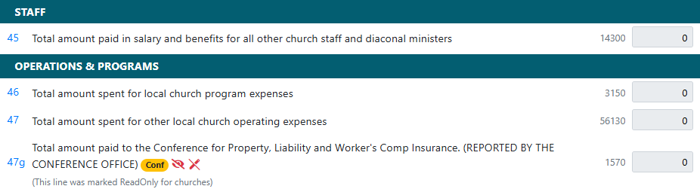
Table 2: Assets & Expenses

Slide 15
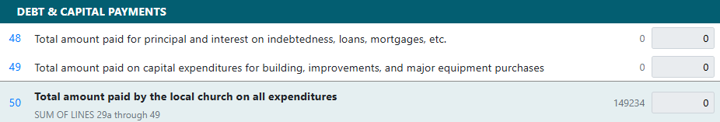
Table 2: Assets & Expenses
Line 49: Should include any building improvements that will extend the life of an asset for more than a year. (i.e. painting a room or remodeling a kitchen) This line can also include major equipment purchases (i.e new water heater).

Slide 16
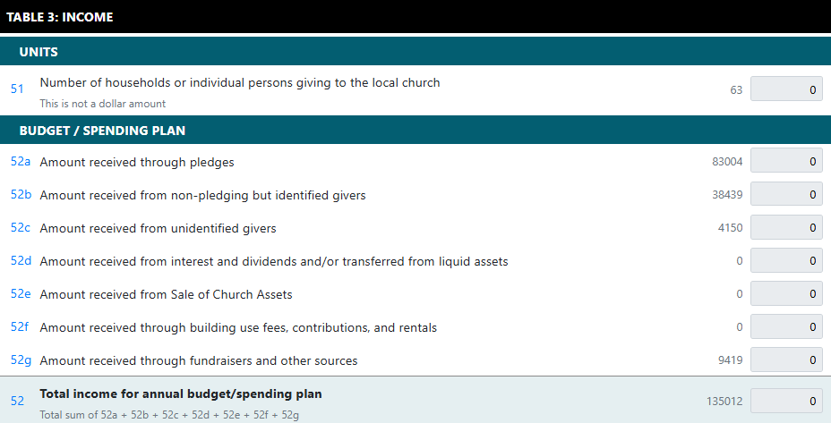
Table 3: Income

Slide 17
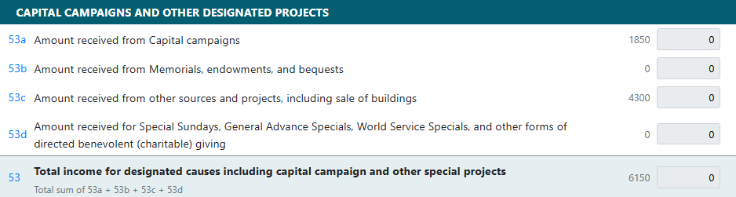
Table 3: Income

Slide 18
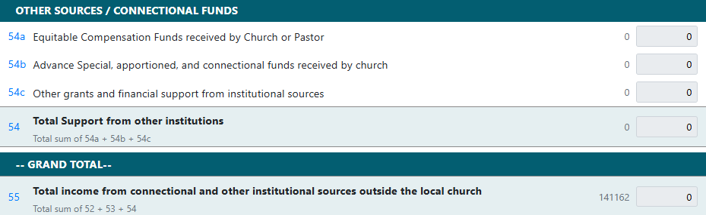
Table 3: Income

Slide 19
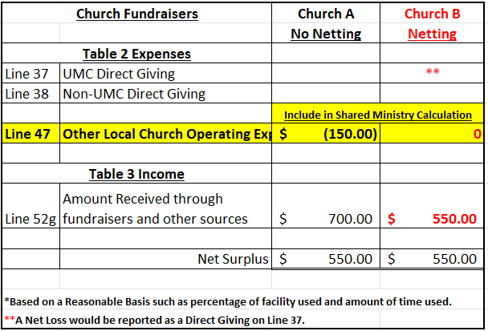
Netting Concept
The Netting Concept allows you to net expenses with related income for situations such as church fundraisers, church run thrift stores and daycares, or building rentals.
Example
Netting allows for more consistent and accurate Shared Ministry Allocation for all churches.

Slide 20
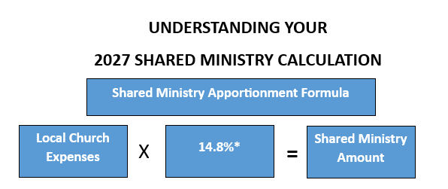








GNJ Shared Ministry Formula
2025 Statistical Reports will be used in the 2027 Shared Ministry Calculation.
*subject to change per CF&A approval

Slide 21
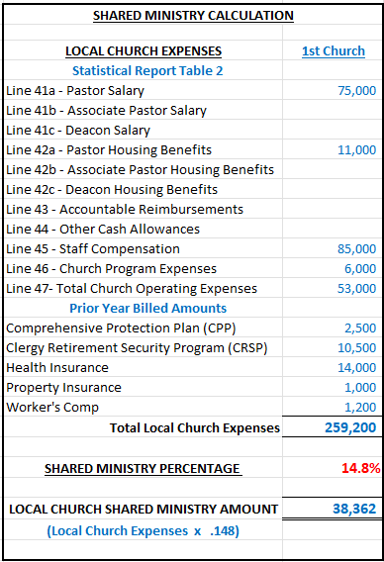
GNJ Shared Ministry Formula
Calculation Example
Increases to any of these expense lines will result in an increase in a Church’s Shared Ministry Allocation.

Slide 22
2024 STATISTICAL REPORTS
If you have any questions, please email:
James Mulligan, Accounting-Database Administrator
jmulligan@epagnj.org
Due Date: January 31, 2026
(2025 Tables Available on December 22)

