Slide 1

Helping You Prepare for Medicare Enrollment We’ll get started at the top of the hour. WELCOME!
September 30, 2025
Greater New Jersey Annual Conference Medicare Retirees
Notes:
Good morning/afternoon/evening.
Welcome everyone to our session on Greater New Jersey Annual Conference’s Medicare program through Via Benefits.

Slide 2
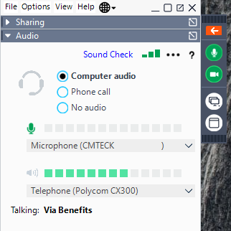
Audio Challenges?
Toggling from Computer audio to No audio and back, typically resets your computer audio
If still unsuccessful, please choose Phone Call to reveal the phone number and dial-in code or refer to your registration Email
Select the White Arrow to expand the control panel if it isn’t already expanded
Notes:
To ensure a smooth experience, please expand the control panel by selecting the white arrow if it isn't already open. If you encounter any audio issues, toggling between computer audio and no audio can often reset the connection. If problems persist, you can opt for a phone call, and the necessary dial-in information will be provided. This slide serves as a guide for our webinar setup. ______

Slide 3



Planned Transition: Beginning 1/1/26, Greater New Jersey Annual Conference is changing the retiree Medicare Advantage plan to a retiree medical program from Via Benefits
Notes:
Via Benefits is really one of the best, if not THE best out there at meeting this need—connecting employers and retirees to the individual market in a way that makes it easiest to transition.
Because they are big, they have a wide range of plans and partners-national/local carriers in each geographic market
They have benefit advisors to initially help through the plan selection process and then ongoing help and advocacy
Allow employers to give funding tax-free
Great outreach and informational communications to support a complicated subject.
Recent stats: over 1,000,000 retirees and 600 Employer Groups served

Slide 4

Why Transition?
Flexibility and savings for individual retirees and spouses
Plans that fit individual needs
Less cost volatility for the conference and local churches in the short term
More sustainable cost in the long term

Slide 5

Why GNJ and Other UMC Conferences Chose Via Benefits
Benefits to Retiree
Benefits to Conference
Choice
Cost Effective
Flexibility
Sustainable
Notes:
Individual plans through Via Benefits has allowed UMC conferences to give choice and flexibility to participants, while controlling costs for long term sustainability. A win-win for conference and participants.
It is also important to remember that Medicare exchanges are much different than active exchanges, in part because so highly regulated by Medicare.

Slide 6
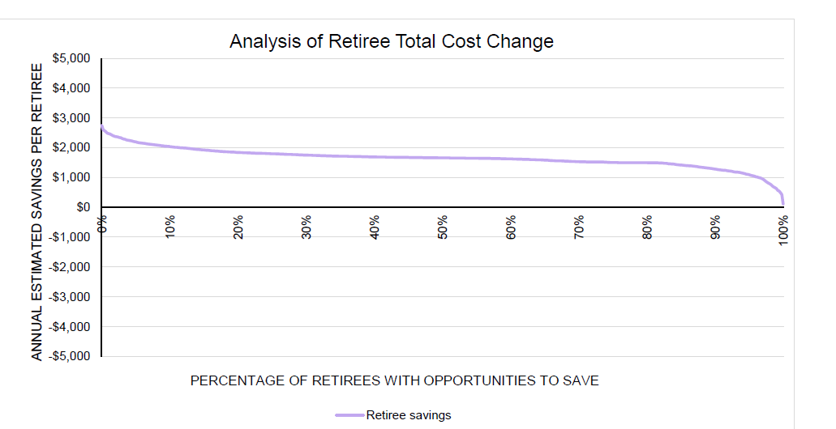
GNJ 2026 HRA Funding Amount: $1500 per individual
100% of retirees can be better off financially if they select the “best choice” plan

Slide 7
Agenda
Introducing Via Benefits
Medicare Education
Get Ready
Selecting Your New Medicare Coverage
The Enrollment Process
Greater New Jersey Annual Conference Funding
Next Steps
Q&A
Audio Challenges?
The phone number and dial-in code can be found in your registration email
Notes:
Here’s our agenda for today. We will start with an introduction to Via Benefits, including more about our partnership with Greater New Jersey Annual Conference, followed by an overview of Medicare, and then we’ll discuss how to get ready for enrollment. We’ll discuss what you can expect during the enrollment process and what happens after you leave the meeting today. As mentioned, we will leave plenty of time for questions. ______

Slide 8

Introducing Via Benefits
Experience That Counts When You Need it Most:
First and largest Medicare marketplace
Now in our 21 Enrollment Season
We’ve helped over 2.4 million retirees
98% of retirees felt they chose a cost-effective plan using Via Benefits
One on One Consultative and Enrollment experience
We are laser-focused on ensuring you have the information, support, and confidence needed for peace of mind when planning for future health coverage.
Notes:
Who is Via Benefits and why has Greater New Jersey Annual Conference chosen to partner with us to support your transition into the Individual Marketplace?
We are the nation's first and largest private Medicare marketplace business. This is our 21st annual enrollment season, so we’ve seen the marketplace evolve.
We've helped over 2 million retirees do exactly what we'd like to do for you, help you to find cost effective prescription drug coverage. Here's a statistic we're really proud of, 98% of the retirees that work with us felt they chose the most cost-effective plan using Via Benefits. We attribute that success to our one-on-one consultative model, where we focus on your individual needs and recommend options that address your healthcare concerns.
WE ARE LASER FOCUSED ON ENSURING YOU HAVE THE INFORMATION, SUPPORT, AND CONFIDENCE NEEDED FOR PEACE OF MIND WHEN PLANNING FOR FUTURE HEALTH COVERAGE
You will have opportunities during the process to share your feedback via surveys, about your experience and our service – please be sure to let us know how we do!
______

Slide 9

Via Benefits
We work for you, not the carriers
All benefits advisors are licensed health insurance agents, based in the U.S.
Benefit Advisors are not incentivized to recommend one plan or carrier over another
Curated plans under one roof
Your benefits advisor will be knowledgeable in Medicare plans
Benefit advisors are trained to help you find the plan that meets your individual needs
Notes:
At Via Benefits, our advisors work for you, not the insurance carriers. All our benefits advisors are licensed health insurance agents based in the U.S. and are not incentivized to recommend one plan or carrier over another. What des that mean? They are salaried, and are not paid commissions. In fact, commission information is not shared with the advisors. We curate plans to meet your individual needs, making the process of finding the right Medicare coverage simpler and more efficient.

Slide 10
How We Help
Consultative Process
Well-versed on the Greater New Jersey Annual Conference’s plan rules
Marketplace experts provide comprehensive coverage and financial guidance
One-on-one consultation
Marketplace Advantages
Largest Medicare marketplace
Curated selection of the top carriers and plans across the country
Individual profiles capture network preferences and prescription drug needs
Ongoing Advocacy
ID Cards and premium payment
Annual enrollment reminders
Carrier support
Understanding legislative changes
Technical assistance
Notes:
This slide how we support you through enrollment and beyond. What sets Via Benefits apart? As mentioned in the previous slide, we take the time to understand your individual needs and what matters to you when selecting a health plan. We leverage our marketplace advantages to provide a premier selection of Medicare plan options, and then use our extensive knowledge and experience to recommend a plan or plans.
You’ll continue to hear from us after enrollment as well. We will send information regularly to inform you about legislative and marketplace changes, as well as reminders every year at annual enrollment. And if you need support we are here to help. Whether you need assistance with ID cards and premiums, or maybe you have moved and need to change plan, know that you will continue to receive support from our team. In the next slide we will share a few real-life examples of where we have helped retirees after their enrollment was completed.

Slide 11
Advocacy
Annual Enrollment “Rose and I were able to switch to new plans without a hitch, despite the fact that I have very bad hearing. I was initially very apprehensive to do it on the phone , but we were able to do it without a problem!”
- Paul H.
Technology
“Joseph was very patient and helped me navigate the website”
- Elizabeth A.
Future Support
‘'Very knowledgeable. They guided me through a complicated insurance maze. Thank you!”
- Cynthia B.
Notes:
As we have been talking about, advocacy is a key component of our service. The quotes shared here represent common examples of area in which we regularly provide advocacy support. We do not expect you to be a Medicare expert – call us and let us help you. Whether that is a plan change, a technology challenge, or just a general question, we encourage you to lean on our experts to provide you with guidance and support into the future.

Slide 12
Medicare Education
Notes:
We are going to provide an overview of Medicare in this next section. We are not expecting anyone in this room to become a Medicare expert – that is what we are here for. But, we did want to talk about what Original Medicare is, and what it isn’t. ______

Slide 13



How Medicare Works
Original Medicare works with both types of supplemental plans
Medicare Advantage with Prescription Drug (Part C) Takes over provisioning of Medicare Parts A and B
Zero or low premiums with higher copays and coinsurance
Preferred rates for in-network providers
Combined medical and prescription drug coverage
Generally excludes coverage outside of the U.S.
+
OR
Medicare Supplement + Prescription Drug (Part D) Works with Medicare Part A and B
Higher premiums, lower copays and coinsurance
See any provider that accepts Medicare
Medigap (medical) works with Parts A & B, and Part D (prescription drug) plan is purchased separately
Most plans include cover emergency services outside the U.S.
Notes:
This slide illustrates how Medicare Advantage plans and Medicare Supplement plans work with Original Medicare and how they are different.
Original Medicare covers about 80% of health care costs. Part A is hospital insurance, and Part B is medical insurance. Medicare Parts A and B cover limited, if any, prescription drug, dental, and vision costs. While Medicare Parts A & B are necessary to cover most of you health expenses, there is still a portion of your health care costs that aren’t covered and can add up.
Also known as Part C, a Medicare Advantage plan combines Medicare Parts A (hospital) and B (doctors visits) with medical and prescription drug coverage which operates as an all-in-one plan. These plans are zero dollar or low premium plans but may have a deductible, coinsurance, or both. Medicare Advantage plans have preferred networks, and as a rule, do not cover foreign travel.
Medicare Supplement plans allow you to see any provider that accepts Medicare. They will have higher premiums and exclude prescription drug coverage, so you will need to purchase a separate Drug plan, also known as Part D. More to come on prescription drug plans, but in the meantime, lets take a look at your different medical plan options. ______

Slide 14
Medicare Advantage with Prescription Drug Plans (Part C)
MAPD
Subsidized by CMS Use MAPD ID Card All-in-one bundled benefits Takes over provisioning of care
HMO Health Maintenance Organization | PPO Preferred Provider Organization
In-network only Must choose primary care physician Referral needed to see a specialist | In or out-of-network coverage You do not need to choose a Primary care Physician No referral needed to see a specialist
Notes:
As mentioned, Medicare Advantage plans are often referred to as Part C, or sometimes MAPD, which stands for Medicare Advantage with Prescription Drug. As mentioned in the previous slide, these plans a typically no-to-low premium, have networks, and combine Medical and prescription drug coverage under one plan. If you enroll into a MAPD plan, you will have one ID card from your carrier that is used instead of your Medicare card. These plans are subsidized by CMS, which takes over the provisioning, or administration of the plan. You do need to continue to pay for your Part B premiums.
There are two main types of Medicare Advantage plans: HMO’s and PPO’s. Some of you may be familiar with these terms already. The main difference between the two plans is how you receive care in the networks. In an HMO plan, you will select an in-network primary care doctor, and must stay in network for the care to be covered, In a PPO plan, there are preferred rates for in-network doctors, meaning lower coinsurance out of your pocket, but you still have the ability to see an out-of-network doctor. Both plans will have low or no premiums, with coinsurance charged as you receive care. ______

Slide 15
Medicare Supplement Insurance (Medigap)
Single-Lettered Plans in 47 States (different in MA / MN / WI)
 | Medicare Supplement Insurance (Medigap) Policies |  |  |  |  |  |  |  |  | Medicare-Eligible Before 2020 ONLY
Benefits | A | B | D | G | K | L | M | N |  | C | F
Medicare Part A coinsurance and hospital costs | 100% | 100% | 100% | 100% | 100% | 100% | 100% | 100% |  | 100% | 100%
Medicare Part B coinsurance or copayment | 100% | 100% | 100% | 100% | 50% | 75% | 100% | 100% |  | 100% | 100%
Blood (first 3 pints) | 100% | 100% | 100% | 100% | 50% | 75% | 100% | 100% |  | 100% | 100%
Part A hospice care coinsurance or copayment | 100% | 100% | 100% | 100% | 50% | 75% | 100% | 100% |  | 100% | 100%
Skilled nursing facility care coinsurance |  |  | 100% | 100% | 50% | 75% | 100% | 100% |  | 100% | 100%
Part A deductible |  | 100% | 100% | 100% | 50% | 75% | 50% | 100% |  | 100% | 100%
Part B deductible |  |  |  |  |  |  |  |  |  | 100% | 100%
Part B excess charges* |  |  |  | 100% |  |  |  |  |  |  | 100%
Foreign travel emergency (up to plan limits) |  |  | 80% | 80% |  |  | 80% | 80% |  | 80% | 80%
Source: CMS |  |  |  |  | Out-of-Pocket Limit in 2025
* No Excess Charges States - CT, MA, MN, NY, OH, PA, RI, VT. |  |  |  |  | $7,220 | $3,610
Notes:
Next we will talk about Medicare Supplement plans. As a reminder, these plans allow you to see any provider that accepts Medicare and can support emergency foreign travel care, but will have a higher monthly premium and requires enrollment into a separate Part D, or Prescription Drug Plan. They help pay your share of out of pocket costs incurred under original Medicare. This chart represents how different Medicare Supplement plans cover those costs differently. As an example, comparing Plan A and Plan G, you can see foreign travel emergency is excluded under Plan A and covered at 80% under Plan G.
Another important characteristic of Medicare Supplement plans is Guarantee Issue. Because you are coming out of a group plan, Medicare provides what is called Guaranteed Issue. This means you can enroll in any Medigap policy and the insurance company cannot deny you coverage due to pre-existing health issues. After this enrollment period, you may be subject to underwriting and can be denied coverage or charged more.
All Medicare plans are standardized, meaning plans with the same letter offer the same core benefits no matter where you live or which insurance company you enroll with (NOTE TO PRESENTER: Edit accordingly if presenting in MA, MN, WI). Price is the only difference between plans with the same letter that are sold by different carriers. If you have decided a Plan G is what best fits your needs, you’ll want to pick the lowest premium plan. Our website and BA’s make it easy to compare plans and determine which plan is the most cost-effective for you.

Slide 16

Comparing Medigap Plans
Dealership #1 - $30,000
Dealership #2 - $31,500
Dealership #3 - $28,750
Important: Medicare Supplement plans are Standardized, Policies with the same letter offer the same benefits regardless of location or insurance company
Notes:
Another way to look at Medicare Supplement premiums is to compare them to new vehicle pricing. When looking to buy a new car, we decide which options we want – four wheel drive, sunroof, leather, etc. Once we determine what options are important, we look for the lowest price. This is similar to a Medicare Supplement plan. Once we determine which lettered plan best fits our needs, the deciding factor is premium. All else being the same, we should pick the car with the lowest cost, or in Medicare terms, the plan with the lowest premium. In our new car example, lets assume all three dealerships have a vehicle in inventory with the same options and all meet our requirements. We are going to purchase from the seller with the lowest price. Keep this example in mind as you are reviewing your options should you decide a Medigap plan is right for you.

Slide 17
Medicare Prescription Drug Coverage 2025
Phases
Deductible
Initial Coverage
Catastrophic Coverage
Participant Pays
Full retail until
deductible is met
Copays for your plan coverage (25%)
$0
Total Cost
$0 – $590
Maximum $2000 out-of-pocket for the year
Part D plans and drug manufacturers pay a larger share than Medicare
Notes:
This slide provides an overview of participant costs and total expenses related to Medicare prescription drug coverage. Understanding copays, deductibles, and out-of-pocket maximums is crucial for budgeting your healthcare expenses. As a reminder, Medicare Advantage (MAPD) will include drug coverage, but you will need to purchase a separate drug plan if you enroll in a Medicare Supplement plan
A deductible is what you pay out of pocket before your plan starts to play
Co-pays are your portion of the cost of the drug
Ou-of pocket maximums are the most you are going to pay under the plan in any given plan year.
Generally, Medicare drug plans and Medicare Advantage Plans with drug coverage have 3 stages:
Deductible stage: If your Medicare plan has a deductible, you pay all out-of-pocket costs until you reach the full deductible. No Medicare drug plan may have a deductible more than $590 in 2025. Some Medicare drug plans don’t have a deductible.
Initial coverage stage: After you reach your full deductible (if your plan has a deductible), you’ll pay 25% of the cost as coinsurance for your generic and brand-name drugs until your out-of-pocket spending on covered Part D drugs reaches $2,000 in 2025
Catastrophic coverage stage: You won’t have to pay out-of-pocket for covered Part D drugs for the rest of the calendar year.
Important – the max out-of-pocket in 2025 is $2000, meaning even if your prescription has a retail cost of $500/month, you won’t pay more than $2000. Once you hit $2000, the plans and manufacturers pay a larger share and your responsibility goes to zero dollars.
When you have Medicare drug coverage, you’ll get an Explanation of Benefits (EOB) the month after the pharmacy bills your plan. Your EOB shows the prescriptions you filled, what your plan paid, what you and others have paid, your coverage stage, and what counts toward your out-of-pocket costs and your total drug costs.
Finally, be aware there is a penalty for not enrolling into a Part D plan when first eligible. The penalty is 1% for every full month you were eligible but did not enroll. So it is important you enroll in either a stand-alone Part D plan or a Medicare Advantage plan that includes drug coverage
______

Slide 18

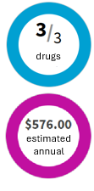
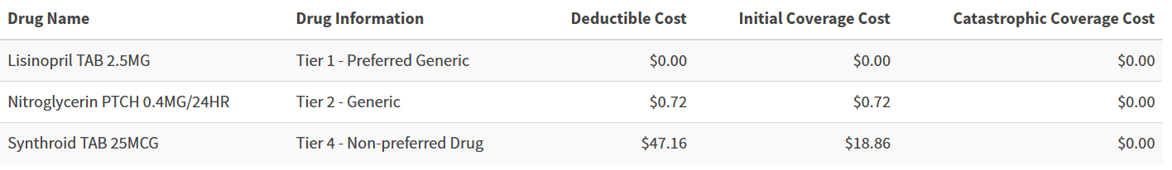
Prescription Drugs — 5 Tiers of Copays
Name | Drug Information | Cost
 | Tier 1 – Preferred Generic
 | Tier 2 – Non-preferred Generic
 | Tier 3 – Preferred Brand
 | Tier 4 – Non-preferred Brand
 | Tier 5 - Specialty
Notes:
Here, we break down the tiers of copays for prescription drugs. Each tier represents different costs associated with various types of medications, from preferred generics to specialty drugs. This structure helps you anticipate your potential expenses.
By sharing the medications you take you can understand which tier each are in, and the copayments in each of the Part D coverage phases. In this example, our participant is taking Lisinopril, Nitroglycerin, and Synthroid. The plan covers three out of three drugs with an estimated annual cost of $576. Lisinopril is considered a Tier one, or preferred generic, and has a $0 copayment, regardless of which phase of the plan you are in. Synthroid is tier 4, or non-preferred brand name drug. It has a cost of $47.16 in the deductible phase, but once the deductible is met the participant responsibility goes to $18.86.
This slide comes straight from our website and the information can be used to help you budget and understand how each drug will be covered. Don’t worry if you are not comfortable navigating the web. Our Benefit Advisors have the same tools and can go through the same exercise via phone if that is how you’d prefer to communicate. You can be confident knowing that our propriety tools allow you to compare multiple plans from carriers you know.

Slide 19
National and Regional Carrier’s
Blue Cross Blue Shield
AARP
Aetna – SilverScript
Wellcare
United Healthcare
Humana
Wellpoint
Cigna – Express Scripts
Notes:
Speaking of carriers, this slide reflects national and regional carriers that offer Medicare plans on the Via Benefits Exchange. Familiarizing yourself with these options can help you understand the variety of plans available and how they may fit your healthcare needs. We have long-standing relationships with our carriers, and are proud of the meaningful selection of plans offered through Via Benefits.

Slide 20
Get Ready
Notes:
As we move forward, it's time to get ready for the enrollment process. Preparation is key to ensuring a smooth transition into your new Medicare coverage.

Slide 21


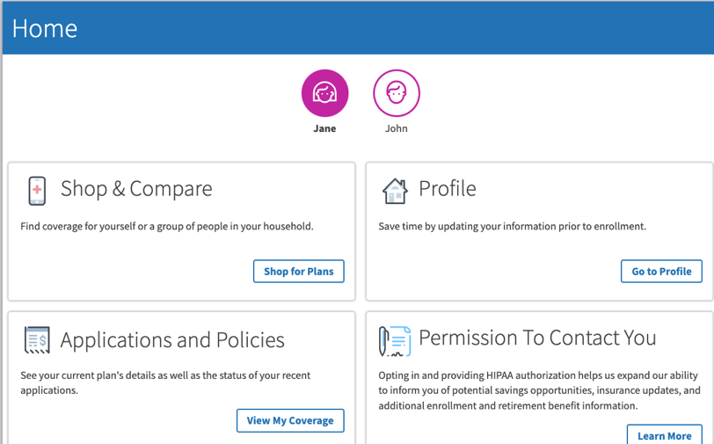

Introducing Via Benefits Guide
Medicare education
Create an account
Schedule an appointment
For step-by-step instructions, watch our video
“Create a Via Benefits Profile” in the video library at
https://my.viabenefits.com/wespath
Notes:
You likely have already received the Introducing Via Benefits Guide, which provides some of the same Medicare information we are covering today, along with information about next steps. You may remember seeing a checklist that starts with instructions on creating a profile. We encourage you to do this so we have your most up-to-date contact information, full legal name, as well as the prescription drugs that need to be covered and any network or provider preferences. This information is saved and can be used when evaluating plans this year and in the future, and can be seen by the benefit advisor when they are assisting with your plan selection. It is very straight-forward, however there is a video online with step-by-step instructions should you need help. Our representatives are also here to assist.
We know that data privacy is a concern, and protecting your information is a priority for us. We do not share any information with Greater New Jersey Annual Conference or use it for other purposes.
You are also able to schedule an appointment if you would like to shop for plans by phone. Note that an appointment is not necessary, and you can call in and speak with a Benefit Advisor without an appointment, but you may have a longer wait.

Slide 22



Call Via Benefits
Evaluate medical plan types
Verify your profile by providing first & last name and two of the following:
Phone number
Last 4 of SSN
Date of Birth
Zip Code
Provide a plan recommendation
Enroll by Phone or Online
Notes:
When you call Via Benefits, please provide the request authentication information, this will ensure your call is answered as quickly as possible. This is done when we know who you are.
To verify your profile, you will need to provide your first and last name along with specific information. This process ensures that we can tailor our recommendations to your coverage needs.
Once your profile is verified, the benefit advisor will discuss your needs to determine the best coverage recommendation. They will ask questions like how many times a year you go to the doctor, chronic conditions, travel habits (maybe you have multiple homes or like to RV). Do you prefer low premiums and pay-as-you-go copayments? Or maybe you prefer a higher premium for ease of budgeting?
Once your preferences are determined, a plan recommendation can be provided. You can enroll immediately or take some time to review your options. But once you are ready to enroll, you can complete your enrollment online or on the phone. We’ll talk about enrollment options in the next few minutes.

Slide 23
Selecting Your New Medicare Coverage

Slide 24

What Retiree’s Share
“Deborah was the most knowledgeable and helpful agent that I can imagine. She took the time that we needed to understand our options, answered all questions thoroughly, made us aware of important issues that we didn't even know to ask about, and gave explanations that were thorough and understandable.”
- Carol L.
Notes:
We have covered a lot of information already. Before we talk about the enrollment process, I wanted to share another quote from one of our retirees who recently went through the shopping and enrollment process. *Read quote* ______

Slide 25
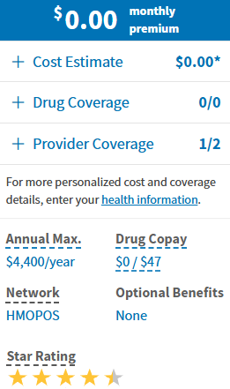
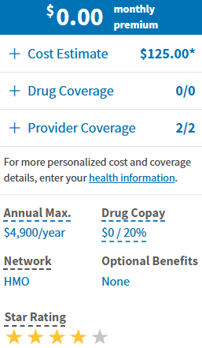
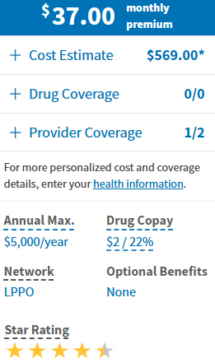
Premier Selection of Medicare Plans
Via Benefits is the largest, oldest Medicare marketplace.
HMO
HMO
PPO
$0.00/month
$0.00/month
$37.00/month
Notes:
Via Benefits combines Medicare expertise, and powerful proprietary digital tools to help you choose, enroll, and maintain coverage that fits your medical and financial needs. This slide is exactly what you may see if you are comparing plans online. The tool allows you to compare up to three plans at a time, in this example we are comparing two HMO plans and one PPO plan. You’ll notice the PPO plan has a $37 monthly premium and an annual estimated cost of $569. Remember that a PPO plan has preferred providers, but does allow you to receive care outside of your network. If flexibility is most important, this may be the right plan for this participant. If cost is more important, the Medicare Premier HMO may be the right choice. However, if keeping your current doctors is non-negotiable, the Medicare CORE HMO would be the right choice since it is the only plan that covers all providers in network.

Slide 26
The Enrollment Process
Notes:
Next we will guide you through the steps necessary to enroll in your chosen plan, ensuring you understand each part of the process. ______

Slide 27


Ready to Enroll –Your Choice
Enroll Online
Enroll anytime within your enrollment period
Compare plans side-by-side, select a plan, and enroll using the website
Identity is verified when you sign into Via Benefits
You read the disclaimers and confirm on the site
Shop and Enroll with help from a friend or family member at my.viabenefits.com/Greater New Jersey Annual Conference
Enroll By Phone
Call at your appointment time during the enrollment window
A member of the team will help you review and enroll in a plan
Identity is voice-verified
Disclaimers are read to you
With your permission, a friend or family member may join the call
Notes:
Enroll Online – Save Time!
The reason you save so much time enrolling online is because of the CMS disclaimers that must be read to you over the phone. If you enroll online, you can quickly move through those disclaimers on your own. Going online you can enroll anytime 24/7. Compare plans side-by-side using the same tools are benefit advisors use to select a plan and complete your application.
If you prefer to enroll by phone, you call Via Benefits at your appointment time (remember you call us, we will not call you). If you have not scheduled an appt, that is perfectly fine. You can call us anytime during your applicable enrollment period and a member of our care team will help you review and get enrolled in a plan
Either method is fine. You can change your mind as many times as you want during your enrollment period. Your decision on file at the end of your enrollment period will be your final enrollment for 2025.

Slide 28



Ready to Enroll –Your Choice
Notes:
There is another option as well – we call it a hybrid approach. Many of our participants end up utilizing both the online and telephonic methods for enrollment. You may find that you want to shop online, put a plan in your cart, and then test your selection with a Benefit Advisor. Alternately, you may talk to a Benefit Advisor, select a plan, and then complete the application online at your convenience.
Remember that the choice is yours. We are here to support you in making the best decision for your healthcare. ______

Slide 29

Granting Caregivers Permission
Trusted Friend
“Your rep was excellent. She helped to set up my account so I could speak on my husband's behalf’
-Maria M
Family Member
Authorization to Release Personal Information (ARPI)
Allows a representative to get information and take limited action on your behalf
Power of Attorney (POA)
Allows a representative to take action on your behalf and make decisions
Notes:
We do recommend establishing permission for a family member or trusted friend to help you just in case there's an emergency.
The most basic form of permission is something called an authorization to release personal information (Limited), and this allows a representative to just get information and take limited action on your behalf.
The more formal, comprehensive authorization is the power of attorney, or POA. A POA is able to get and provide information on your behalf, but also make decisions for you. You may be using a POA to make medical decisions as part of your enrollment. If you'd like to set up one of these caregiver permissions, please call into the Via Benefits service center. This is not something you can do online but we are happy to assist over the phone. Also, note that this can be done at any time should your needs or circumstances change.
______

Slide 30



Post Enrollment Communications
Selection Confirmation Letter
Confirms your plan choices
Welcome to
Communications from Your New Insurance plan(s)
Packet that contain your new insurance cards, and information about your new benefits
Welcome to Via Benefits
Welcomes you to Via Benefits and highlights our advocacy services and available resources
Watch our videos
my.viabenefits.com/Wespath
Notes:
After you complete an enrollment through Via Benefits, we will send you a selection confirmation letter in the mail. So, you'll be able to see your selection in writing.
Additionally, the insurance carrier that you have selected is required by Medicare to also mail you a whole welcome packet that will include your new id cards, a detailed explanation of benefits, and information about your new plan.
Most pharmacies retain coverage information in their system, so remember to give your new id card to your pharmacy as of January 1, 2026. If they pharmacy tries to process a claim through the group plan it will be denied.
Note that there is also an educational video online regarding post-enrollment communications if you’d like more information or want to revisit the topic in the future.

Slide 31
Greater New Jersey Annual Conference Health Reimbursement Arrangement (HRA)
Notes:
This slide introduces the concept of client funding through Health Reimbursement Arrangements (HRAs), which can help manage healthcare costs. ______

Slide 32

Greater New Jersey Annual Conference Health Reimbursement Arrangement (HRA)
Tax-Free Account
Used to reimburse you for eligible post-tax health care costs
If You Are Eligible
Greater New Jersey Annual Conference will make an annual contribution to your HRA
Get Reimbursed
For eligible premiums and OOP expenses
Unused Funds WILL Rollover
It is not a use it or lose it account
Notes:
HRAs are tax-free accounts designed to reimburse eligible healthcare expenses. Understanding how these accounts work can significantly benefit your financial planning.
If you are eligible, Greater New Jersey Annual Conference will contribute funds Annually to your HRA, and those funds Will roll over to the following year(s).
Review eligible expenses. All 213d
Your enrollment qualifies you for the HRA. Once that is completed, you will receive a Via Benefits Guide to reimbursement, which provides instructions on reimbursement, how to set up direct deposit, set up the mobile app, among other information. So keep an eye out for this AFTER you qualify for the HRA.

Slide 33





How Reimbursement Works
Step
1
Step
2
Step
3
Step
4
Step
5
You Enroll into a qualified plan with Via Benefits
New Jersey Conference makes an annual contribution to your account
You pay for your eligible premiums & expenses first
You request reimbursement
Via Benefits approves your request and reimburses you
Notes:
Understanding the reimbursement process is crucial for clients utilizing Via Benefits. This slide breaks down the procedure into five clear steps, starting with enrolling in a qualified plan, which is required for eligibility. You can see the ‘Blue Steps’ are actions taken by you, and the ‘purple steps’ are Via Benefits action steps. Next, the allocation provided by Greater New Jersey Annual Conference is posted to your account. You will pay your premiums and any other expenses first, and then submit for reimbursement. We will talk about the different methods to request reimbursement in the next slides. The request is reviewed and processed very quickly, typically within a few days. If for some reason the request is denied you will receive a denial reason. Some common reasons for denials could be the date of service was prior to you becoming eligible, or the request was for an ineligible expense. Note that
blue steps are retiree-initiated, purple steps are Via Benefits activities

Slide 34




Automatic Reimbursement
Requires Enrollment through Via Benefits
You set up automatic reimbursement
Insurance Carrier sends notification of payment
You pay for your premiums
Via Benefits reimburses you
95% of carriers support Auto-reimbursement.
Notes:
Via Benefits offers an Automatic Premium Reimbursement feature for most Medicare insurance plans when enrolled through Via Benefits. With this feature, you first pay your premium directly to the insurance carrier, which will then notify Via Benefits that your payment has been received. Your premium reimbursement will be automatically deposited into your bank account if you’ve set up direct deposit. Your Benefit Advisor can turn this feature on for you.
Automatic reimbursement is a convenient feature supported by most carriers. Enrollment through Via Benefits is required to take advantage of this option.

Slide 35



Recurring Reimbursement
1
2
3
You pay your premiums
Complete once
per year
Required Documentation:
Premium Coverage Period
Premium Type
Carrier
Individual Serviced
Monthly Amount
Via Benefits reimburses you
Notes:
If Auto-reimbursement is not available, you may choose to use our recurring reimbursement process.
When you request Recurring Premium Reimbursement, you must provide supporting documents, such as a premium bill or statement. You can do this on the mobile app or our website, and works the same way, except we receive the premium payment information from you, not the insurance carrier.
Recurring Premium Reimbursement must be requested each plan year and whenever your premium amount changes.
Note: If you already have Auto-reimbursement turned on (the process discussed on the previous slide), there is no need for recurring reimbursement.

Slide 36
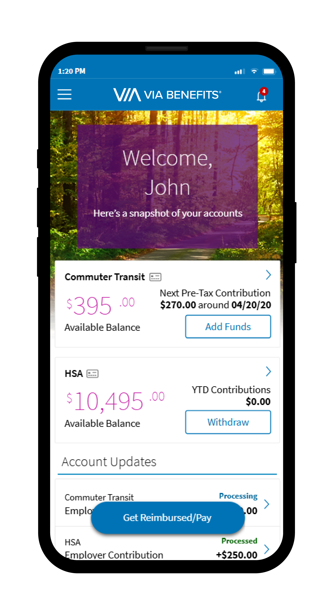



Via Benefits Mobile App
Download and install
Same username / password as your online account
Take a snapshot of your proof of payment – Easy!
Set up push notifications to keep informed on the go
Note: ONLY available once your account is active
Notes:
Once you have activated your account, you will also have access to the mobile app. Our app is similar to what you may already use for banking. You can see account balances, transactions, submit reimbursement requests, and even upload supporting documentation. You can also enable notifications to tell you when a claim has been processed o approved. We encourage you to check it out. Our retirees report a high level of satisfaction with this tool. You can go to the app store on your phone to download the app, and instructions will be included in the funding kit you receive <after enrollment>.

Slide 37
Next Steps
Notes:
As we look ahead, let's discuss the next steps you should take to prepare for your Medicare enrollment. ______

Slide 38

Ready? Let’s Go!
Pre-Enrollment
Create a Via Benefits Profile
Gather your information
Medicare Card
Prescriptions
Physicians and Facilities
Call Via Benefits
Enrollment
Call us at your scheduled appointment time
Enroll using the Via Benefits website any time during your enrollment period or by phone
Post-Enrollment
Watch for communications about your new coverage
Reminder:
Enrollment Deadline is 12/07/2025 or 12/31/2025
1-866-249-7785
www.my.viabenefits.com/Wespath
Notes:
If you haven’t already….
Create Your Online Account: Visit the Via Benefits website at my.viabenefits.com/Wespath to create your account and set up your profile.
Schedule an Enrollment Appointment: Call Via Benefits at 1-866-249-7785 to schedule an appointment and to get assistance with completing your profile.
Review Educational Materials: Review the Introducing Via Benefits Guide and related information that you may have received already or will receive shortly.
In addition to this virtual educational session, <Add any opportunities for live or recorded webinars>
Enroll between 10/15/2025 and 12/07/2025 or 12/31/2025 for anyone losing coverage, by calling Via Benefits or going online to complete your enrollment. Typically, our call center is the least busy on Fridays – try calling then for a shorter wait time to reach an advisor!
You may enroll using the Via Benefits website any time 24/7
Once you enroll in an Individual Medicare Drug Plan your Health Reimbursement Arrangement (HRA) will be activated, if eligible.
Finally, rely on Via Benefits help you through the process and enjoy your new benefits. Note your enrollment deadline as well. You must enroll by 12/31/2025 in order to avoid a lapse in coverage.

Slide 39

Helpful Resources
Notes:
As we have mentioned, there is also a suite of helpful information including videos, online if you would like to learn more or need a refresher in the future. We will be displaying the Via Benefits Greater New Jersey Annual Conferencecontact information on the next slide and will be leaving it up during the Q&A.

Slide 40
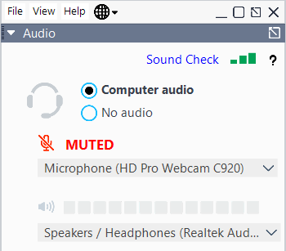

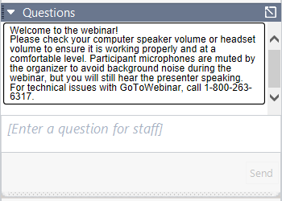

GoToWebinar Questions Panel
Minimize/Expand Control Panel
All computer microphones will be muted to avoid background noise You will have the option to type questions
Note:
For privacy, all individual situation questions should be called in to the Via Benefit Service Center We do not have access to any individual profiles in this session
Type general question, press “Send”
Notes:
During our webinar, all microphones will be muted to minimize background noise. You will have the opportunity to type questions, and we encourage you to use the GoToWebinar Questions Panel for any inquiries. ______

Slide 41

Start Today!
We’re here to help you!
Gather your information and go online now to set up your profile and complete your pre-enrollment assessment!
my.viabenefits.com/Wespath
1-866-249-7785 (TTY:711)
Monday – Friday 8:00 a.m. – 7:00 p.m. ET
Notes:
We will be starting our Q&A now. (Note: Recommend support resource reads questions submitted by the audience via notecards.)
My colleague <Support>, has collected the question cards and will be reading them. We likely received duplicate questions that may have been worded differently so we want you to be aware that your specific question may not be read verbatim if others submitted the same question. Lets get started.

