Slide 1

2024 STATISTICAL TRAINING
January 2025

Slide 2

2024 STATISTICAL REPORTS
2024 Highlights – New Features
Forgot Password Feature
  If a password has been forgotten, please click on “Forgot Password”, and an email will be sent to the email address entered at first login to reset password.
  Note, the same email address can be used for multiple usernames. ( for those instances of pastors with multiple churches)
Printing a PDF version of the tables
  Clicking on the Print button allows the church to print a PDF versions of the report
Update Pastor Information (if necessary)
  Under Church Details, church’s have the option to update Pastor Information when necessary.

Slide 3
2024 STATISTICAL REPORTS
Login Information:
New Website: http://stats.gcfa.org
Username: Six-digit GCFA Number
Password: gnjchurch24!
(Passwords must be at least 8 characters (with a least 1 letter, 1 number, and 1 special character)
Due Date:
January 31, 2025

Slide 4
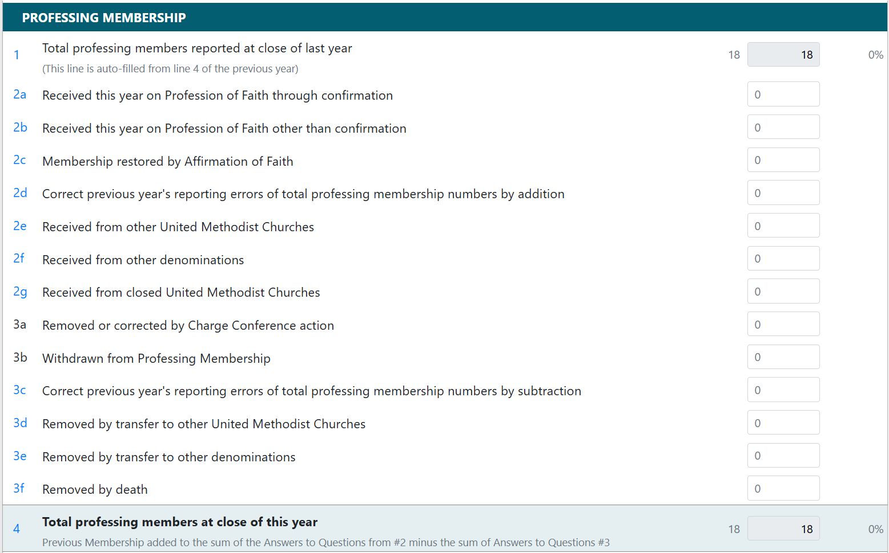
Table 1: Membership & Participation

Slide 5
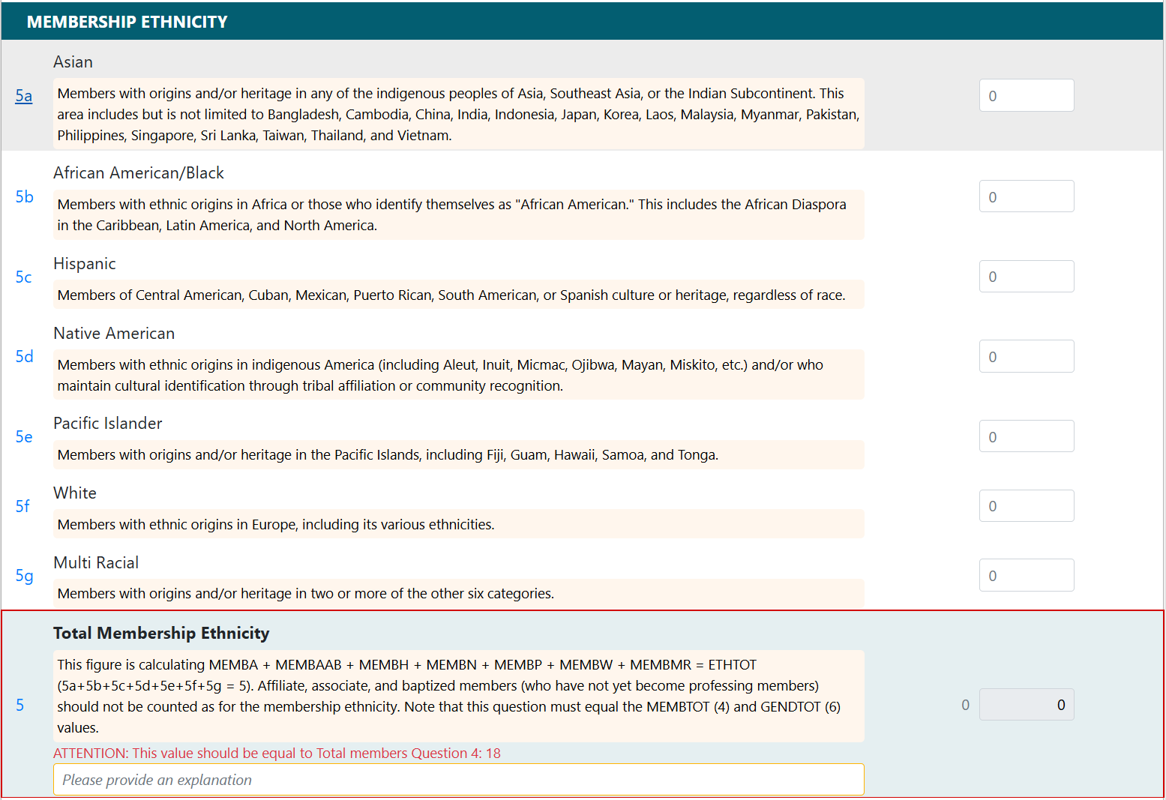
Table 1: Membership & Participation

Slide 6
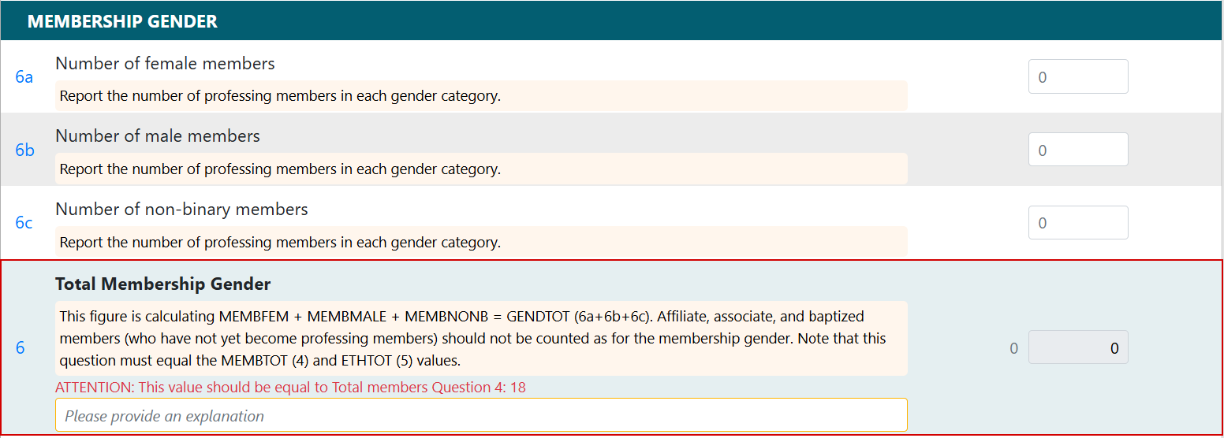
Table 1: Membership & Participation

Slide 7
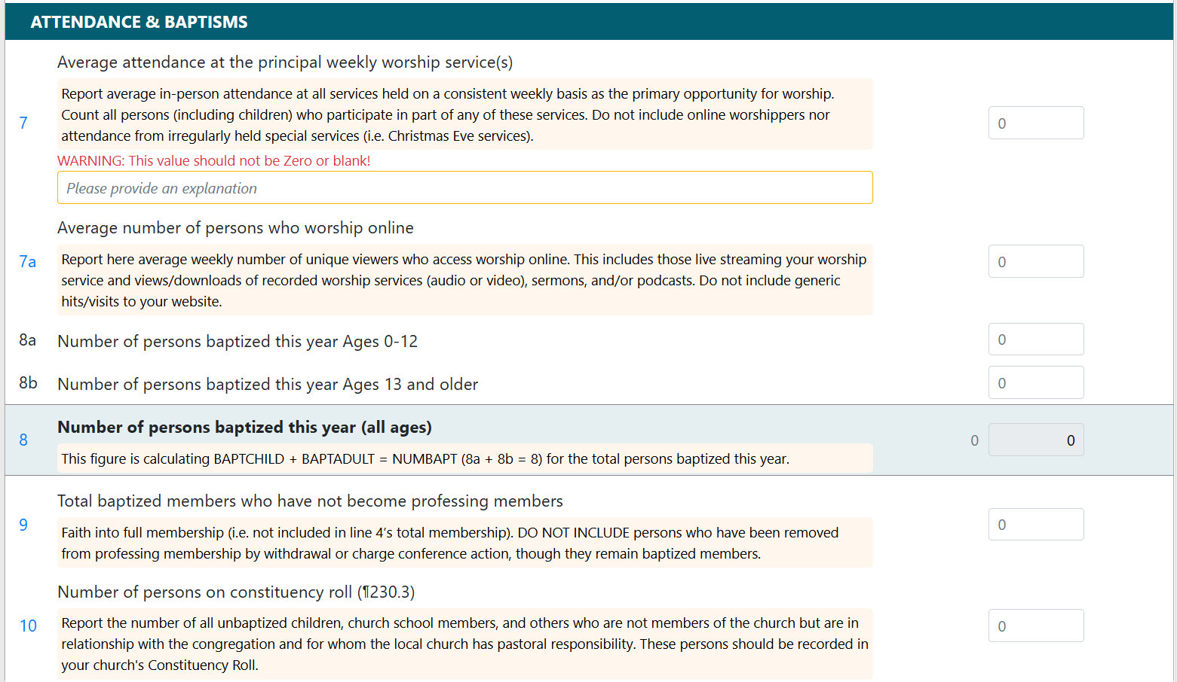
Table 1: Membership & Participation

Slide 8
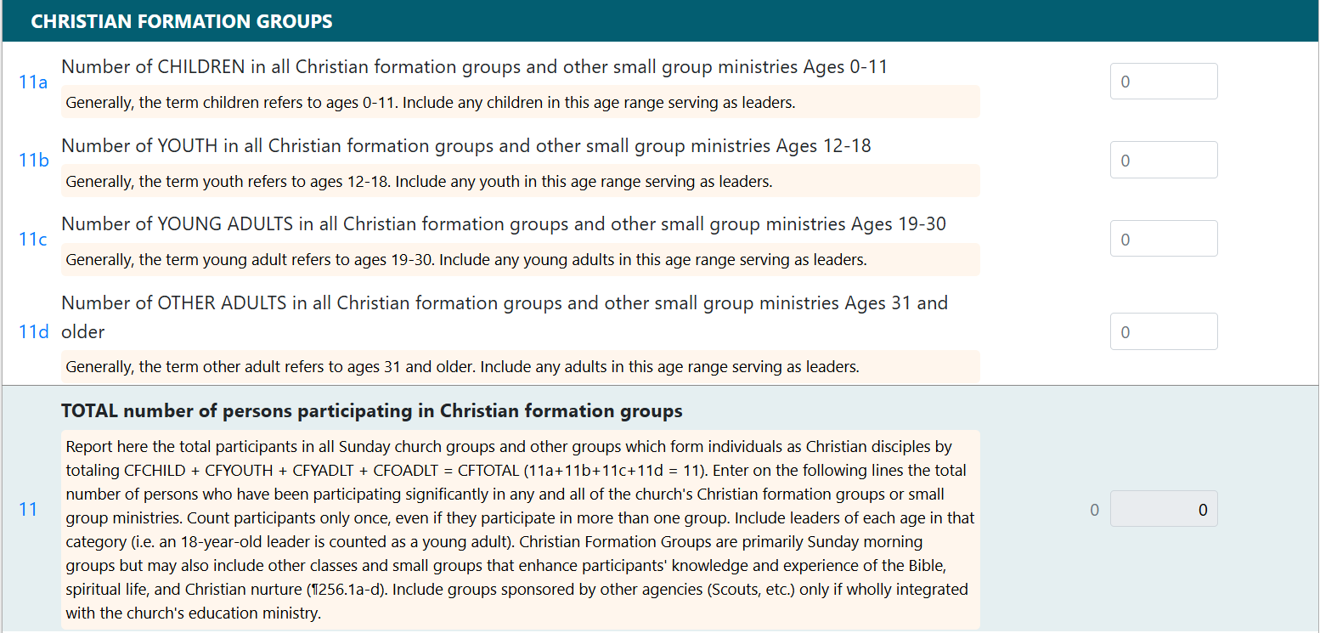
Table 1: Membership & Participation

Slide 9
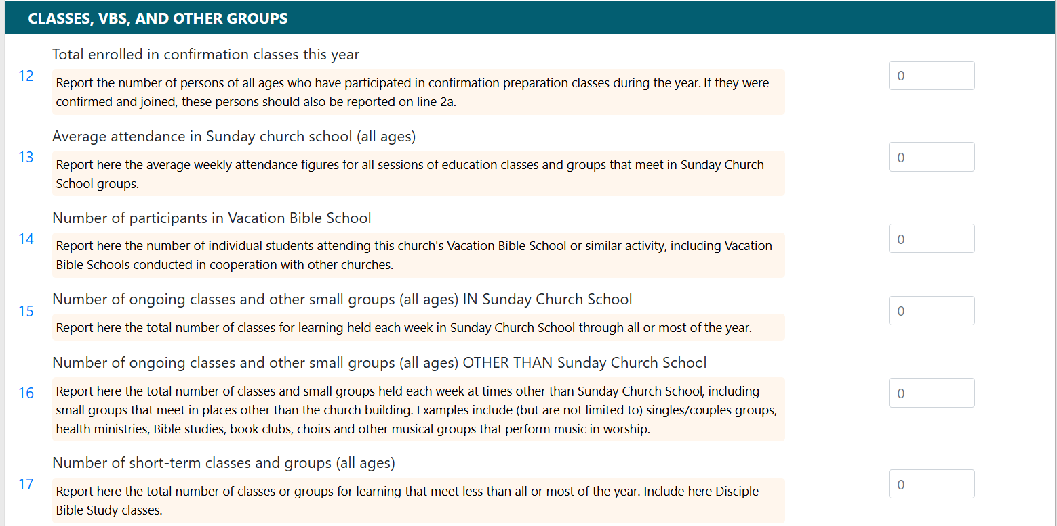
Table 1: Membership & Participation

Slide 10
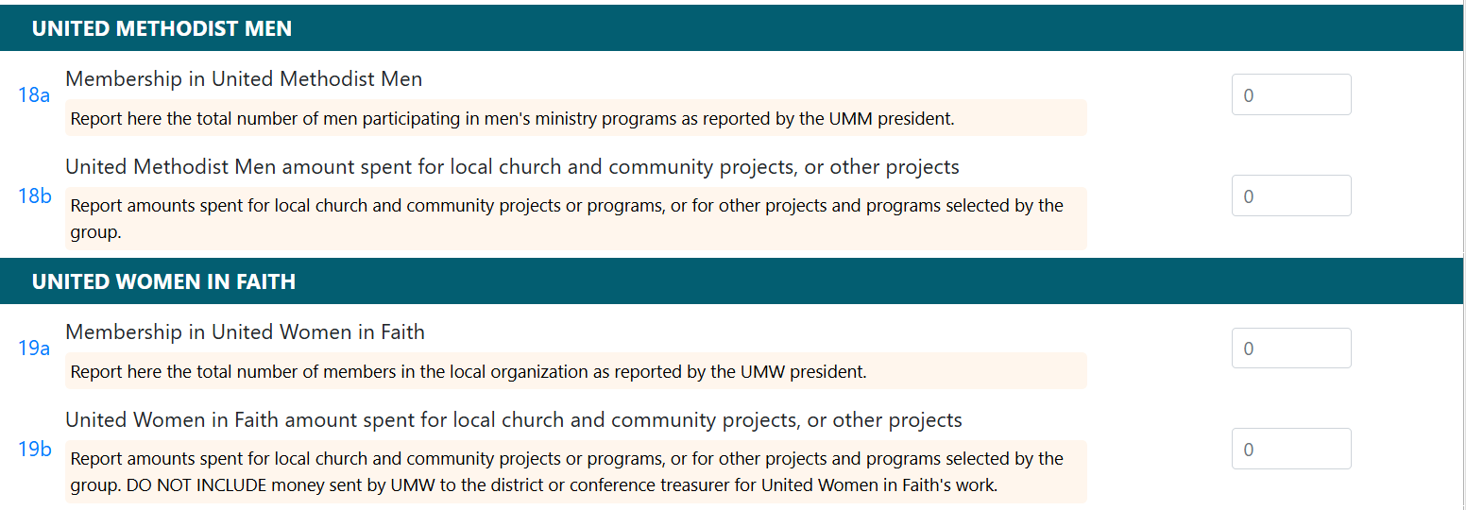
Table 1: Membership & Participation

Slide 11
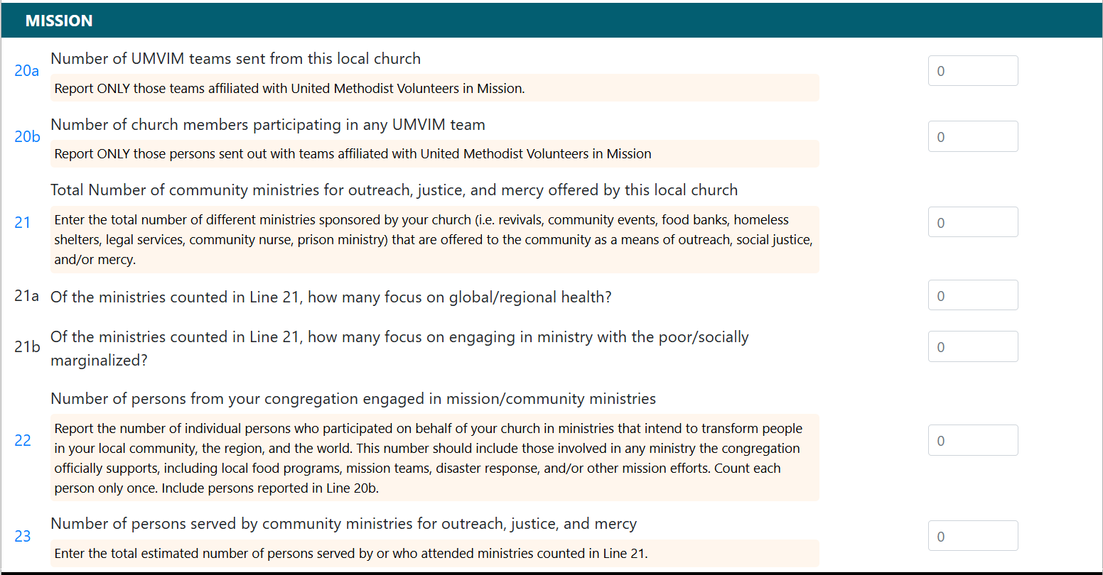
Table 1: Membership & Participation

Slide 12
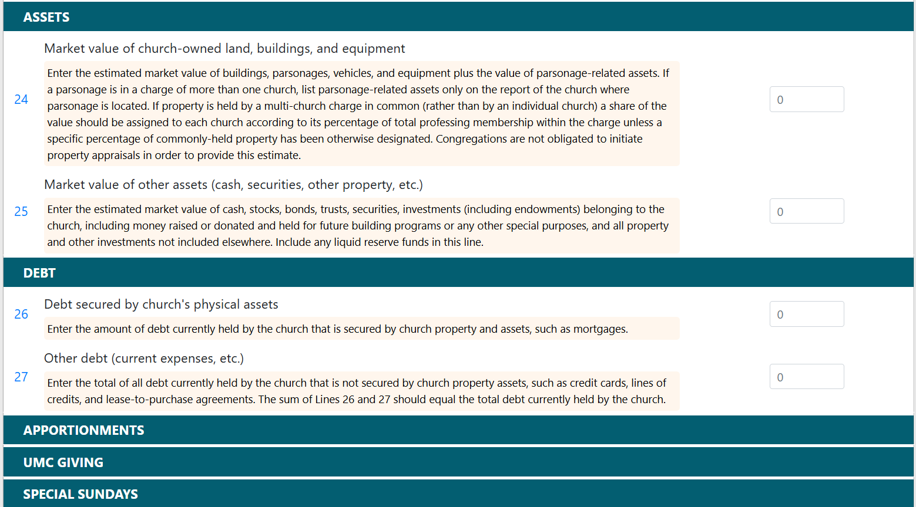
Table 2: Assets & Expenses
Conference Completed Lines
Conference Completed Lines
Conference Completed Lines

Slide 13
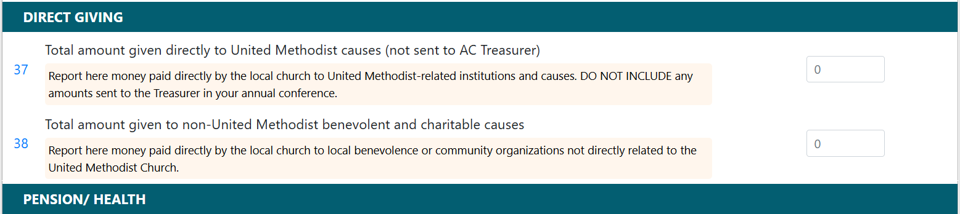
Table 2: Assets & Expenses
Conference Completed Lines

Slide 14
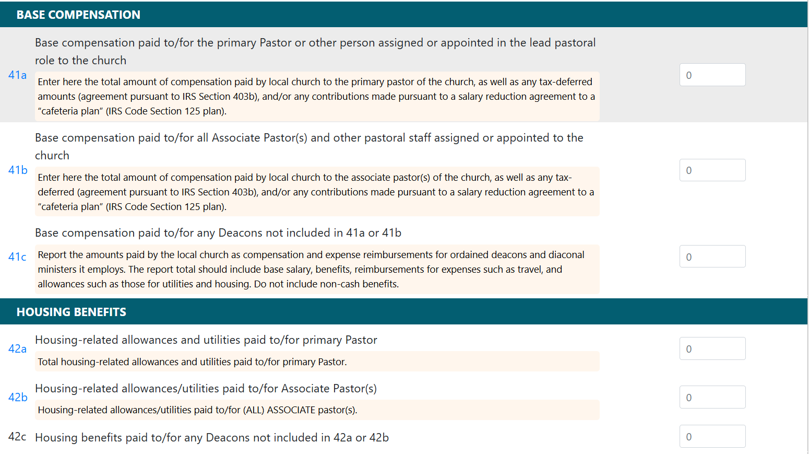
Table 2: Assets & Expenses
These lines are included in Shared Ministry Calculation
These lines are included in Shared Ministry Calculation

Slide 15
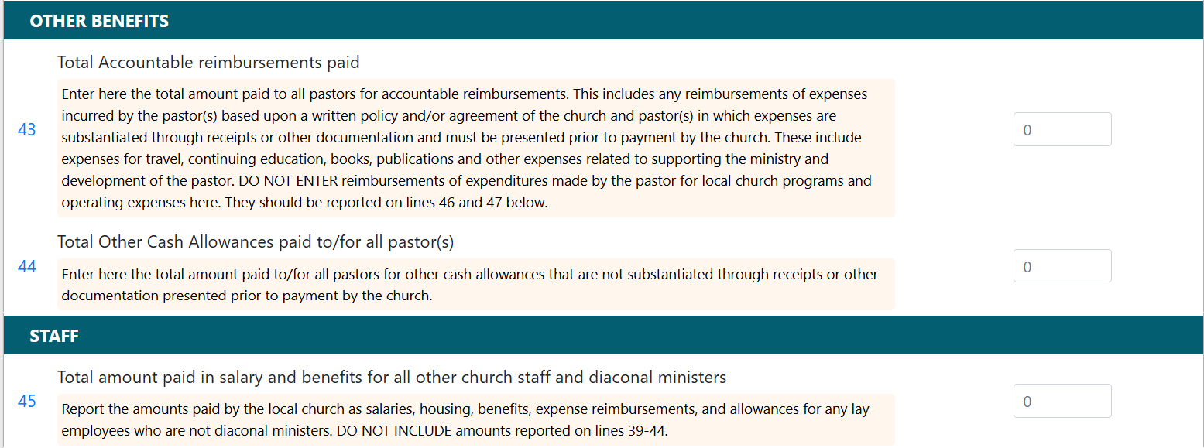
Table 2: Assets & Expenses
These lines are included in Shared Ministry Calculation
These lines are included in Shared Ministry Calculation

Slide 16
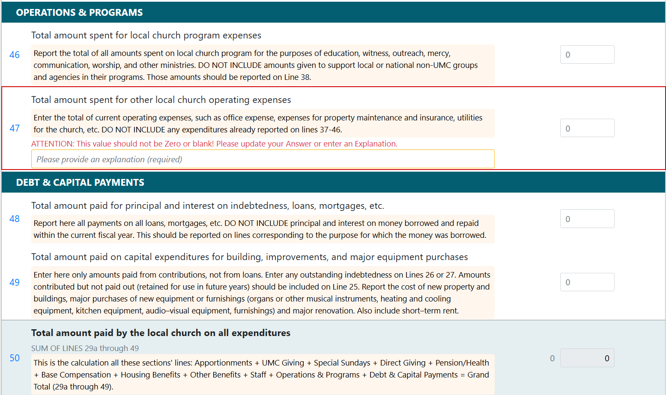
Table 2: Assets & Expenses
These lines are included in Shared Ministry Calculation

Slide 17
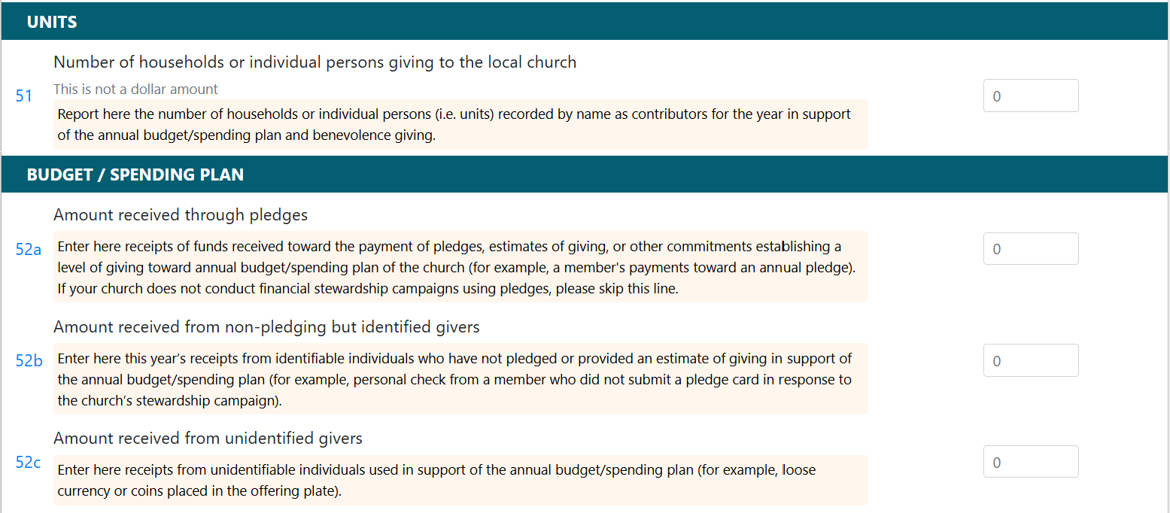
Table 3: Income

Slide 18
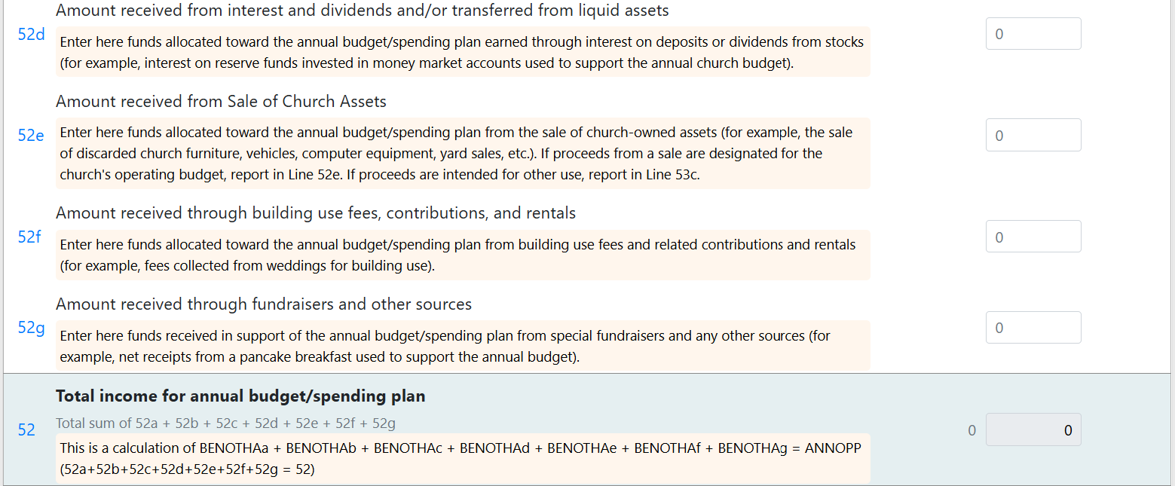
Table 3: Income

Slide 19
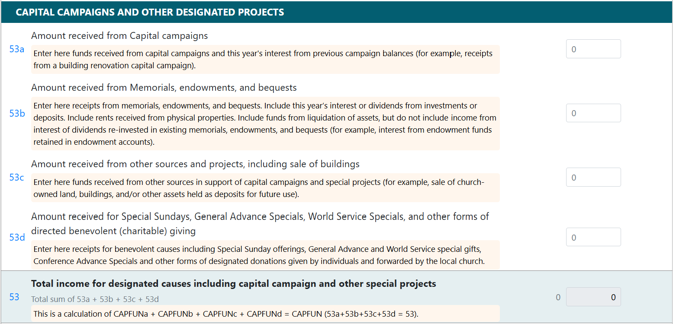
Table 3: Income

Slide 20
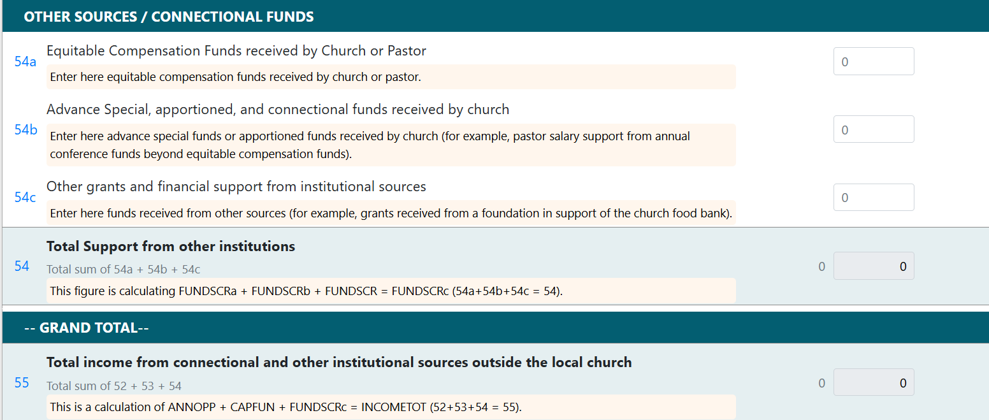
Table 3: Income

Slide 21
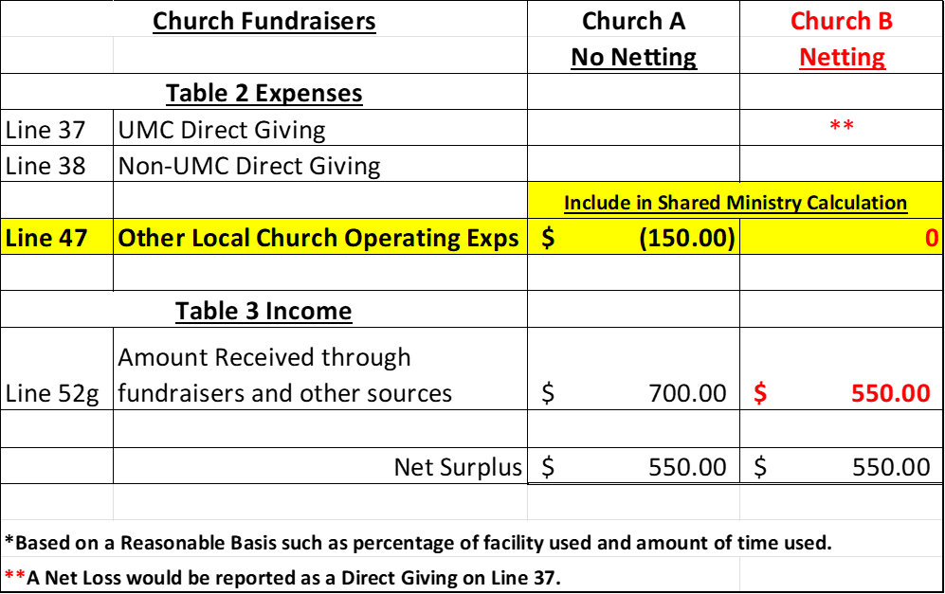
Netting Concept
The Netting Concept allows you to net expenses with related income for situations such as church fundraisers, church run thrift stores and daycares, or building rentals.
Example
Netting allows for more consistent and accurate Shared Ministry Allocation for all churches.

Slide 22








GNJ Shared Ministry Formula
2024 Statistical Reports will be used in the 2026 Shared Ministry Calculation.
* The % may change based on final budget approval by the Annual Conference at the May Annual Conference Session.

Slide 23
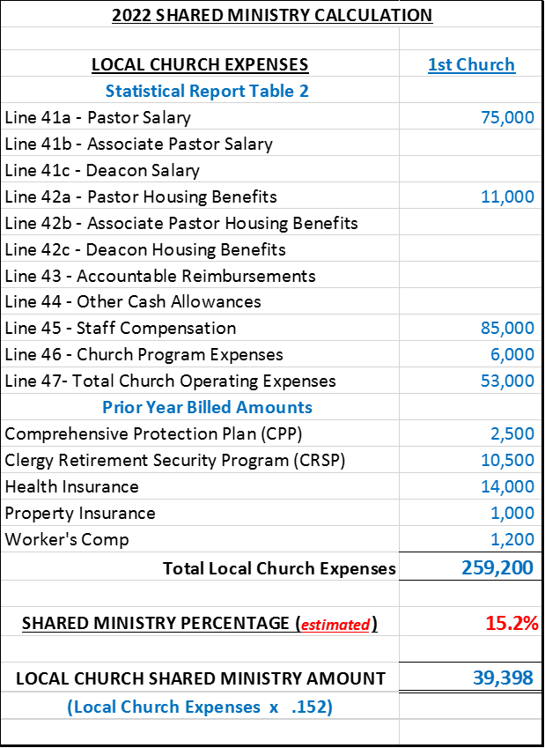
GNJ Shared Ministry Formula
Calculation Example
Increases to any of these expense lines will result in an increase in a Church’s Shared Ministry Allocation.

Slide 24
2024 STATISTICAL REPORTS
If you have any questions, please email:
James Mulligan, Accounting-Database Administrator
jmulligan@gnjumc.org
Danielle Andrews, Controller
dandrews@epagnj.org
Due Date: January 31, 2025

