Slide 1

2022 STATISTICAL TRAINING
December 2022

Slide 2

2022 STATISTICAL REPORTS
Key Points:
You will be prompted to change your password at the first login. Please note the conference office does not have access to your new password.
Keep the username and password available for all users.
There have been no significate changes to the 2022 report.
  Suggestion: Before entering any data print your Church Report with prior year comparison.
  New website makes data entry simplified with all questions on one page. Easier to maneuver and scroll through answers of all three tables without having to reload each webpage.
Reports cannot be changed after they have been vetted and submitted to GCFA.

Slide 3
2022 STATISTICAL REPORTS
Login Information:
New Website: http://stats.gcfa.org
Username: Six-digit GCFA Number
Password: gnjchurch22
Due Date:
January 31, 2023 (2022 Tables Available on December 31, 2022)

Slide 4
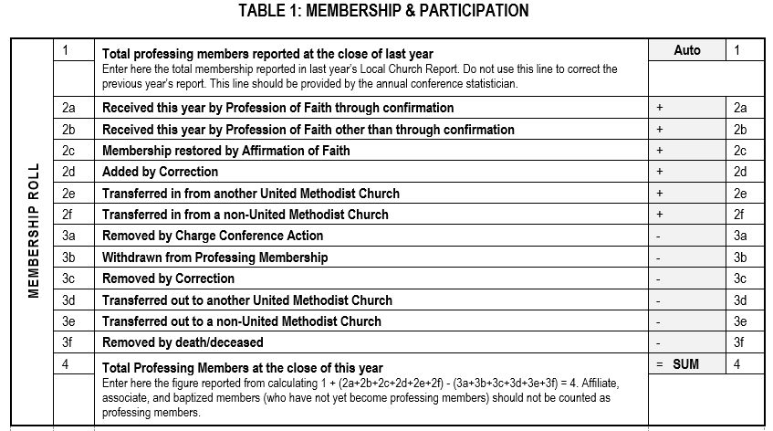
Table 1: Membership & Participation
Line 1 auto populates based on last year’s ending total.

Slide 5
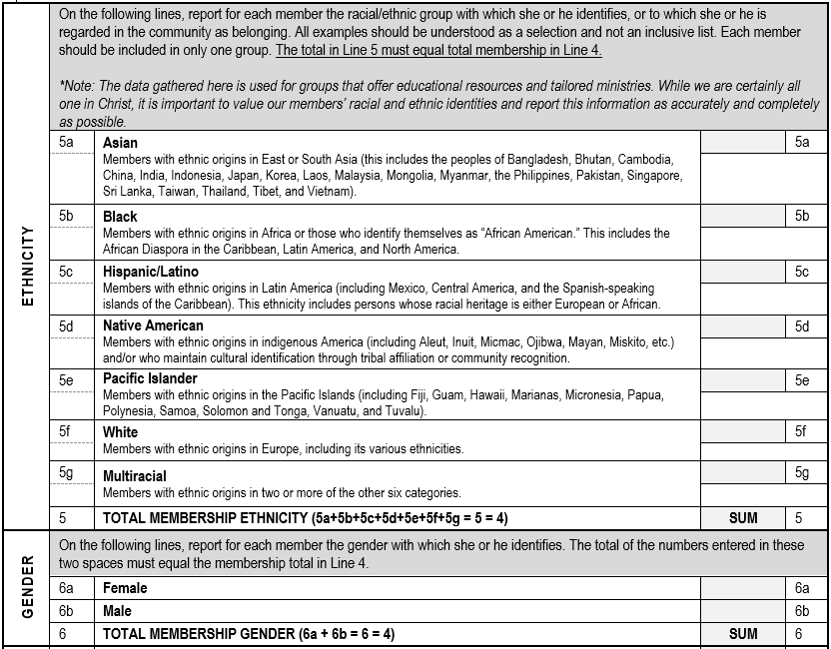
Table 1: Membership & Participation
The Total in Line 5 & 6 must equal total membership in Line 4.
Line 6c has been added for Non-Binary Membership and will be included in the Total for Line 6.

Slide 6
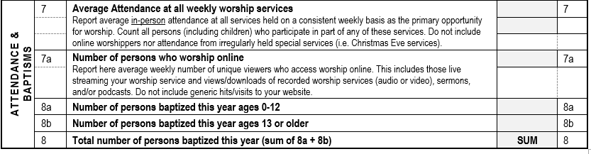
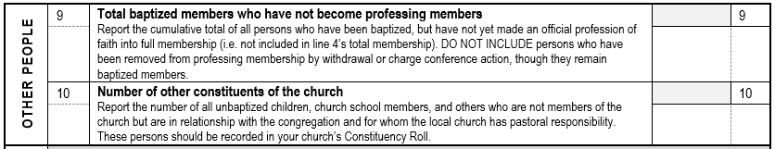
Table 1: Membership & Participation

Slide 7
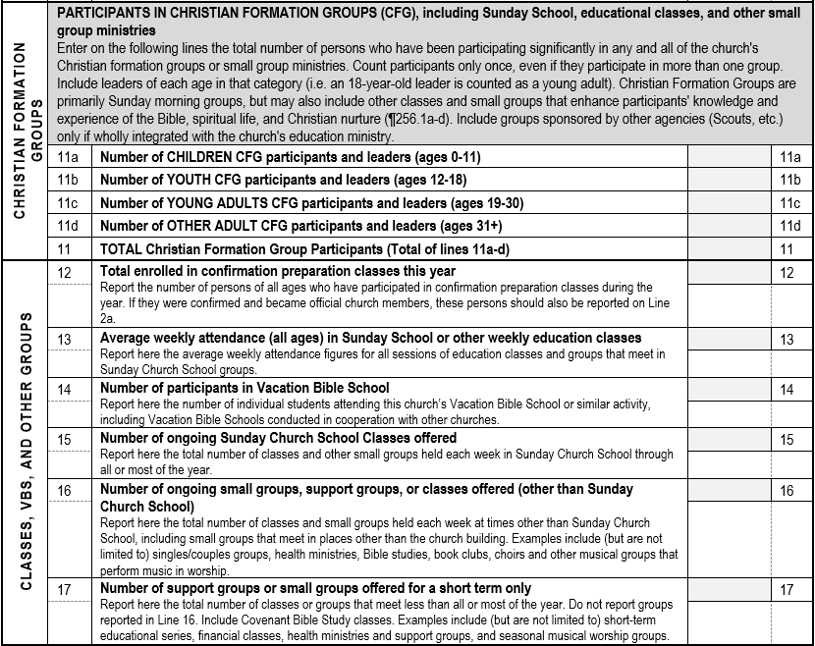
Table 1: Membership & Participation
Count all those who have participated in any church groups.

Slide 8
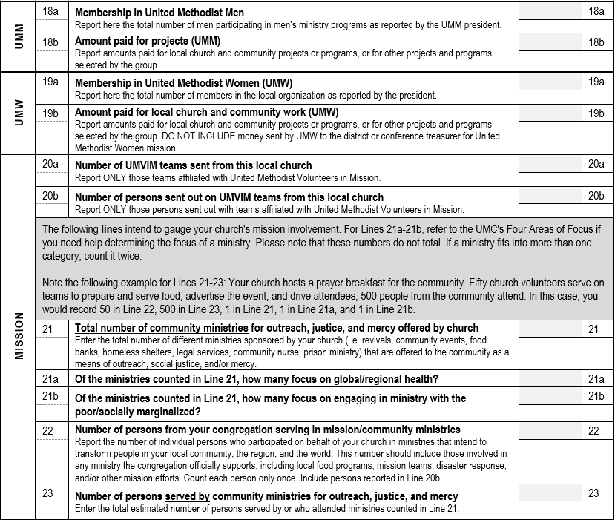
Table 1: Membership & Participation
Example
This Mission Section has been reorganized to better collect how churches do ministry. And if your ministry fits in both categories, count it in twice.

Slide 9
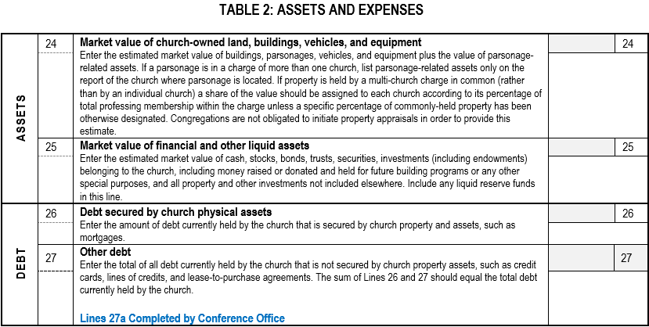
Table 2: Assets & Expenses

Slide 10
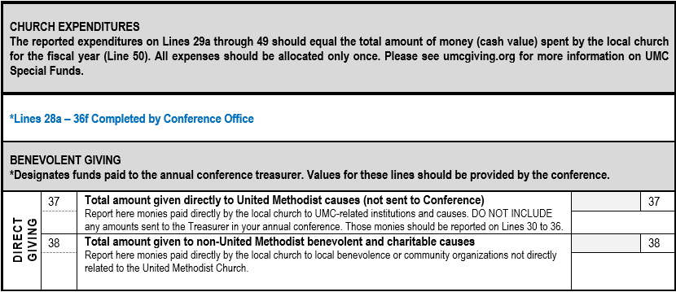
Table 2: Assets & Expenses
Shared Ministries and Special Sunday amounts sent to the Conference Office will be populated on their appropriate lines by the Conference Office.

Slide 11
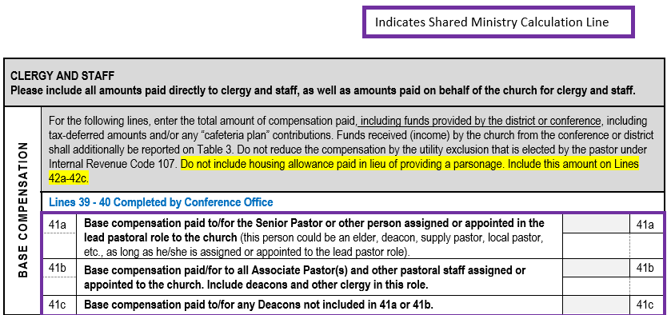
Table 2: Assets & Expenses
NOTE: Senior/Lead pastor compensation includes any clergy status in the lead/primary role. If a church has a supply pastor, their salary including any applicable FICA taxes should be included on that line.

Slide 12
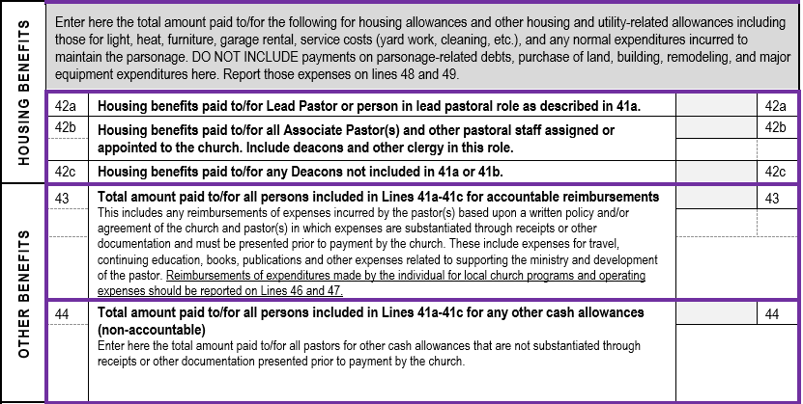
Table 2: Assets & Expenses

Slide 13
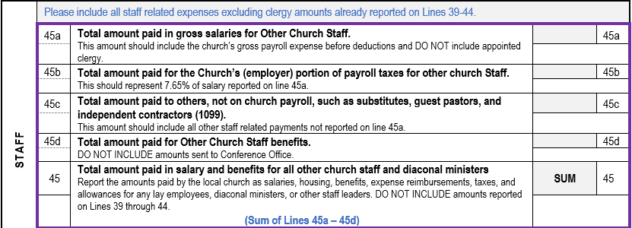
Table 2: Assets & Expenses
Line 45a: Should include all employees who receive a W-2 at year- end excluding clergy.
Line 45b: Should include the employer FICA match paid for the salaries reported on line 45a.
Line 45c: Should include all other payments for services.
Line 45d: Should include any additional benefits paid for on behalf of all other church staff not sent to the Conference.

Slide 14
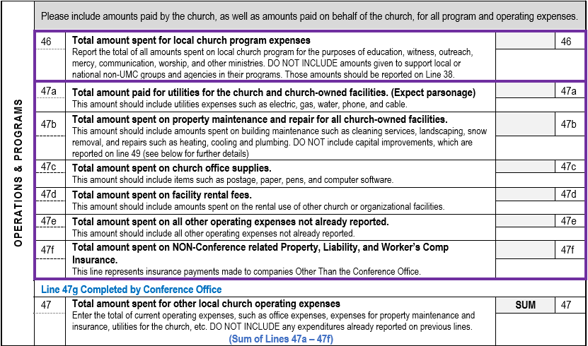
Table 2: Assets & Expenses

Slide 15
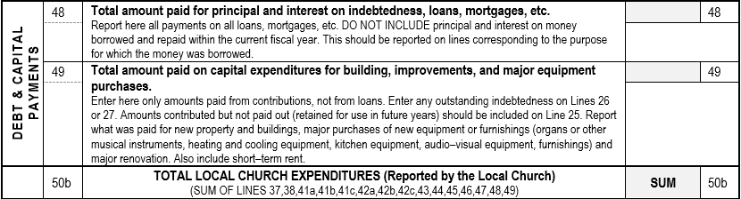
Table 2: Assets & Expenses
Line 49: Should include any building improvements that will extend the life of an asset for more than a year. (i.e. painting a room or remodeling a kitchen) This line can also include major equipment purchases (i.e new water heater).

Slide 16
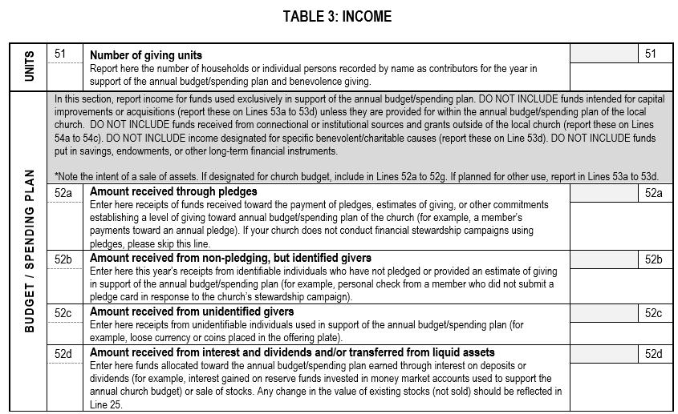
Table 3: Income

Slide 17
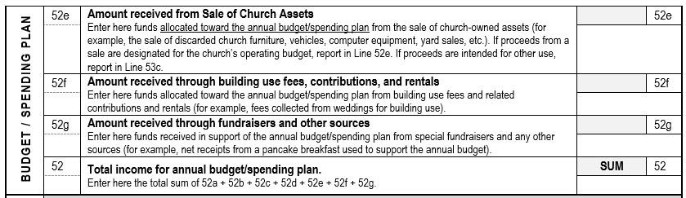
Table 3: Income

Slide 18
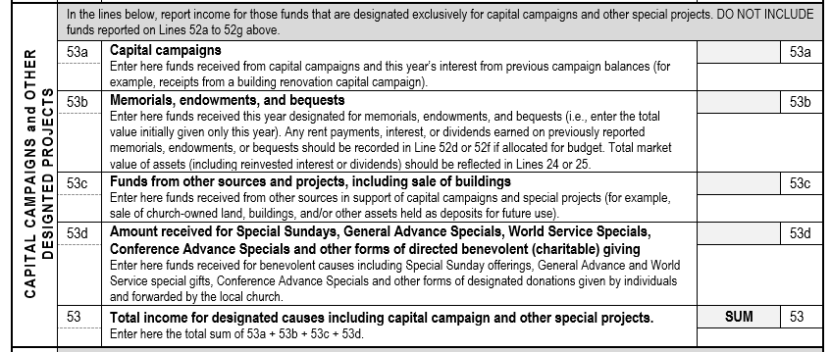
Table 3: Income
Include Mission Funds collected here.

Slide 19
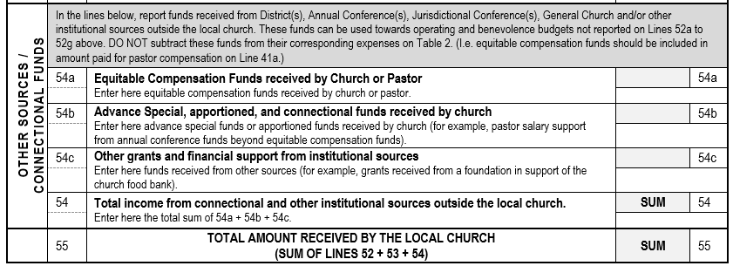
Table 3: Income

Slide 20
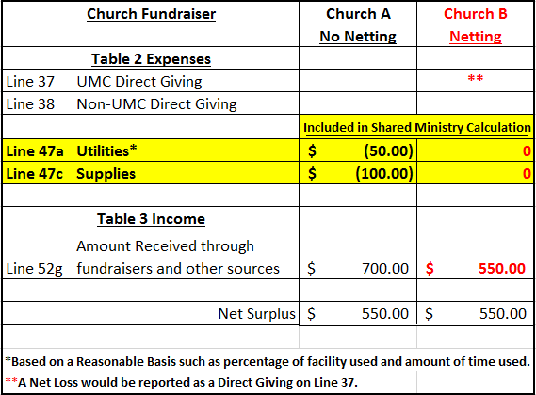
Netting Concept
The Netting Concept allows you to net expenses with related income for situations such as church fundraisers, church run thrift stores and daycares, or building rentals.
Example
Netting allows for more consistent and accurate Shared Ministry Allocation for all churches.

Slide 21
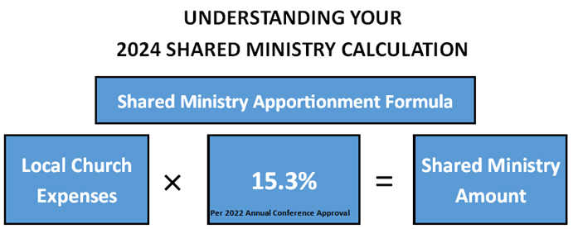








Shared Ministry Formula
2022 Statistical Reports will be used in the 2024 Shared Ministry Calculation.

Slide 22
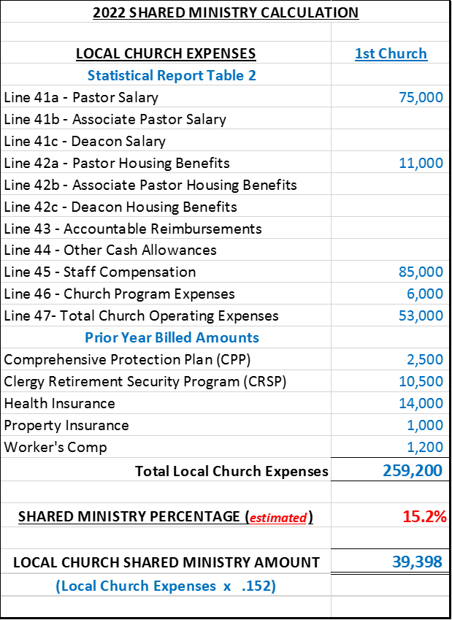
Shared Ministry Formula
Calculation Example
Increases to any of these expense lines will result in an increase in a Church’s Shared Ministry Allocation.

Slide 23
2022 STATISTICAL REPORTS
If you have any questions please email:
James Mulligan, Accounting-Database Administrator
jmulligan@gnjumc.org
Danielle Andrews, Controller
dandrews@gnjumc.org
Due Date: January 31, 2023
(2022 Tables Available on December 31, 2022)

