Slide 1

2021 STATISTICAL TRAINING
January 2022

Slide 2

2021 STATISTICAL REPORTS
Login Information:
Website: http://ezra.gcfa.org
Username: 3360_ _ _ _ (4-Digit Church Number)
Password: gnjchurch21
Due Date:
January 31, 2022 (2021 Tables Available on December 21, 2021)

Slide 3
2021 STATISTICAL REPORTS
Key Points:
You will be prompted to change your password at the first login. Please note the conference office does not have access to your new password.
Keep the username and password available for all users.
There have been no significate changes to the 2021 report.
  Suggestion: Before entering any data print your Church Report with prior year comparison.
Reports cannot be changed after they have been vetted and submitted to GCFA.

Slide 4
2021 STATISTICAL REPORTS
COVID-19 HIGHLIGHTS:
ON-LINE WORSHIP (report on line 7a)
  Report average number of unique viewers who access on-line worship services.
COVID RELATED EXPENSES (report on appropriate expense lines)
  Example: Report Cleaning supplies on line 47
  Example: Major equipment (such as video equipment) on line 49
PPP LOANS (report as follows)
  PPP Loan NOT yet forgiven by the bank, report on line 27
  PPP Loan that WAS forgiven by the bank, report on line 54c
  Expenses SHOULD NOT to be netted against the loan.

Slide 5
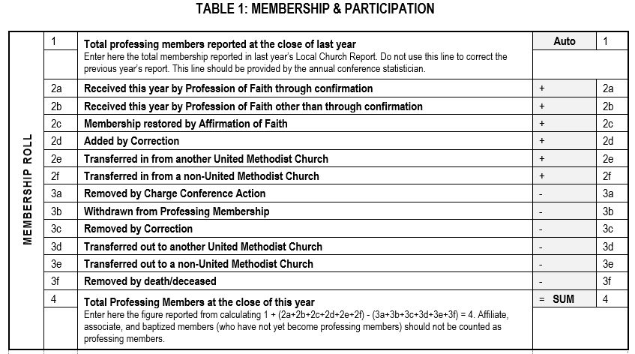
Table 1: Membership & Participation
Line 1 auto populates based on last year’s ending total.

Slide 6
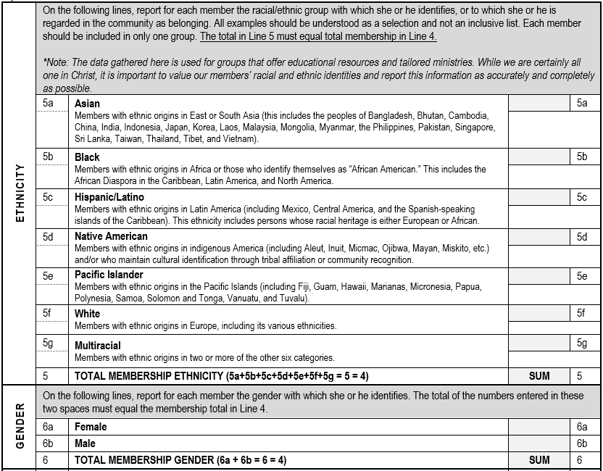
Table 1: Membership & Participation
The Total in Line 5 & 6 must equal total membership in Line 4.
Line 6c has been added for Non-Binary Membership and will be included in the Total for Line 6.

Slide 7
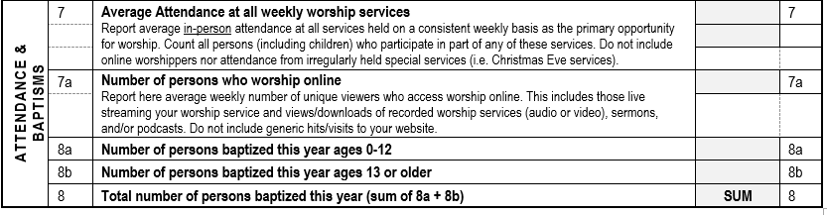
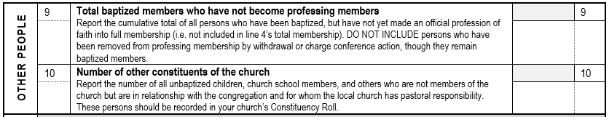
Table 1: Membership & Participation

Slide 8
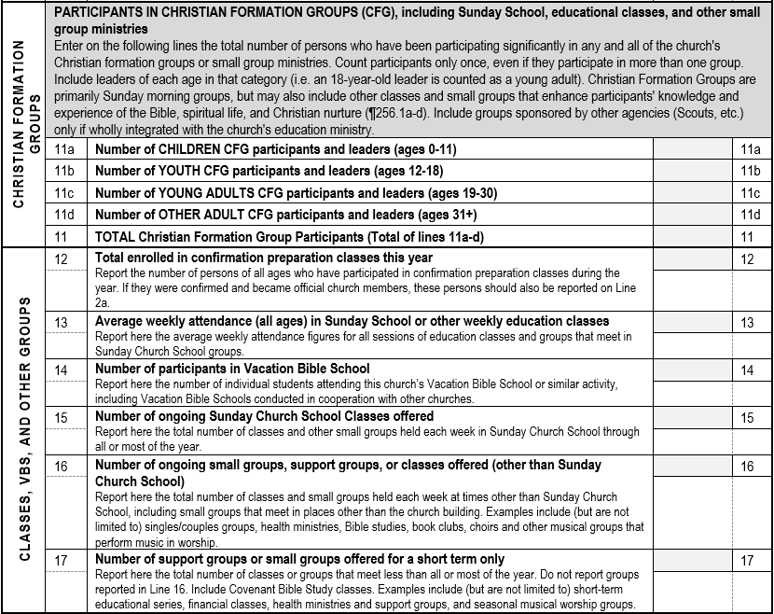
Table 1: Membership & Participation
Count all those who have participated in any church groups.

Slide 9
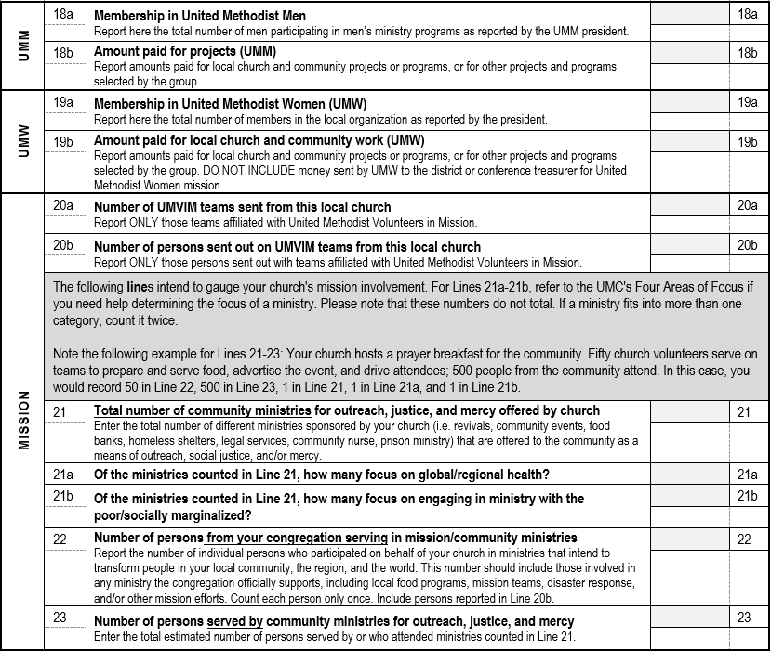
Table 1: Membership & Participation
Example
If your ministry fits in both categories, count it in twice.

Slide 10
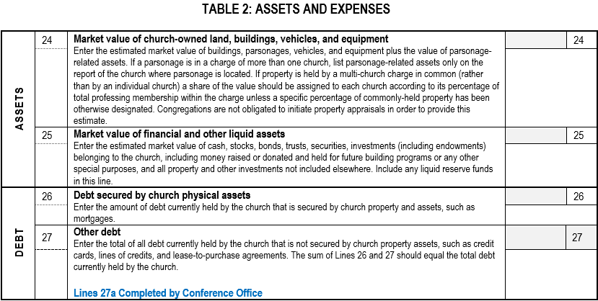
Table 2: Assets & Expenses

Slide 11
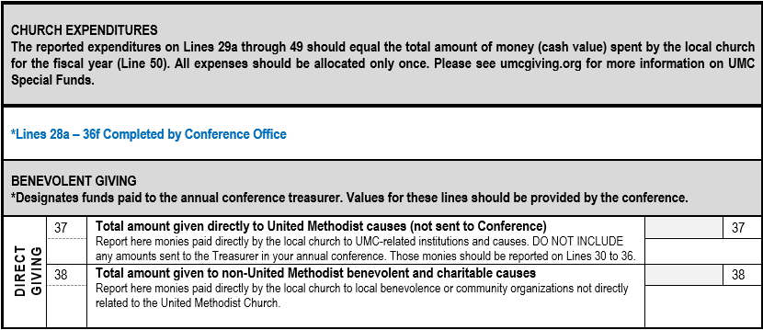
Table 2: Assets & Expenses
Shared Ministries and Special Sunday amounts sent to the Conference Office will be populated on their appropriate lines by the Conference Office.

Slide 12
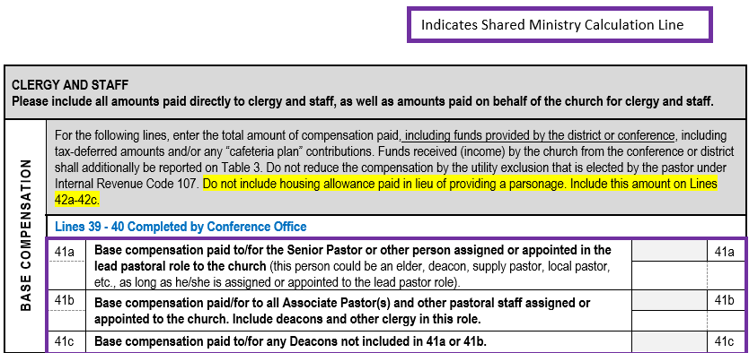
Table 2: Assets & Expenses
NOTE: Senior/Lead pastor compensation includes any clergy status in the lead/primary role. If a church has a supply pastor, their salary including any applicable FICA taxes should be included on that line.

Slide 13
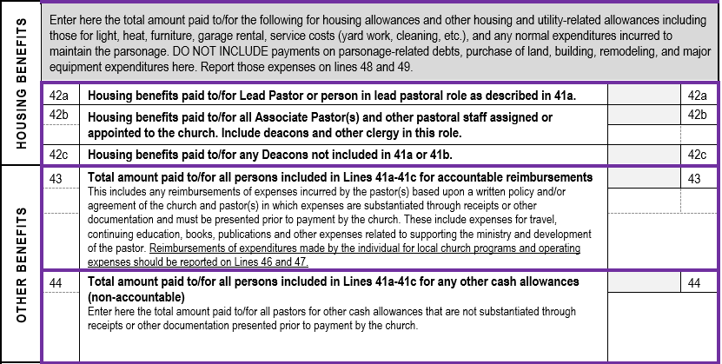
Table 2: Assets & Expenses

Slide 14
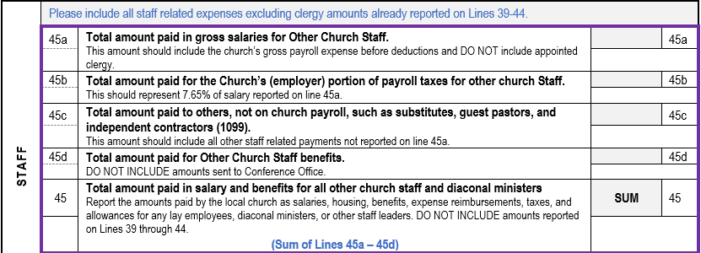
Table 2: Assets & Expenses
Line 45a: Should include all employees who receive a W-2 at year- end excluding clergy.
Line 45b: Should include the employer FICA match paid for the salaries reported on line 45a.
Line 45c: Should include all other payments for services.
Line 45d: Should include any additional benefits paid for on behalf of all other church staff not sent to the Conference.

Slide 15
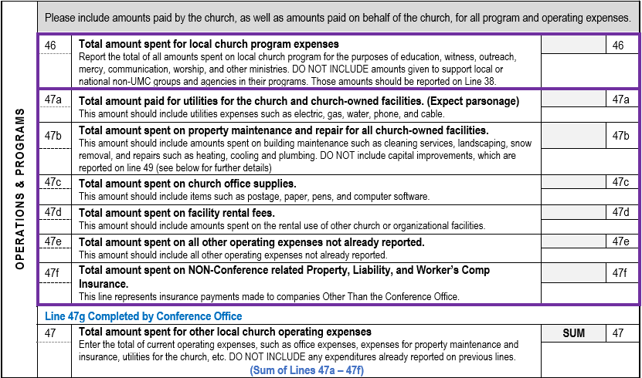
Table 2: Assets & Expenses

Slide 16
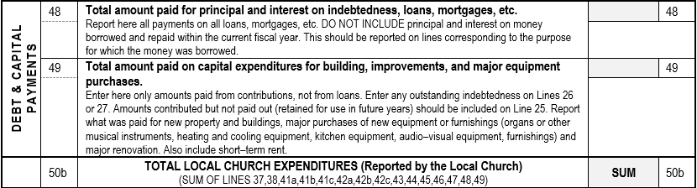
Table 2: Assets & Expenses
Line 49: Should include any building improvements that will extend the life of an asset for more than a year. (i.e. painting a room or remodeling a kitchen) This line can also include major equipment purchases (i.e new water heater).

Slide 17
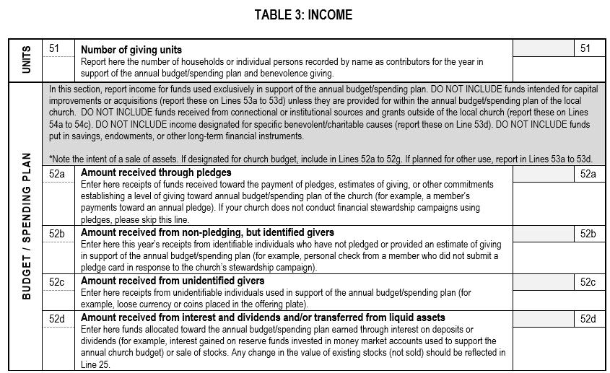
Table 3: Income

Slide 18
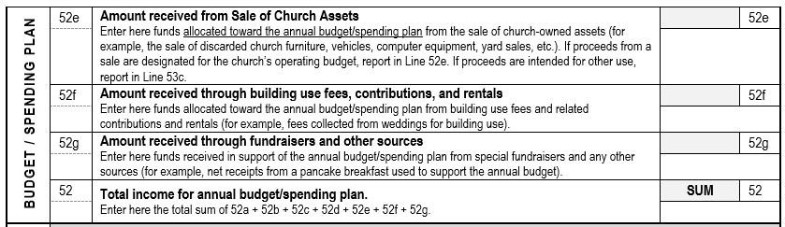
Table 3: Income

Slide 19
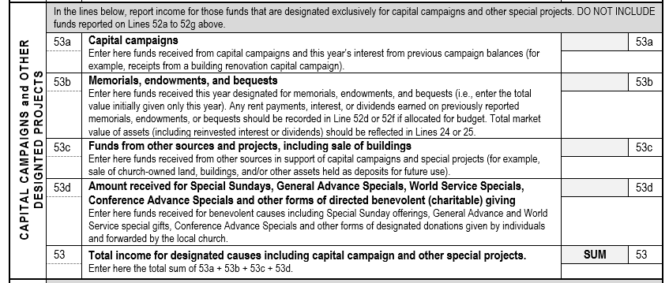
Table 3: Income
Include Mission Funds collected here.

Slide 20
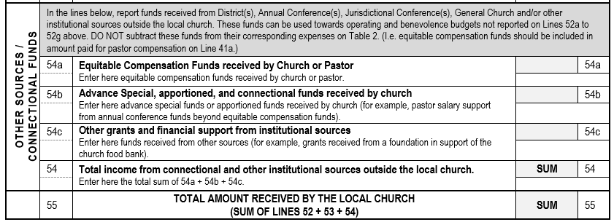
Table 3: Income

Slide 21
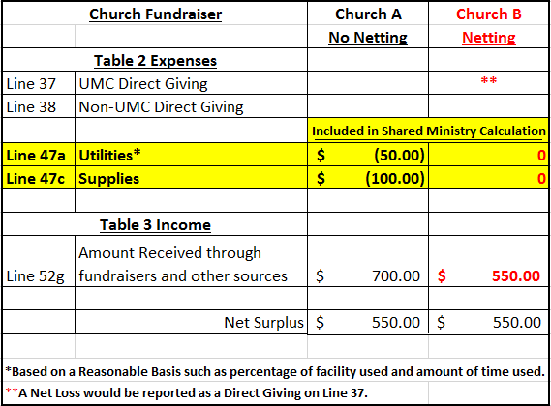
Netting Concept
The Netting Concept allows you to net expenses with related income for situations such as church fundraisers, church run thrift stores and daycares, or building rentals.
Example
Netting allows for more consistent and accurate Shared Ministry Allocation for all churches.

Slide 22
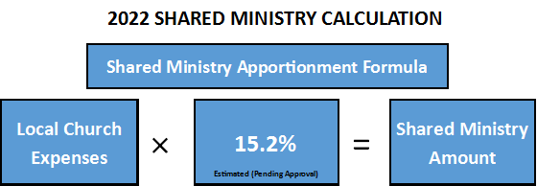
Shared Ministry Formula
2021 Statistical Reports will be used in the 2023 Shared Ministry Calculation.

Slide 23
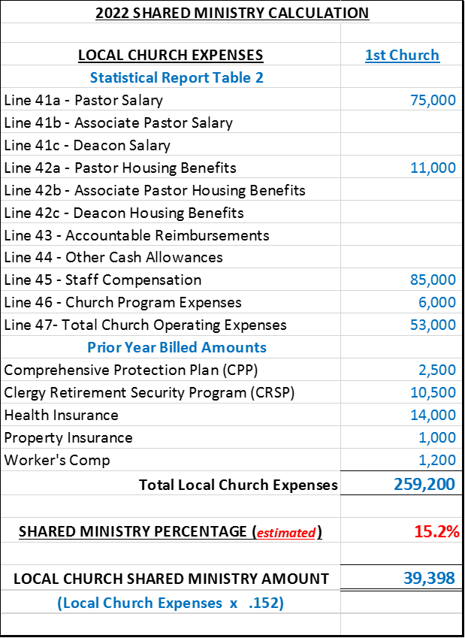
Shared Ministry Formula
Calculation Example
Increases to any of these expense lines will result in an increase in a Church’s Shared Ministry Allocation.

Slide 24
2021 STATISTICAL REPORTS
If you have any questions please email:
James Mulligan, Accounting-Database Administrator
jmulligan@gnjumc.org
Danielle Andrews, Accounting Manager
dandrews@gnjumc.org
Due Date: January 31, 2022
(2021 Tables Available on December 21, 2021)

