Slide 1
TRUSTEES
Managing the resources of the congregation
Rev. Charlie Soper
Pastor of Epworth UMC, Palmyra
Member of District Board of Location & Buildings

Slide 2
What is the ultimate purpose?
“
To be Christian stewards of all property God has entrusted to the congregation so that the ministries of the congregation can be effective.

Slide 3
THE BASICS:
SERVES A 3 YEAR TERM (CLASS)
MAY SUCCEED THEMSELVES
ELECT THEIR OWN OFFICERS
LEGAL REPRESENATIVES OF THE CHURCH
DO NOT NEED TO BE A MEMBER
Notes:
----- Meeting Notes (5/14/19 14:46) -----
Q: Do you have a church website?
Q: Are you happy with your church website?
Q: Do you have some control over your church website?

Slide 4
Useful Gifts as a Trustee:
KNOWLEDGE OF PROPERTY AND ASSET MANAGEMENT
ABILITY TO LISTEN TO AND COMMUNICATE WITH PEOPLE
WILLINGNESS TO PARTNER WITH COMMUNITY INTERESTS
SERVANTHOOD, HELPING, DISCERNMENT, LEADERSHIP, ADMINISTRATION, AND GIVING
Notes:
----- Meeting Notes (5/14/19 14:46) -----
Q: Do you have a church website?
Q: Are you happy with your church website?
Q: Do you have some control over your church website?

Slide 5
Trustee Responsibilities:
“
“This team, subject to the direction of the charge/church conference, has oversight and care of all local church property, buildings, and equipment to further the mission of the church. This work is done in consultation with the pastor.”

Slide 6
Trustee Responsibilities:
REMEMBER: THIS INCLUDES THE PARSONAGE!

Slide 7
Trustee Responsibilities:
Manage & coordinates the use of church property and facilities
Who organizes the church and facilities calendar?
Who receives & handles facility use applications?

Slide 8
Trustee Responsibilities:
Trustees receive and administer all gifts made to the congregation and make certain that trust funds of the congregation are invested properly.

Slide 9
Trustee Responsibilities:
Trustees ensure that the Articles of Incorporation of the congregation are kept up-to-date.
Property variances are current.

Slide 10
Trustee Responsibilities:
Conduct an annual accessibility audit of buildings and grounds to discover and then work toward eliminating barriers that impede the full participation of all people.

Slide 11
Trustee Responsibilities:
Submits annual budget requests to the committee on finance for property maintenance and improvement and new property/equipment purchases.

Slide 12
Good Practices:
PROACTIVE v.s. REACTIVE
Preventative Maintenance
Repairs

Slide 13
Good Practices:
Do walkthrough
Make list of repairs and projects
Schedule work days

Slide 14
Good Practices:
Multiple bids for costly repairs
Make decisions
Communicate
Insurance for contractors
Celebrate accomplishments
Inform about need

Slide 15
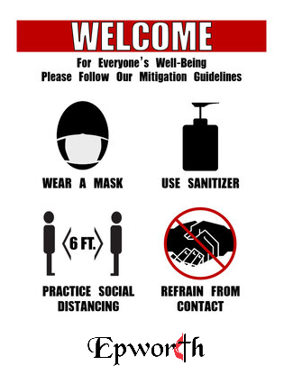

Slide 16
District Board of Location & Building
?
Both a sounding board and a safety net helping churches discern direction and deploy resources in the most effective way possible.

Slide 17
www.churchmutual.com

Slide 18
The Guidelines for Trustees is available as a PDF on Cokesbury

Slide 19
TRUSTEES
Managing the resources of the congregation
Rev. Charlie Soper
Pastor of Epworth UMC, Palmyra
Member of District Board of Location & Buildings

