Slide 1
FINANCE
{258.4}
Rev. Dr. Rich Hendrickson
Pastor of St. Paul’s UMC Ocean Grove

Slide 2
Committee Members ¶258.4
Chairperson Church Council Chair
Pastor(s) SPR Chair or Representative
Lay Leader Trustee Chair or Representative
Lay member to A/C *Stewardship Chair or Representative
Financial Secretary Treasurer
*Business Administrator Others as determined by charge conference
{*If applicable}

Slide 3
THE BASICS ¶258.4
Oversee stewardship Compile a budget annually
Raise sufficient income to support the budget Administer funds received by the church
Counting and depositing the offering Disbursing funds
Annually review and report on internal controls Provide for an annual audit
Report the audit to the annual Charge Conference Recommend proper depositories for church funds
Ensure compliance with donors intent
Annually report to church council all designated funds

Slide 4
THE BIG PICTURE
“The ministry of the committee on finance is to nurture the financial vitality of the congregation.”
Financial Transparency
Missional Budgeting and Fundraising
Best Practices
Notes:
----- Meeting Notes (5/14/19 14:46) -----
Q: Do you have a church website?
Q: Are you happy with your church website?
Q: Do you have some control over your church website?

Slide 5
Clear, easy to understand financial reports (income and expense)
Budget
Actual
YTD
Annual audit
Strong system of internal controls
Receiving
Handling
Counting
TRANSPARENCY
Notes:
----- Meeting Notes (5/14/19 14:46) -----
Q: Do you have a church website?
Q: Are you happy with your church website?
Q: Do you have some control over your church website?

Slide 6
Budget & Fundraising
?
The usual questions:
How much money do we need?
How are we going to get the money we need?
Who will give it to us?
How will we ask them?
“Fund-raising is proclaiming what we believe is such a way that we offer other people an opportunity to participate with us in our vision and our purpose.”
— Henri Nouwen

Slide 7
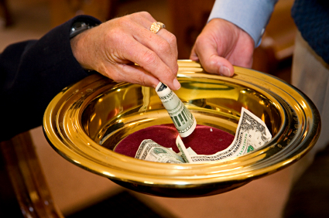
Budget & Fundraising
Mission drives the budget
Vision, goals, outcomes
Expense budget
Ministry Action Plan (MAP)
Stewardship/Giving

Slide 8
Narrative
Budget

Slide 9
Resources:
2016-2020 United Methodist Church Financial Records Handbook.
2016 United Methodist Book of Discipline
A Spirituality of Fundraising, by Henri Nouwen
Not Your Parent’s Offering Plate, by J. Clif Christopher
Guidelines/Finance Committee

Slide 10
FINANCE
{258.4}
Rev. Dr. Rich Hendrickson
Pastor of St. Paul’s UMC Ocean Grove

