Slide 1
Making Worship Work: Behind the Scenes
GNJ Laity Leadership Academy 2020
Session 2
Notes:
Introduce myself

Slide 2
Notes:
Seed of wheat

Slide 3
Goals
Evaluate
Benchmark/Learn
Grow
Notes:
Today:
Look at plan
Challenges
Streaming Models
Top 10
Planning!
Your Questions

Slide 4
Notes:
Does technology bring people to church?
Does it retain?
What methods?
Why?

Slide 5
Where to Focus
Execution
Demand

Slide 6
Homework: Plan Template
Fill out
Identify sponsor and audience
Review with Sponsor and plan to present
Notes:
Review plans at the end of class, after we go through streaming and top 10
Template is in the Google Drive

Slide 7
Breakout Session
What is your challenge
What do you need to overcome it?
Notes:
If you can’t think of a way to overcome it, maybe that’s not your challenge…
Staffing, etc

Slide 8
Live Streaming
Easy
Medium
Expert

Slide 9
Elements of Streaming
Notes:
Goal is to get from you to the end user
Send to one our multiple destinations, youtube, etc

Slide 10
Easy
Notes:
Use the app on your phone

Slide 11
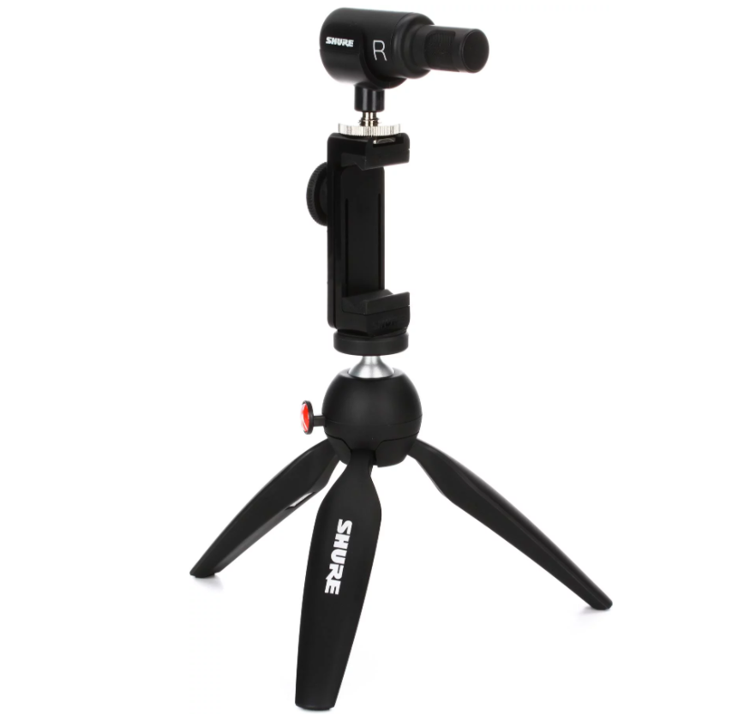
Easy
Phone + Kit ($219)
App
Sign in
Stream!

Slide 12
Easy +
Web Cam (or other camera)
Restream
Play Video From the app

Slide 13
Medium
Notes:
Goal is to get from you to the end user
Send to one our multiple destinations, youtube, etc

Slide 14
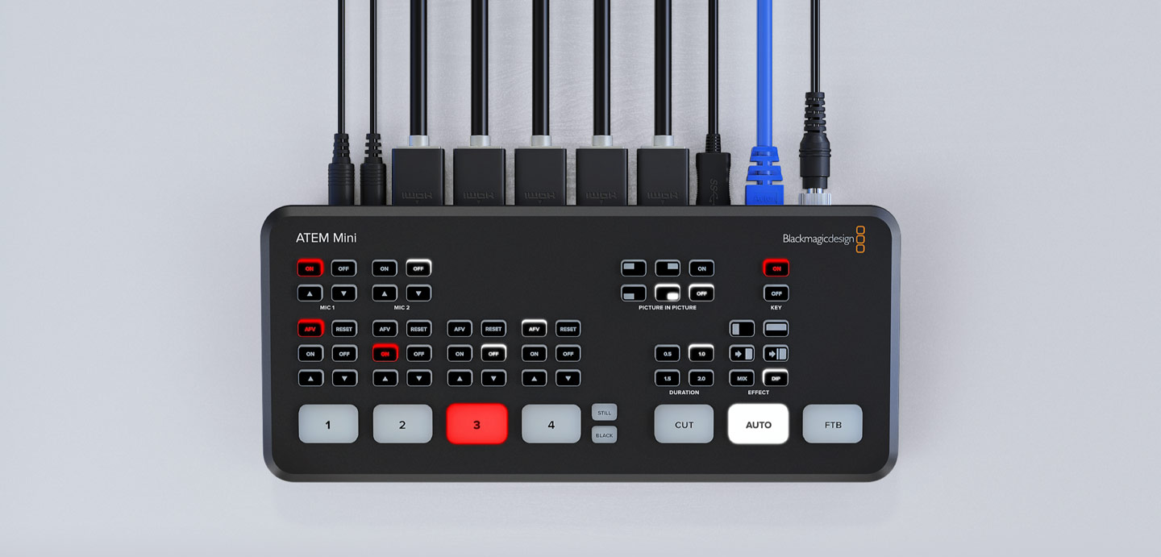
Medium
Any camera, laptop, player, etc
ATEM Mini ($259)
Laptop
Log into Facebook/Youtube or
Restream ($19-$99/month)-optional
ATEM Mini Pro ($595) stream directly over network
Notes:
Multiple Cameras
App/Remote
Con: Need staff
Cables
https://www.blackmagicdesign.com/products/atemmini

Slide 15
Expert
Notes:
Goal is to get from you to the end user
Send to one our multiple destinations, youtube, etc

Slide 16
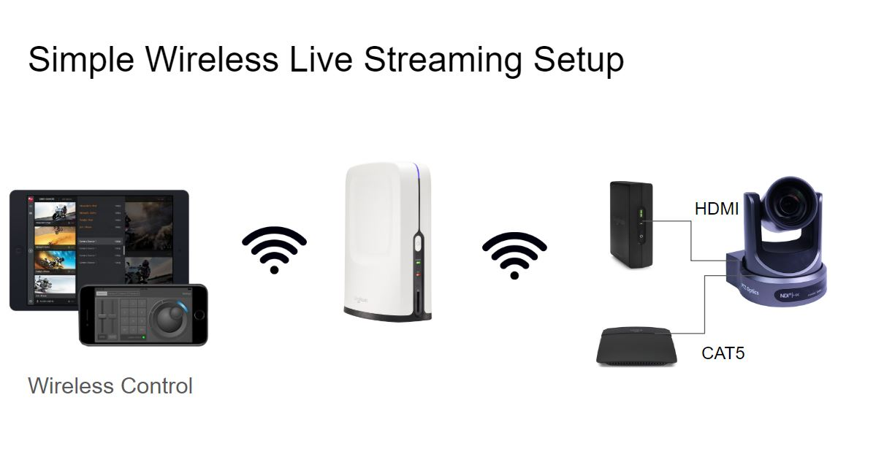
Expert
Any camera, laptop, player, etc
Or CELLPHONE!
Sling Studio ($1697)
Stream to one or multiple destinations
Notes:
No Monthly fees
Medium might be “harder” more cables, but it’s cheeper

Slide 17
Top 10 Hints
Notes:
I can’t count

Slide 18
Audio
EQ your main speakers, and save it
Use the right Mic
Digital Board
Mute groups
Use a sub mix for streaming
Matrix
Mix the sends separately, from a mobile device
Get out and listen
Pay attention to what’s next
Make notes during rehearsal
Monitor Mix
This is not for you, it’s for the band

Slide 19
Graphics/ Visuals
Use a tool
Worship Extreme
Pro Presenter
Create a cover slide for transitions
Add blank slides in songs
Slide operator should know the songs
Rehearse
Test your show in the room

Slide 20
Lighting
Start Small
Use settings on the fixture to create ambiance
Start Cheap
VLC and a USB controller
Movers save money
Notes:
See resources for more info

Slide 21
Planning

Slide 22
What are YOU going to do?

Slide 23
Breakout Session
Review YOUR Plan
Where do you need more help or resources?

Slide 24
Notes:
Closing Prayer
Jess Campbell?

