Slide 1
Making Worship Work: Behind the Scenes
GNJ Laity Leadership Academy 2020
Session 2
Notes:
Introduce myself

Slide 2
Notes:
Seed of wheat

Slide 3
Goals
Evaluate
Benchmark/Learn
Grow

Slide 4
Deliverables
Helpful Tips
Peers/Benchmark Group
Actionable Plan

Slide 5
Session 1
Evaluate/Challenges
Team
Begin Plan: Opportunity Statement
Session 2
Benchmarking Groups
Top 10 hints
Session 3
Communication
Flow
Finalize Plan
Resources

Slide 6
Session 1
Evaluate/Challenges
Team
Begin Plan: Opportunity Statement
Session 2
Demand/Support/Execution
Create and Share your plan
Session 3
Communication/Flow
Finalize Plan: Share
Top 10 Tips
Questions

Slide 7
Rules for Zoom

Slide 8
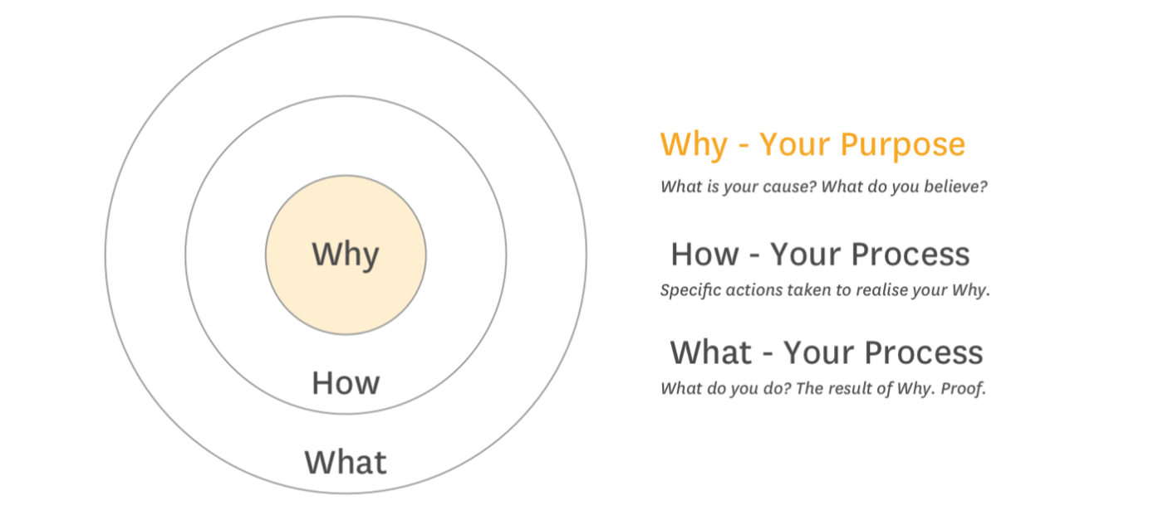
Why are you here?
Notes:
To Run Sound?
Make great lighting effects? Look cool?
Be great?
Why: Enhance Worship
Serve

Slide 9
Making it happen
Demand
Support
Execution

Slide 10
Demand
Does your congregation want this?
Would it ENHANCE worship?

Slide 11
Demand
Support
Does Church Leadership understand the demand?
Do you have the team you need to accomplish?
Do you have funding?

Slide 12
Demand
Support
Execution
What do you want to do better?
Do you have glitches consistently?

Slide 13
Now What?
Notes:
I will provide an export of the survey

Slide 14
Where to Focus
Execution
Demand
Notes:
Banana Slicer
There’s demand but you stink at it.
Don’t tackle too much
Focus on what you CAN change: Support and Execution.
Execution depends on Support, so focus on support first.

Slide 15
Getting Building Support
What Resources do you have?
What Resources do you need?
What support do you have?
Notes:
Getting is passive, Building is active
Find the biggest need

Slide 16
Getting Building Support
Who is your audience?
Who is your sponsor?
Need Resource Provider
Notes:
Who can help us get that?
Money Finance Team
People SPRC, Pastor

Slide 17
Homework: Plan Template
Fill out
Identify sponsor and audience
Review with Sponsor and plan to present
Notes:
Pause and share screen

Slide 18
Getting Better (Execution)
Audio
Graphics/Visuals
Steaming
Planning
Lighting

Slide 19
Audio
Source
Mic
Line input
Console
Mix
Eq
Amplification
Array
Selection
Positioning

Slide 20
Graphics/ Visuals
Content
Process
Software
Flow
Projection
Size
Resolution
Color Temp/Balance
Ambient Light

Slide 21
Streaming
Source
Camera
Graphics
Lower thirds
Switching
Display/Projection
Streaming Platform
Notes:
PEOPLE!

Slide 22
Planning
Getting on the same page
Leader
Method
Voice of the congregation
Voice of flow
Changes
Process
During the service
After the service
Method for feedback

Slide 23
Lighting
Fixtures
Coverage
Front, Side, Back
Controller
Scenes
Notes:
See resources for more info

Slide 24
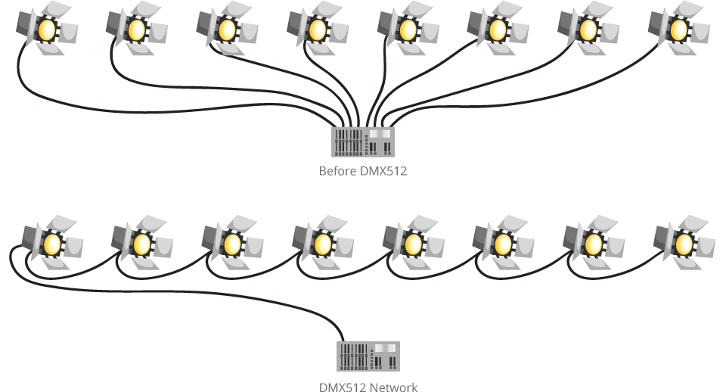

Slide 26
Notes:
Closing Prayer
Jess Campbell?

