Slide 1
Making Worship Work: Behind the Scenes
GNJ Laity Leadership Academy 2020
Notes:
Introduce myself

Slide 2
Goals
Evaluate
Benchmark/Learn
Grow

Slide 3
Deliverables
Helpful Tips
Peers/Benchmark Group
Actionable Plan

Slide 4
Session 1
Evaluate/Challenges
Team
Begin Plan: Opportunity Statement
Session 2
Benchmarking Groups
Top 10 hints
Session 3
Communication
Flow
Finalize Plan
Resources

Slide 5
Notes:
Seed of wheat

Slide 6
Rules for Zoom

Slide 7
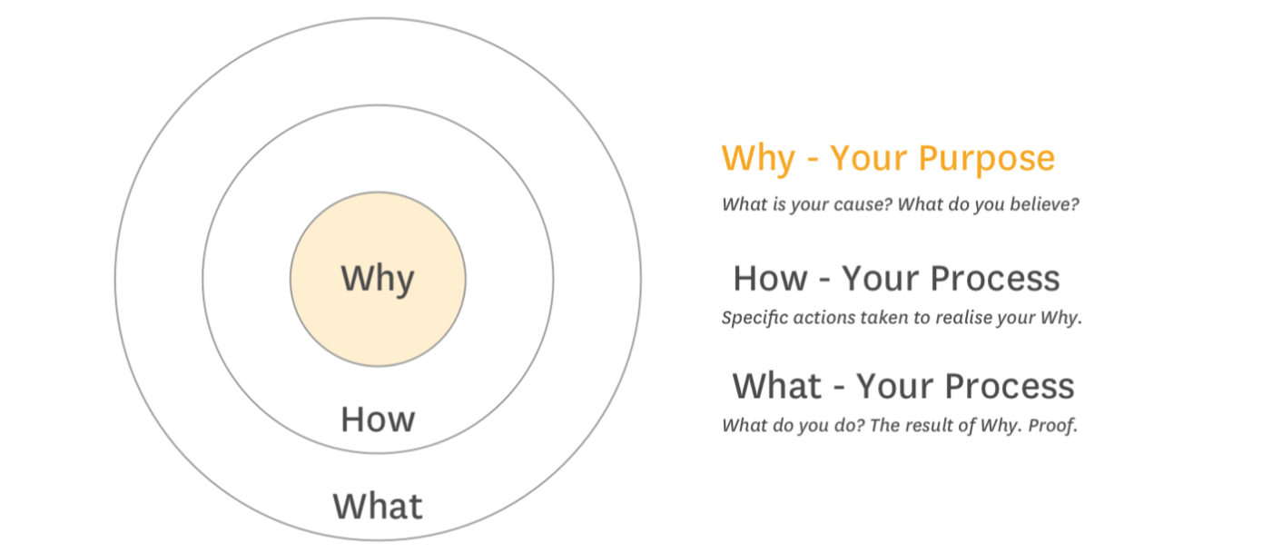
Why are you here?
Notes:
To Run Sound?
Make great lighting effects? Look cool?
Be great?
Why: Enhance Worship
Serve

Slide 8
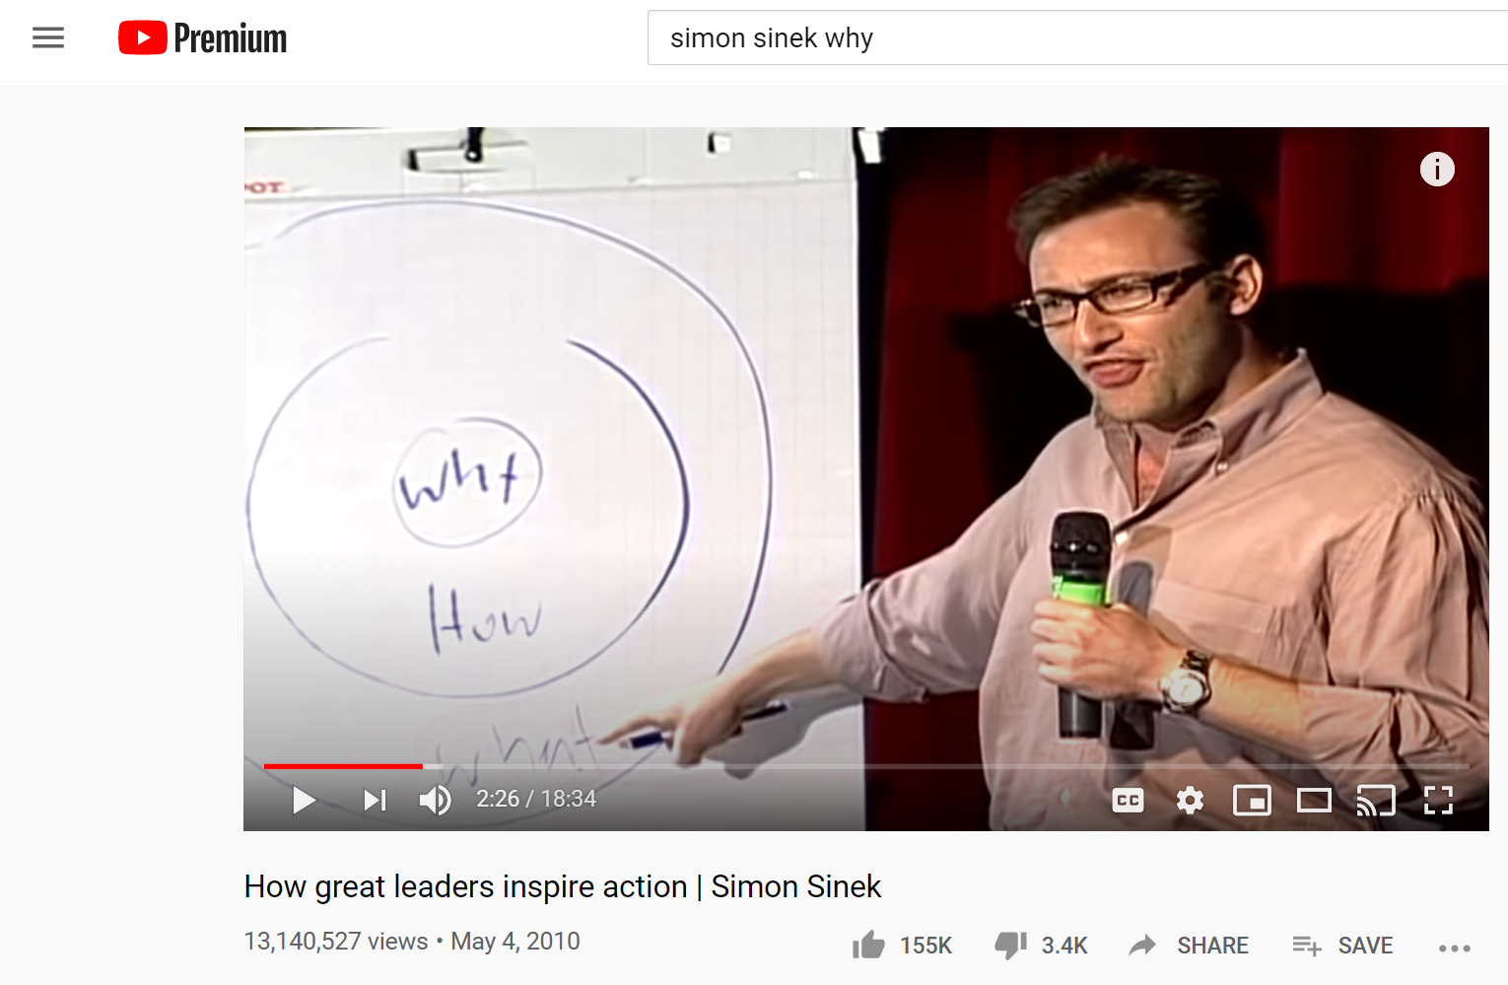
Notes:
Homework, watch this!

Slide 9
Notes:
About halfway through this guy changes the mic
PROACTIVE, battery was running low in the wireless.
BAD, because we saw him, he broke the flow
Simon went with it

Slide 10
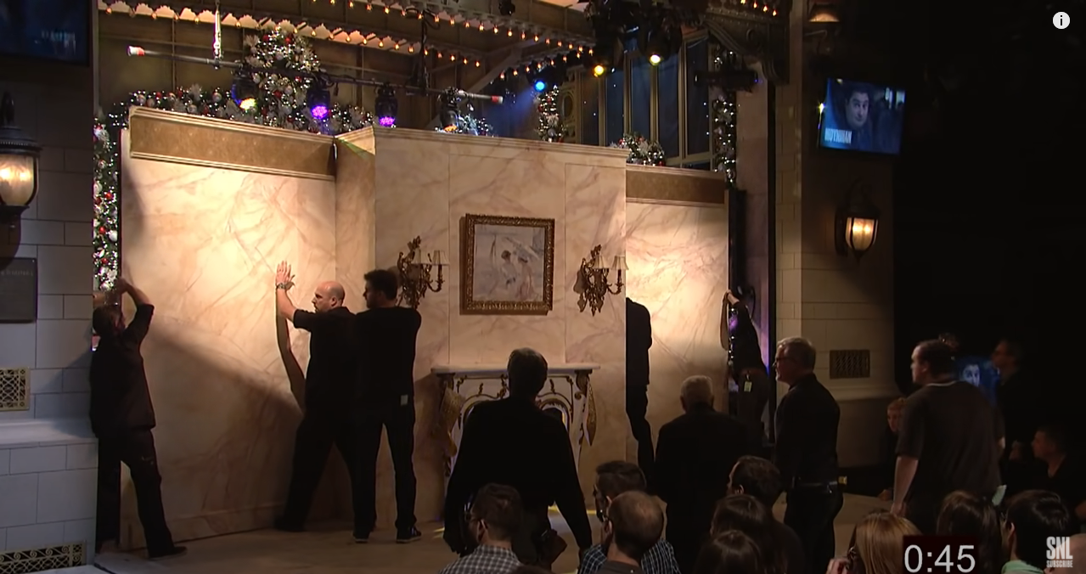
Notes:
Home work review
What stood out to you?
How many people we involved
How did they act?
How did the folks on intercom sound?
Would you want to work on that team?
Would you want to work on YOUR team team?

Slide 11
How many people are on your team?
Notes:
POLL-1
Technology will not solve every problem, but people can help
You don’t need the best tools/equipment, but you do need the best people

Slide 12
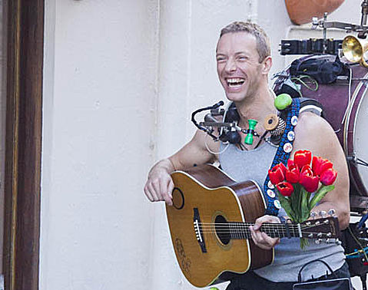
One person show?
Staffing
Space
Difficult to train
Team Retention
Notes:
Why is it tough to train?
Our time is busy during service
Tough to let go
You CAN’T do it on your own
You don’t need to be the only expert

Slide 13
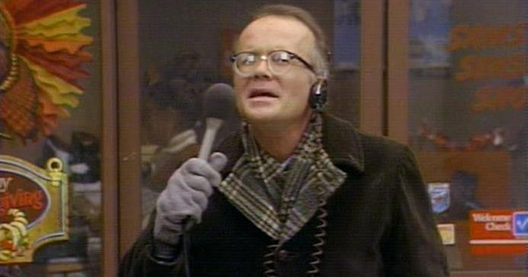
Notes:
WKRP Turkey Drop
Give it away!
Your knowledge
Fame etc

Slide 14
NOW
Notes:
Does COVID make it easier or harder to work on team?
Are you working on a weekly service now?
Time to train and develop?
Practice?
What are you doing NOW to train and recruit?

Slide 15
Team
Leading
Training
Recruiting
Organizing
Notes:
I don’t have all the answers
Feel free to comment any questions or ideas

Slide 16
What do people like to hear?
Their Name
Something to learn
Gratitude

Slide 17
Their Name
Do you know their name?
Something about them
Family
Occupation
Recreation
Dreams
The Customer Service Revolution: Overthrow Conventional Business, Inspire Employees, and Change the World, John R. Dijulius III

Slide 18
Something to learn
Grow
Feedback is the breakfast of champions
We all want to get better
Notes:
Better today than yesterday
Be confident
More in “training”

Slide 19
Gratitude
Always
Even if they screw up
Notes:
Must be sincere
Try to be specific
Thank you for…
-Being here
-Your time
-Attention to detail

Slide 20
What’s so tough about leading a tech team anyway?
Notes:
Timing? Stress of production
Last minute changes
Get through a week, forget it and move on.
Who holds you accountable? Easy to fall into traps.
It’s exhausting

Slide 21
Training
Curriculum
Ongoing Training
Create Experts
Notes:
Training Guide
Check list of knowledge
What would folks like follow up on?
Ongoing: Videos, learning
What do you use?

Slide 22
Feedback
Open: Hey, let’s talk about how that went today….
Listen: Allow them to talk
Suggest: I noticed…
Ask: What do you think/what should we do?
Agree on a solution
Ensure Understanding
Notes:
Suggest, no confrontational

Slide 23
Would YOU want to be on your tech team?
Notes:
Answer yes or no
Does it look fun?

Slide 24
Recruiting
Does it look like an enjoyable experience?
Where do you find your team members?
How do you get excitement?
Notes:
Youth Groups
New Families
New Member orientation
Email blast
Fun promo video

Slide 25
Organizing
When to show up
What to do
Feedback for next time
Notes:
When
-Google Calendar
-Planning Center
-Trello
What to do
-Checklists
Feedback
-Shared doc

Slide 26
What’s your biggest challenge?
Notes:
POLL 2

Slide 27
Your plan
My Biggest Challenge is:
I want to learn:
I want my team to:
Notes:
Break out groups
Home work ideas:
Evaluate training process

Slide 28
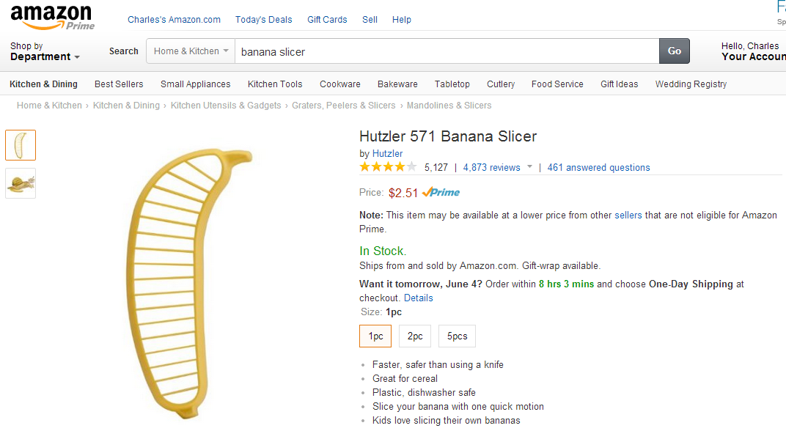

Slide 29
For decades I have been trying to come up with an ideal way to slice a banana. "Use a knife!" they say. Well...my parole officer won't allow me to be around knives.
What can I say about the 571B Banana Slicer that hasn't already been said about the wheel, penicillin, or the iPhone.... this is one of the greatest inventions of all time.
When a burglar came to my house I was tempted to reach for the butcher knife in the kitchen, but instead I grabbed the 571B banana slicer.
No more throwing bananas at the ceiling fan for me!
Notes:
Dawn

Slide 31
Next Week
Resources
Audio
Video
Lighting
Break Out Groups

Slide 32
Notes:
Closing Prayer
Jess Campbell?

