Slide 1

2020 STATISTICAL TRAINING
December 2020

Slide 2

2020 STATISTICAL REPORTS
Login Information:
Website: http://ezra.gcfa.org
Username: 3360_ _ _ _ (4-Digit Church Number)
Password: gnjchurch20
Due Date:
January 31, 2021 (2020 Tables Available on December 16, 2020)

Slide 3
2020 STATISTICAL REPORTS
Key Points:
You will be prompted to change your password at the first login. Please note the conference office does not have access to your new password.
Keep the username and password available for all users.
There have been no significate changes to the 2020 report.
  Suggestion: Before entering any data print your Church Report with prior year comparison.
Reports cannot be changed after they have been vetted and submitted to GCFA.

Slide 4
2020 STATISTICAL REPORTS
COVID-19 HIGHLIGHTS:
ON-LINE WORSHIP (report on line 7a)
  Report average number of unique viewers who access on-line worship services; see next page for additional information.
COVID RELATED EXPENSES (report on appropriate expense lines)
  Example: Report Cleaning supplies on line 47
  Example: Major equipment (such as video equipment) on line 49
PPP LOANS (report as follows)
  PPP Loan NOT yet forgiven by the bank, report on line 27
  PPP Loan that WAS forgiven by the bank, report on line 54c
  Expenses SHOULD NOT be netted against the loan.

Slide 5
2020 STATISTICAL REPORTS
A note about worship attendance:
This has been a difficult year connecting with and engaging people in ministry and in particular worship. The GNJ leadership is grateful for all you have done to adapt and change to the present circumstances. While it has been a difficult year, average worship attendance this year will always be seen through the lens of the pandemic.
Guidance/Instruction – we recognize recording worship attendance will be difficult this year, use the following as a guide.
Do the best you can in determining worship attendance
Counting those who came to worship at the church building, whether inside or outside are counted the same as in previous years (line 7).
For those who worshiped with you virtually, all of this attendance is to be included in the line for online worship (7a). Online and on location worship will be added together to arrive at your average worship attendance. Do not add those on line to the regular worship attendance line.
  Zoom – 1.7 people for each zoom connection. This is to account for people who have more than one person watching the same Zoom connection.
  Phone conference call – the exact number of people if you know or 1.3 people calling in to account for more than one person on the same phone connection.
  Facebook – This is very difficult because of how Facebook identifies views. There may be hundreds of views because people scroll through there Facebook feed. Best guestimate from your experience with your congregation and someone who may like or post a comment what you believe are the actual number of people who at least listen to the sermon.
  YouTube – The same as Facebook although YouTube views may be more reliable and also more that one person may be watching from home.
We recognize that this will be a difficult year for identifying average worship. We ask that you do your best. If you average attendance in 2020 is more than 10% higher than 2019 we will contact you to learn how you arrived at your worship attendance average. If you feel that you are not able to gage actual worship attendance, you may use your 2019 average for 2020. Thank you for doing your best to determine average worship attendance.

Slide 6
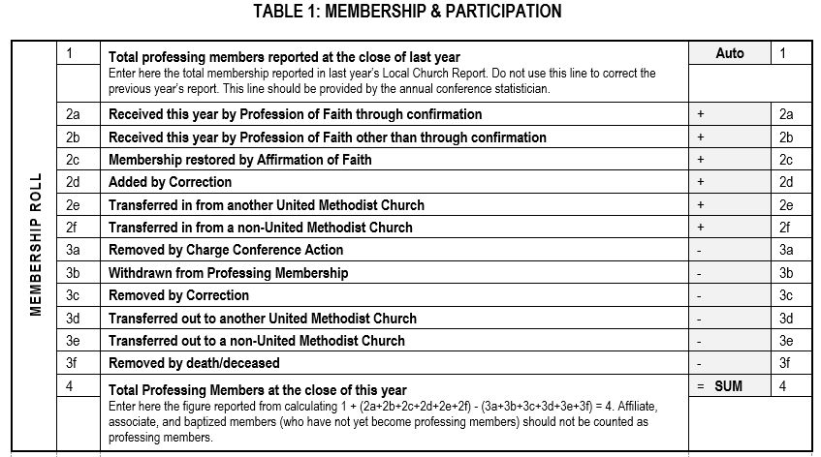
Table 1: Membership & Participation
Line 1 auto populates based on last year’s ending total.

Slide 7
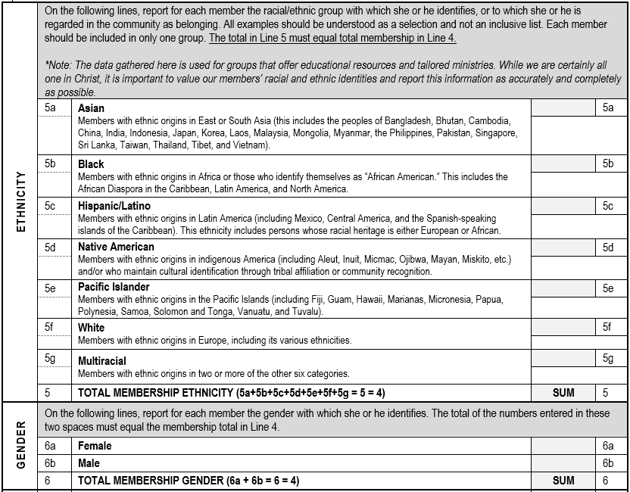
Table 1: Membership & Participation
The Total in Line 5 & 6 must equal total membership in Line 4.

Slide 8
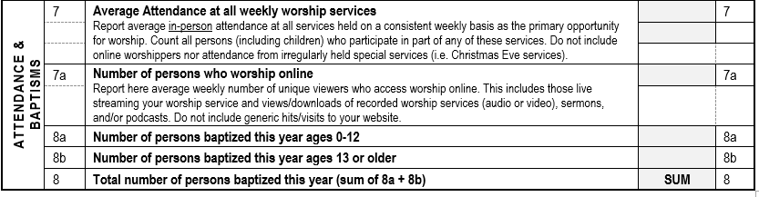
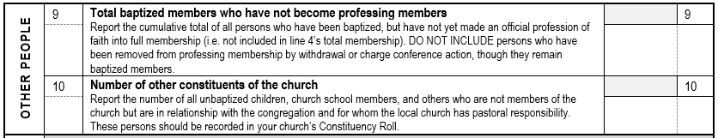
Table 1: Membership & Participation

Slide 9
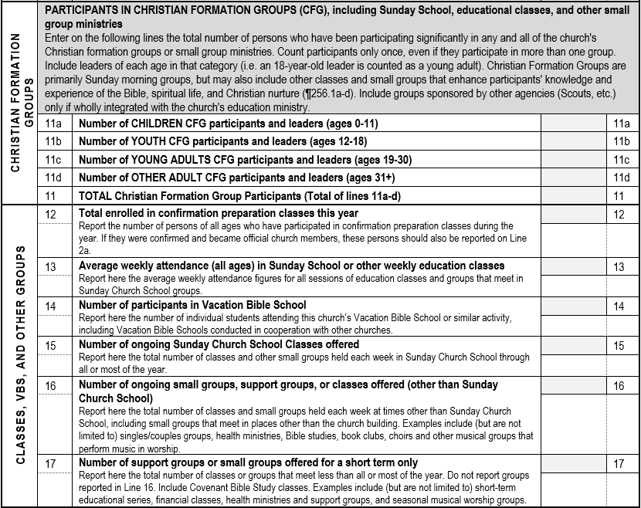
Table 1: Membership & Participation
Count all those who have participated in any church groups.

Slide 10
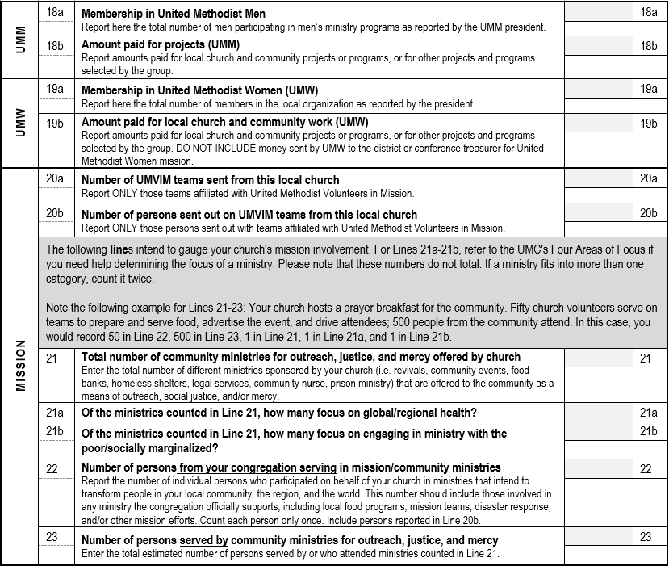
Table 1: Membership & Participation
Example
This Mission Section has been reorganized to better collect how churches do ministry. And if your ministry fits in both categories, count it in twice.

Slide 11
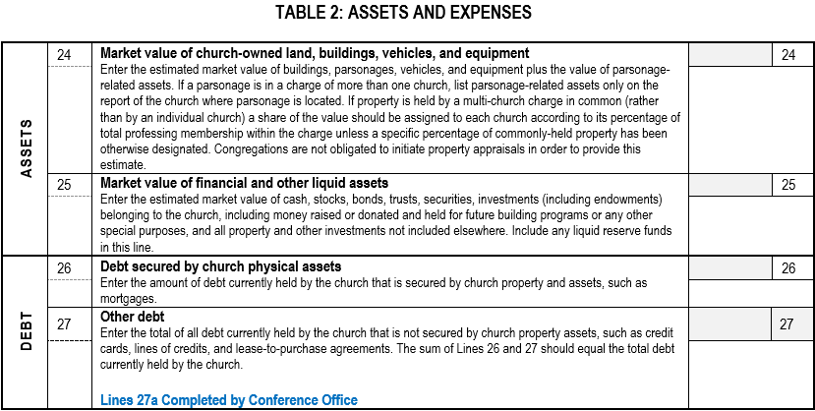
Table 2: Assets & Expenses

Slide 12
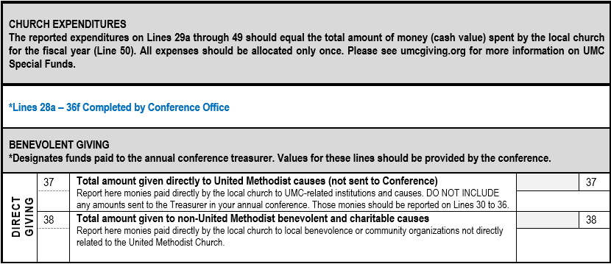
Table 2: Assets & Expenses
Shared Ministries and Special Sunday amounts sent to the Conference Office will be populated on their appropriate lines by the Conference Office.

Slide 13
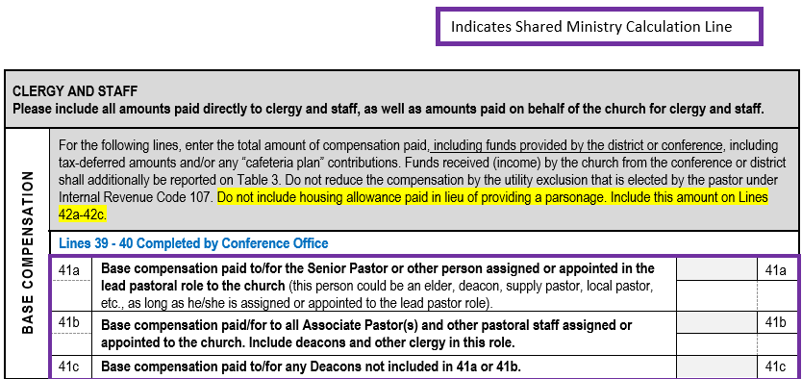
Table 2: Assets & Expenses
Base Compensation section for clergy has been reorganized for better clarification.
NOTE: Senior/Lead pastor compensation includes any clergy status in the lead/primary role. If a church has a supply pastor, their salary including any applicable FICA taxes should be included on that line.

Slide 14
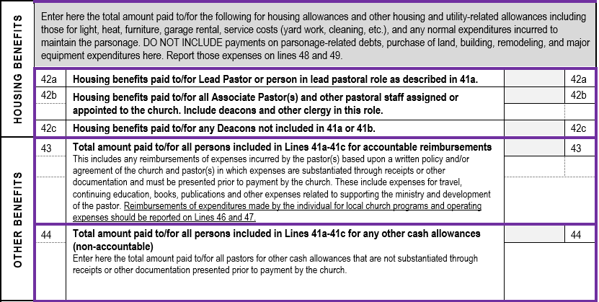
Table 2: Assets & Expenses

Slide 15
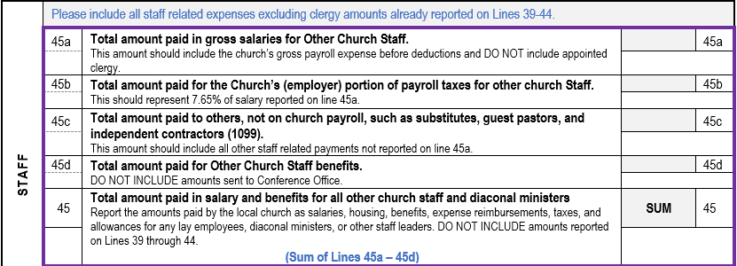
Table 2: Assets & Expenses
Line 45a: Should include all employees who receive a W-2 at year- end excluding clergy.
Line 45b: Should include the employer FICA match paid for the salaries reported on line 45a.
Line 45c: Should include all other payments for services.
Line 45d: Should include any additional benefits paid for on behalf of all other church staff not sent to the Conference.

Slide 16
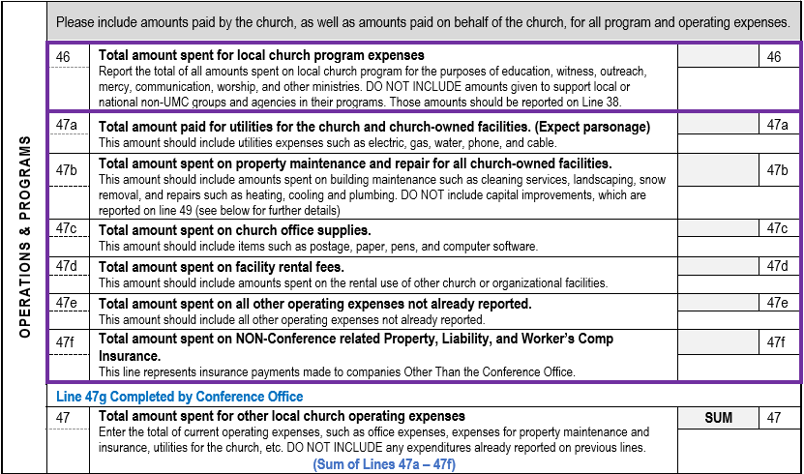
Table 2: Assets & Expenses

Slide 17
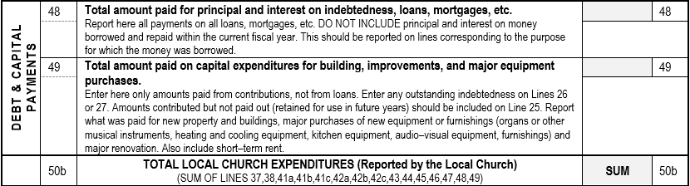
Table 2: Assets & Expenses
Line 49: Should include any building improvements that will extend the life of an asset for more than a year. (i.e. painting a room or remodeling a kitchen) This line can also include major equipment purchases (i.e new water heater).

Slide 18
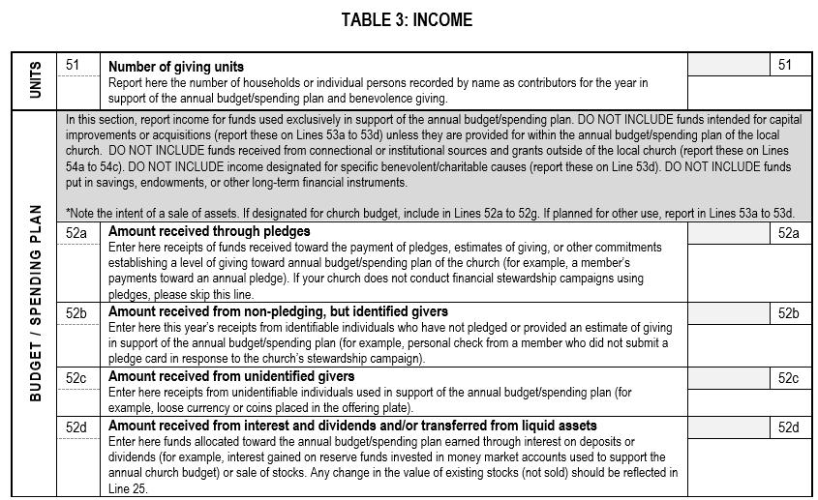
Table 3: Income

Slide 19
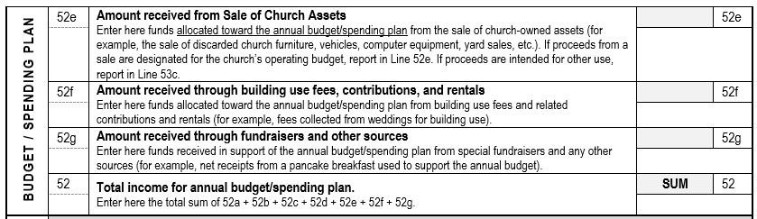
Table 3: Income

Slide 20
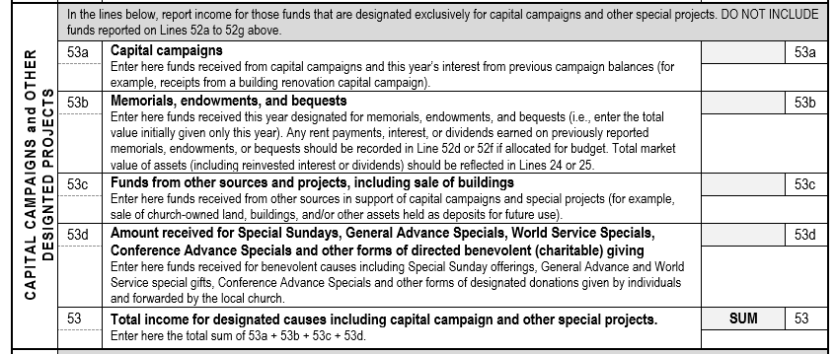
Table 3: Income
Include Mission Funds collected here.

Slide 21
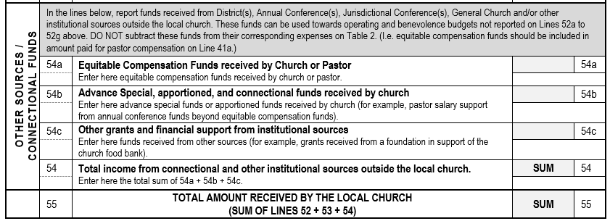
Table 3: Income

Slide 22
Netting Concept
The Netting Concept allows you to net expenses with related income for situations such as church fundraisers, church run thrift stores and daycares, or building rentals.
Example
Netting allows for more consistent and accurate Shared Ministry Allocation for all churches.

Slide 23
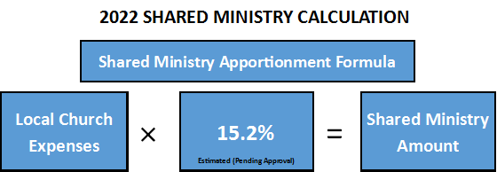
Shared Ministry Formula
2020 Statistical Reports will be used in the 2022 Shared Ministry Calculation.

Slide 24
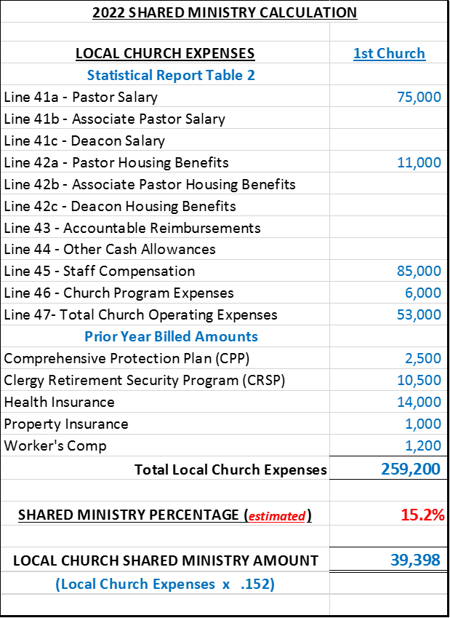
Shared Ministry Formula
Calculation Example
Increases to any of these expense lines will result in an increase in a Church’s Shared Ministry Allocation.

Slide 25
2020 STATISTICAL REPORTS
If you have any questions please email:
James Mulligan, Accounting-Database Administrator
jmulligan@gnjumc.org
Danielle Andrews, Accounting Manager
dandrews@gnjumc.org
Due Date: January 31, 2021
(2020 Tables Available on December 16, 2020)

