Slide 2
Carlisle Industrial Indian School was started in 1879 by Richard Henry Pratt. There were almost 10,000 kids, all from different tribes Sioux,Shawnee,Cherokee, Pawnee,Omaha,Navajo,Seneca,and Cheyenne. Richard would mix up the tribes so that the kids couldn’t speak their language to each other. .Also they made the boys cut their long hair so they could be like the “white men”.They made them wear uniforms and if they were caught with their regalias on they were taken then and beaten and put in a dark closet.For punishment they would put lye soap in their mouths for speaking their language. They had to share everything from pencils to books to bath water. None of the kids got to see their parents until they graduated and some of them ended up dying at the school.There were 186 graves at Carlisle Industrial School. When I went for the first time I had fun learning about a place I've never heard of before, everything was so interesting about how the kids,

Slide 3
built the FarmHouse that people are living in now. Also the sad part about my first trip as that they wanted to tear down the FarmHouse but Native Americans wouldn’t let them. The cool thing about Carlisle is how pretty the FarmHouse was. When I first came to Carlisle and visited the cemetery I was sad and I cried because of how many kids there didn’t even have birth dates or names. But it was special to put the spirit ponies and chocolate on their graves the second time I went. Carlisle was open for 39 years before closing,1879-1918.

Slide 4
Language
Shawnee
Dog- Wiiss Squirrel- Hanikwa
Raccoon- Hahthapeti Cat- Poosiitha
Horse- M’seewe Turtle- Ka’kile
Fish- Namee’tha Wolf- M’wewa
Chicken- Peleewa Cow- M’thoothwa
Rabbit- Petakine’thi Squirrel- Hanikwa
Raccoon- Hahthapeti
These and other words were not allowed at Carlisle.

Slide 5
Lenape
Beans- Malaxkwsita Sassafras tea- Winakw
Fry Bread- Salapon
Nanticoke- Wenetko
Moccasin- Lenhaksen
Medicine- Bisun
Wolf- Teme
Flower- Otaes
Insect- Muxwes
Mouse- Pukwes
Bald Eagle- Opalaniye
Sioux
Welcome- Tanyan yahi
Good Luck- Tokhi waniphikani
Where are you from- Tuktenitanhanhe
Good night- Hanhepi waste
I don’t understand- Owakahnige sni
Do you speak- Iya woyalaka he
Thank you- Philamayaye
Fire- Pheta!
Good morning- Hinhanni waste
My name is..- Emaciyapi he!

Slide 6
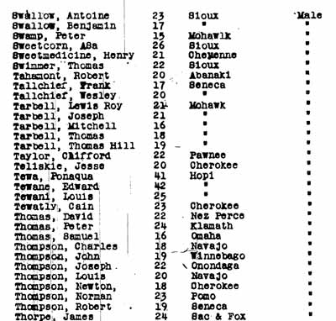
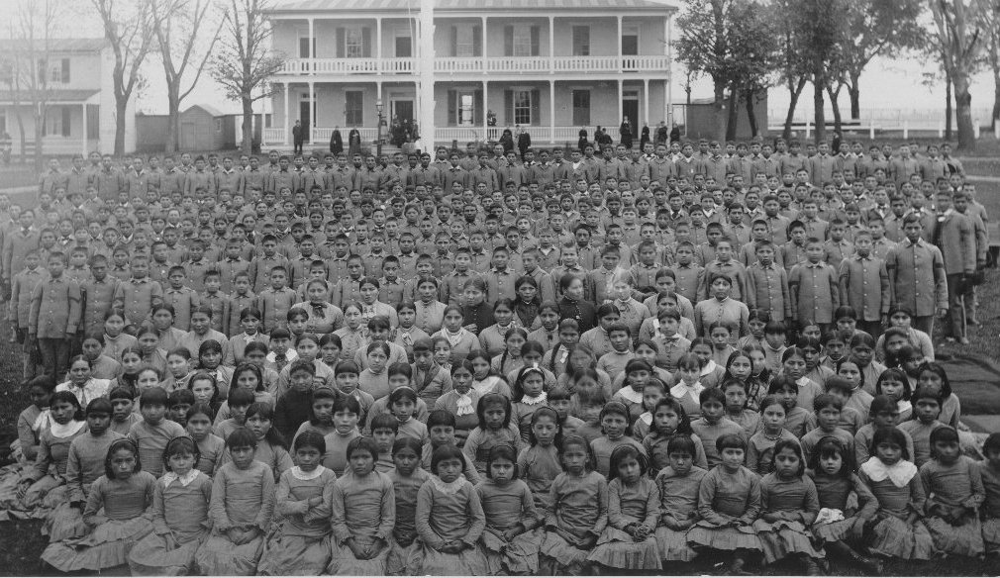
Students

Slide 7
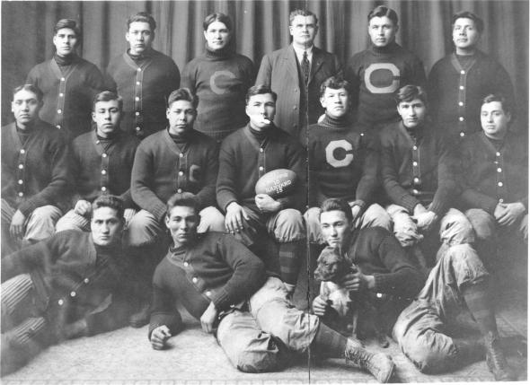
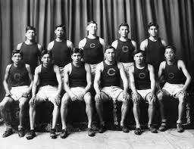
carlisle sports teams

Slide 8
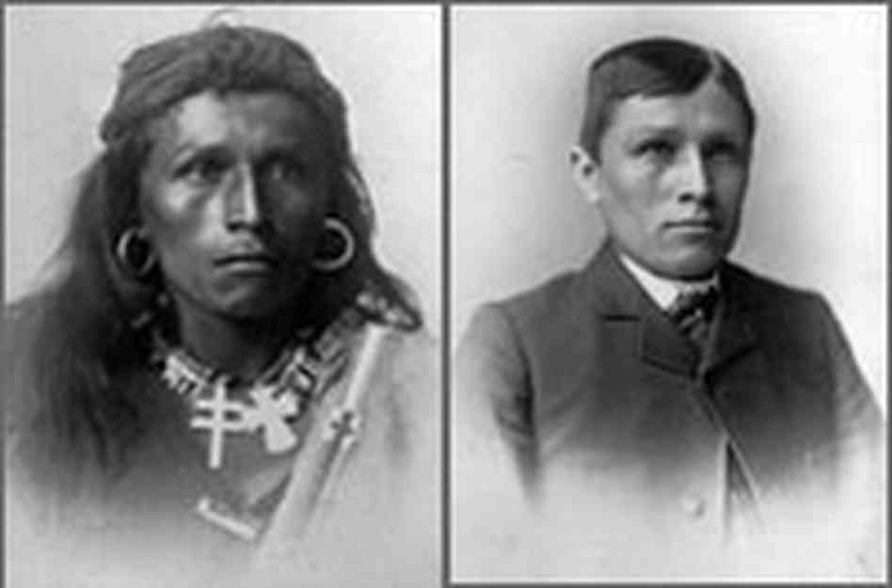
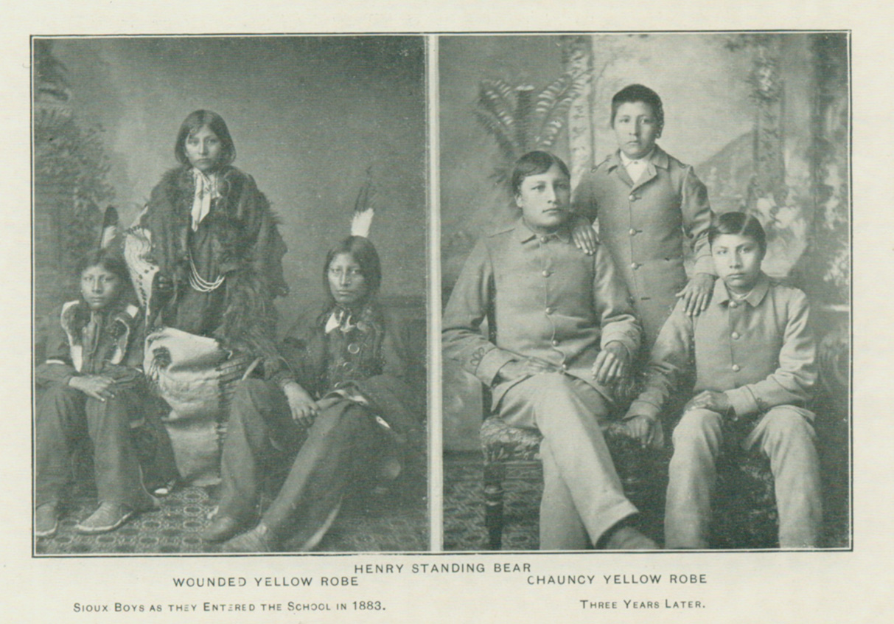
Transformations

Slide 9
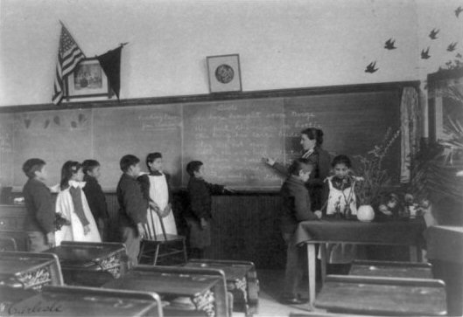
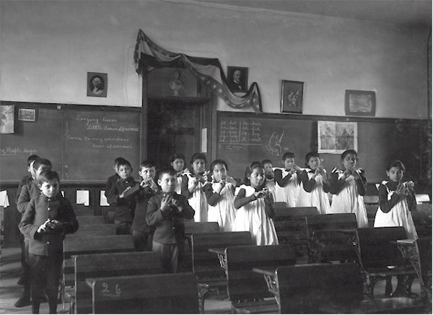
Classrooms

Slide 10
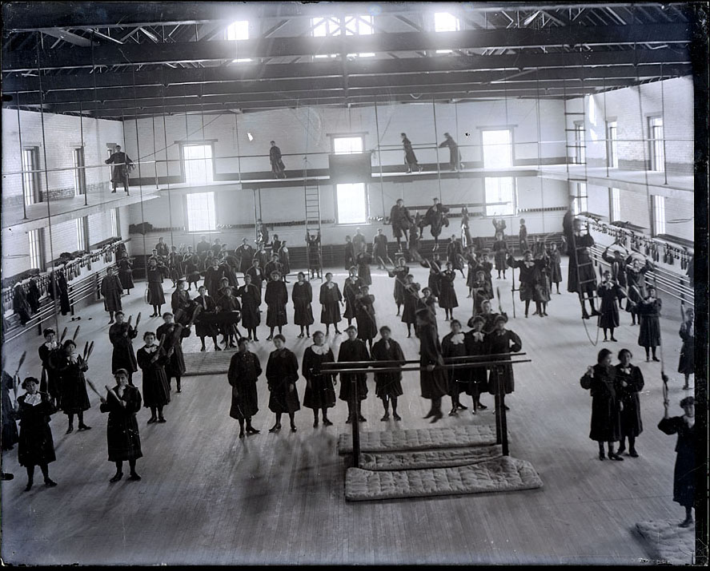
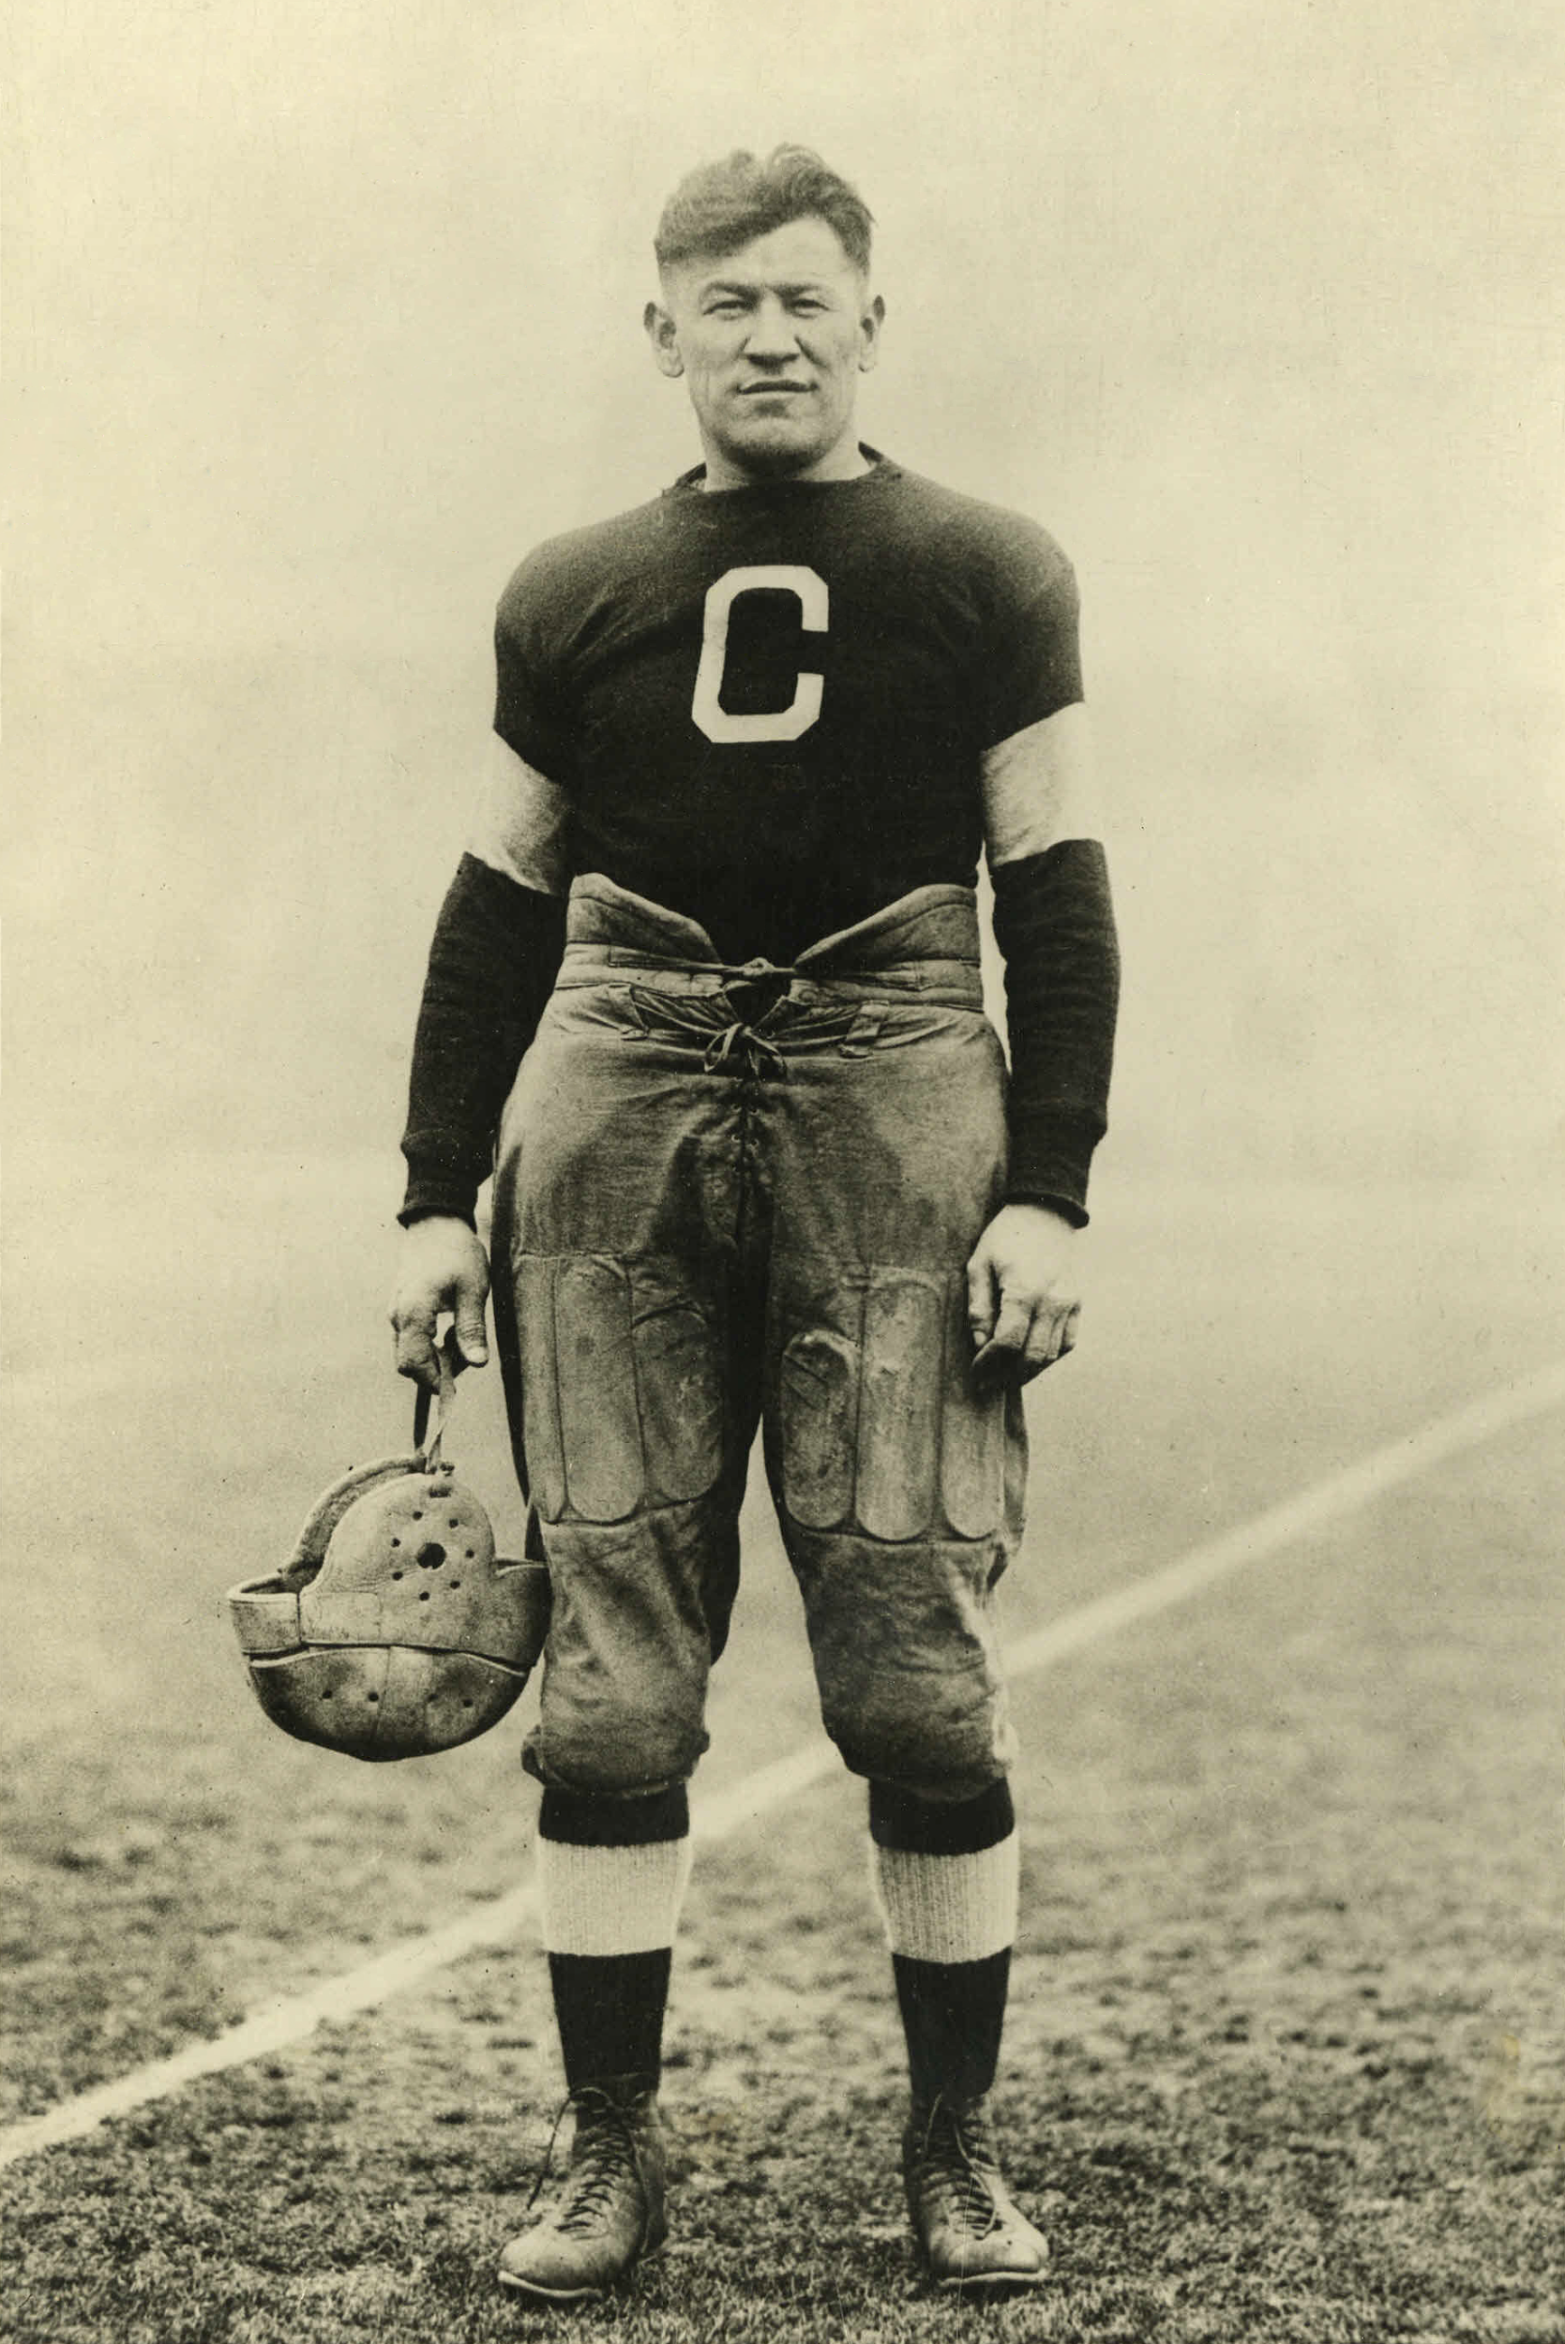
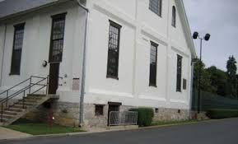
Jim Thorpe
Thorpe hall
Notes:
Jim Thorpe

Slide 11
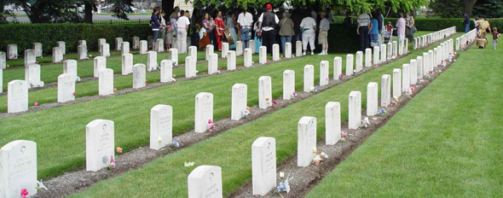
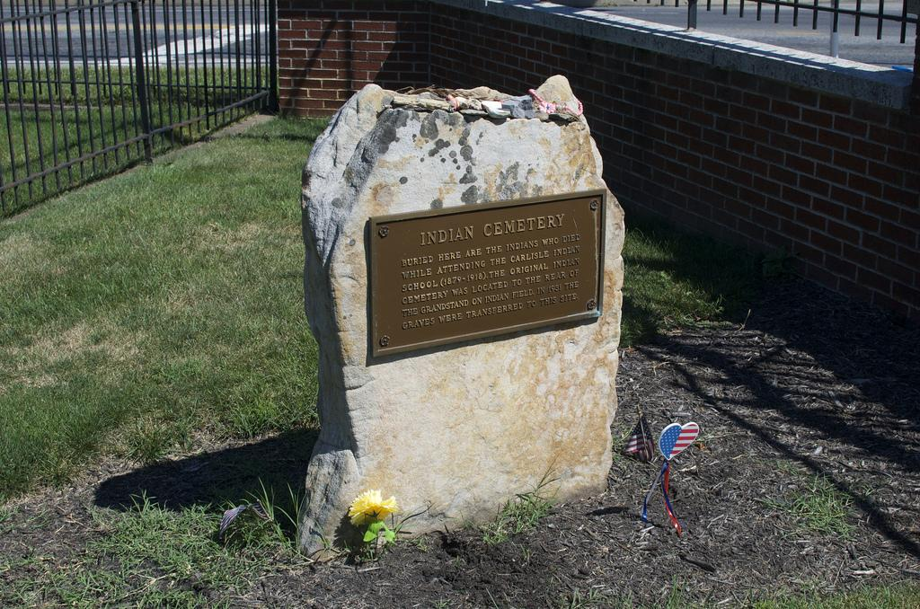
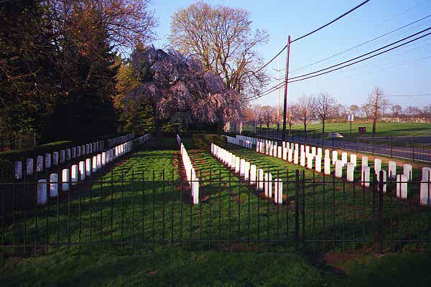
graves

Slide 12
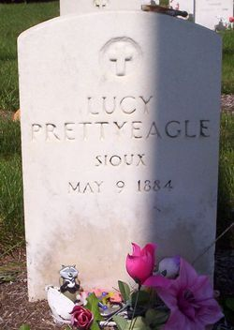
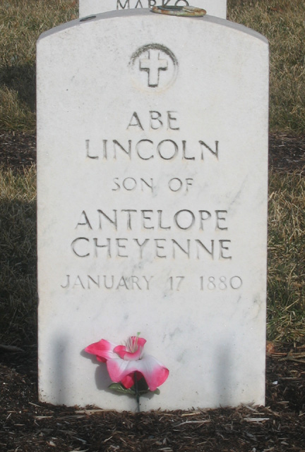
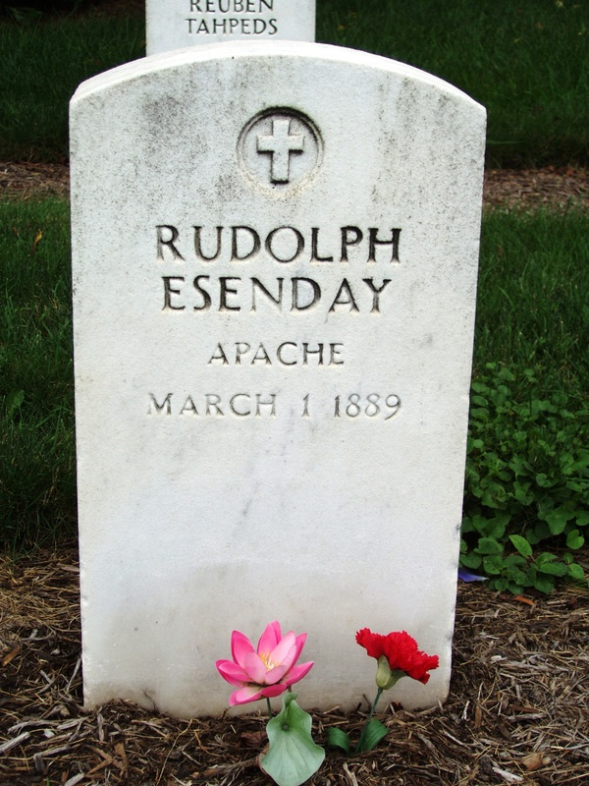

Slide 13
Notes:
The school believed they should take Native American children at an early age to begin assimilation.
The school hired a barber to cut the Native American children’s hair.
The Native Americans were required to wear a scratchy flannel uniform.
Next bullet is OK.
vocational trade classes.

Slide 14
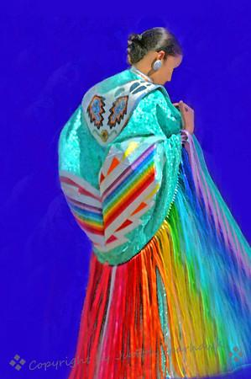
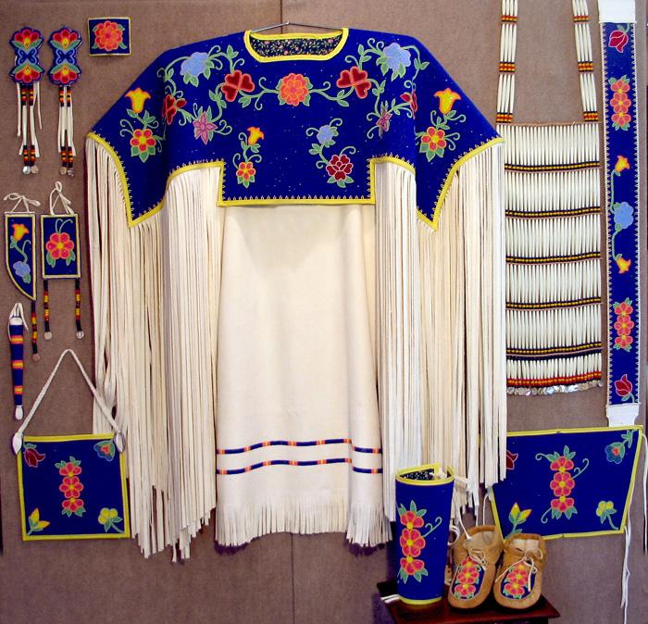
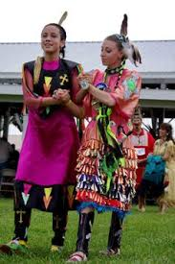

Slide 15
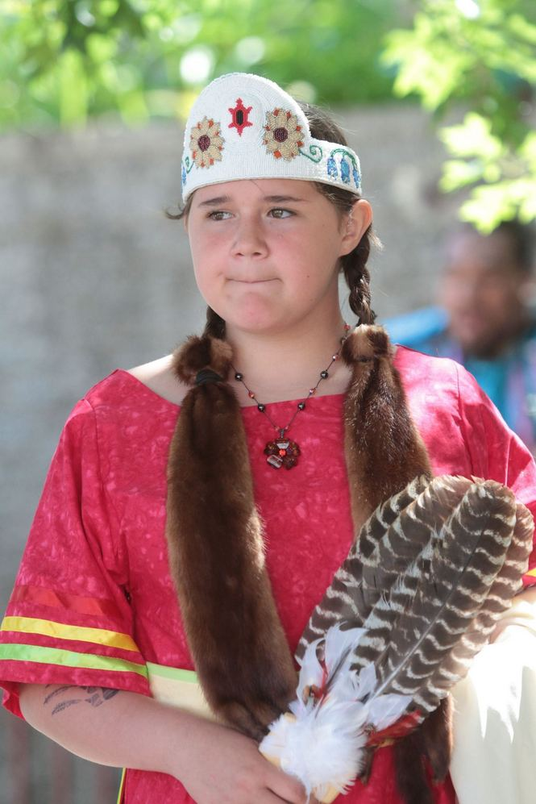
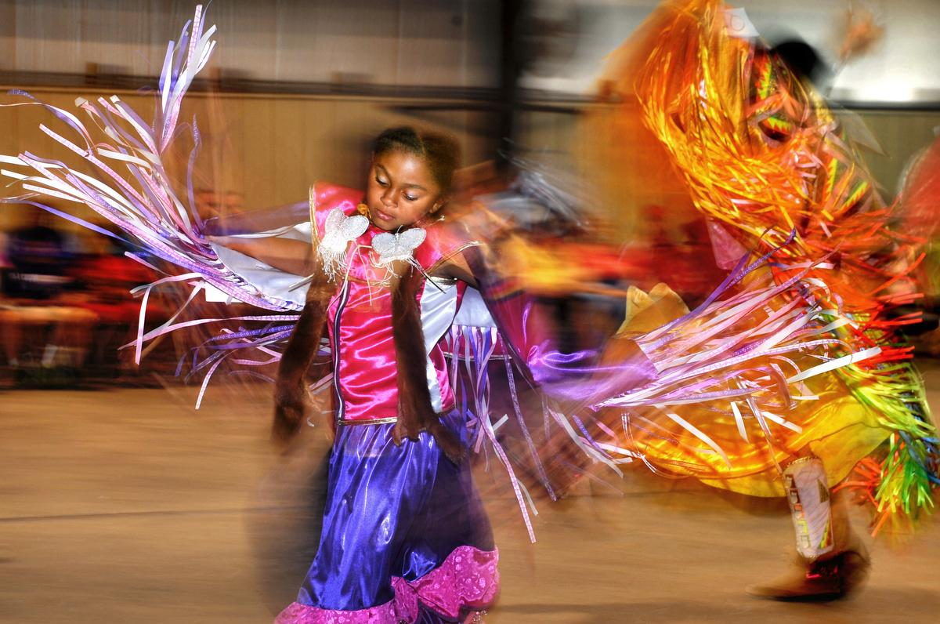

Slide 16
Thanks for watching my powerpoint

Slide 17
By: Allie “Wild Red Rose” Mosley

