Slide 1
Small Church Worship
A guide by Gina Yeske

Slide 2
Name three things:
that your church is known for
that you value
keeps you coming to back

Slide 3
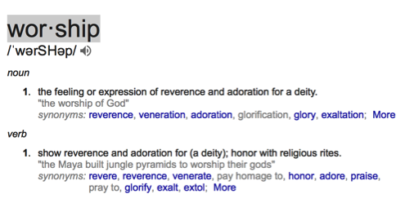
Define Worship

Slide 5
Leader: What do you bring before the Lord this day?
People: We bring our hopes and our dreams to the Lord
Leader: What do you seek?
People: We seek peace for our weary souls.
Leader: You will find it in this place, for this is the house of the Lord.
People: Open our hearts and our spirits, O Lord, to hear your words of comfort and peace. AMEN.

Slide 6
OPENING PRAYER
Lord, we have come to you this day bringing all that we have, our lives, our hopes and dreams, our fears and sorrows. We place these before you in faith and hope, knowing that no matter what has happened you are with us and blessing us. Open our hearts to receive your words and your spirit. Open our lives to the wondrous possibilities for service and joy that you offer to us. Ease our minds and spirits that we may hear the words of encouragement and peace this day. AMEN.

Slide 7
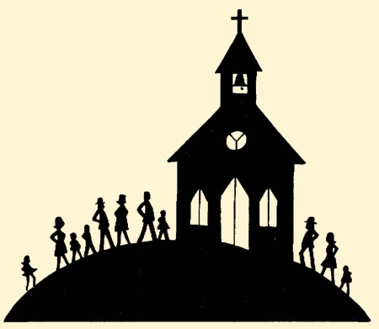
What is it that you bring to worship each Sunday?

Slide 8
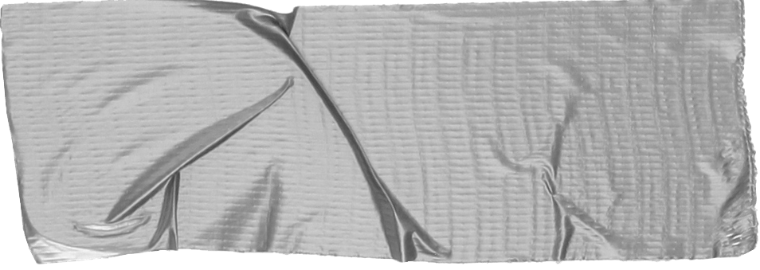
Discussion #1
In a small group discuss the following:
What does worship mean to you?

Slide 9
Name your setting:
Is the congregation new and growing?
Is it adventurous and still forming its traditions?
Is the congregation older?
How open is the congregation to trying new things?
Who lives in the surrounding area?
How does the church define community?

Slide 10
Discussion #2
In a small group discuss the following:
How does your sanctuary tell the story of your current congregation?
Are there items in our sanctuaries that are no longer express who we are?

Slide 11
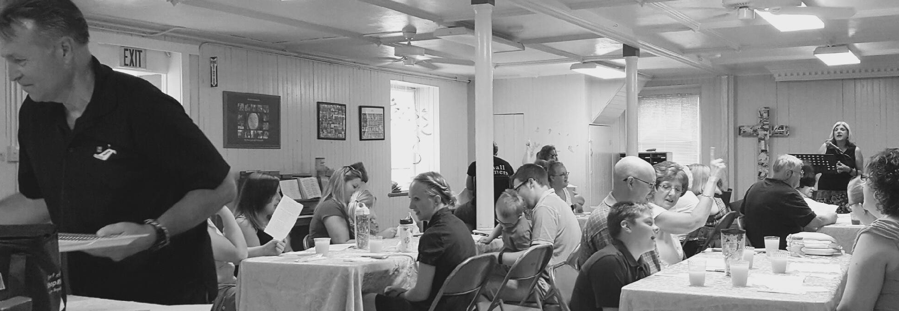
Worship in a small church needs to be participatory.

Slide 12
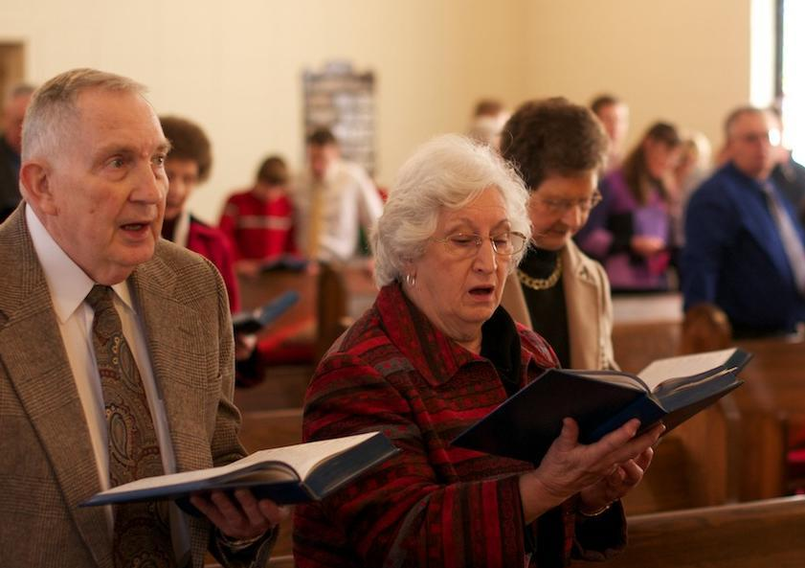
By praise we acknowledge God’s greatness
By worship we acknowledge God’s holiness
By thanksgiving we acknowledge God’s goodness

Slide 13
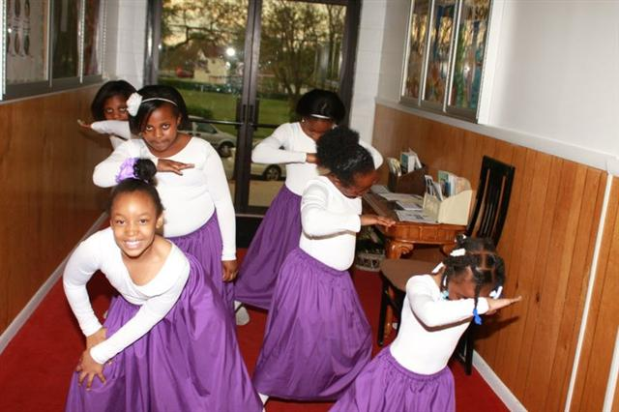
"Praise, prepares us for worship"

Slide 14
Prayer of Confession
Reader 1: I don't have much to offer.
Reader 2: I don't have much that I can do.
Reader 3: I don't have anything that's worth much to bring to the Lord.
Reader 1: I don't have many skills that are worth much.
Reader 2: I don't have the great wisdom that will change much.
Reader 3: I don't have the knowledge that will help things to move forward.
Reader 1: My prayers are weak.
Reader 2: My words are inadequate.
Reader 3: My fears overcome my spirit and I can't pray easily

Slide 16
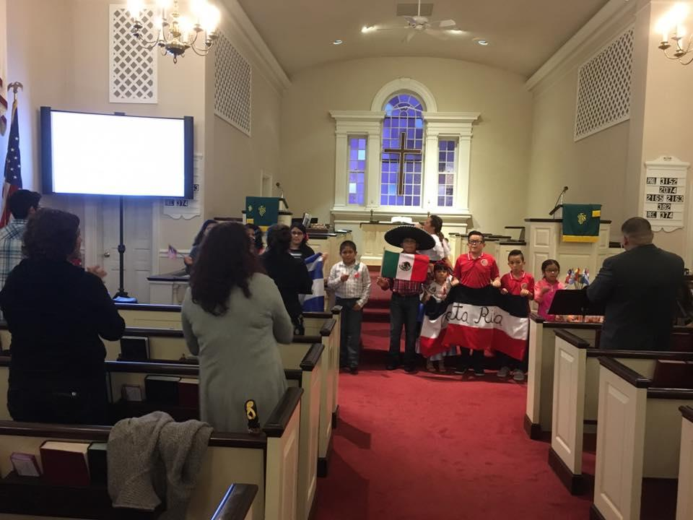
HOW TO ESTABLISH A WORSHIP CULTURE
Liturgy is a word from the Greek that means “the work of the people.” Therefore you as the people are the leaders in worship.

Slide 17
Discussion #3
In a small group discuss the following:
How do you prepare for worship each Sunday?
How have you found ways to connect to God in worship during the week?
What keeps you from worshipping?
Each of you has a role in worship, what is yours?

Slide 18
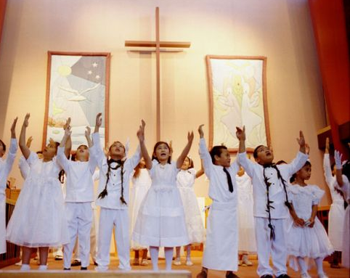
Thanksgiving
God has given to each one of us such blessings and talents. With joy we bring these gifts to God.

Slide 19
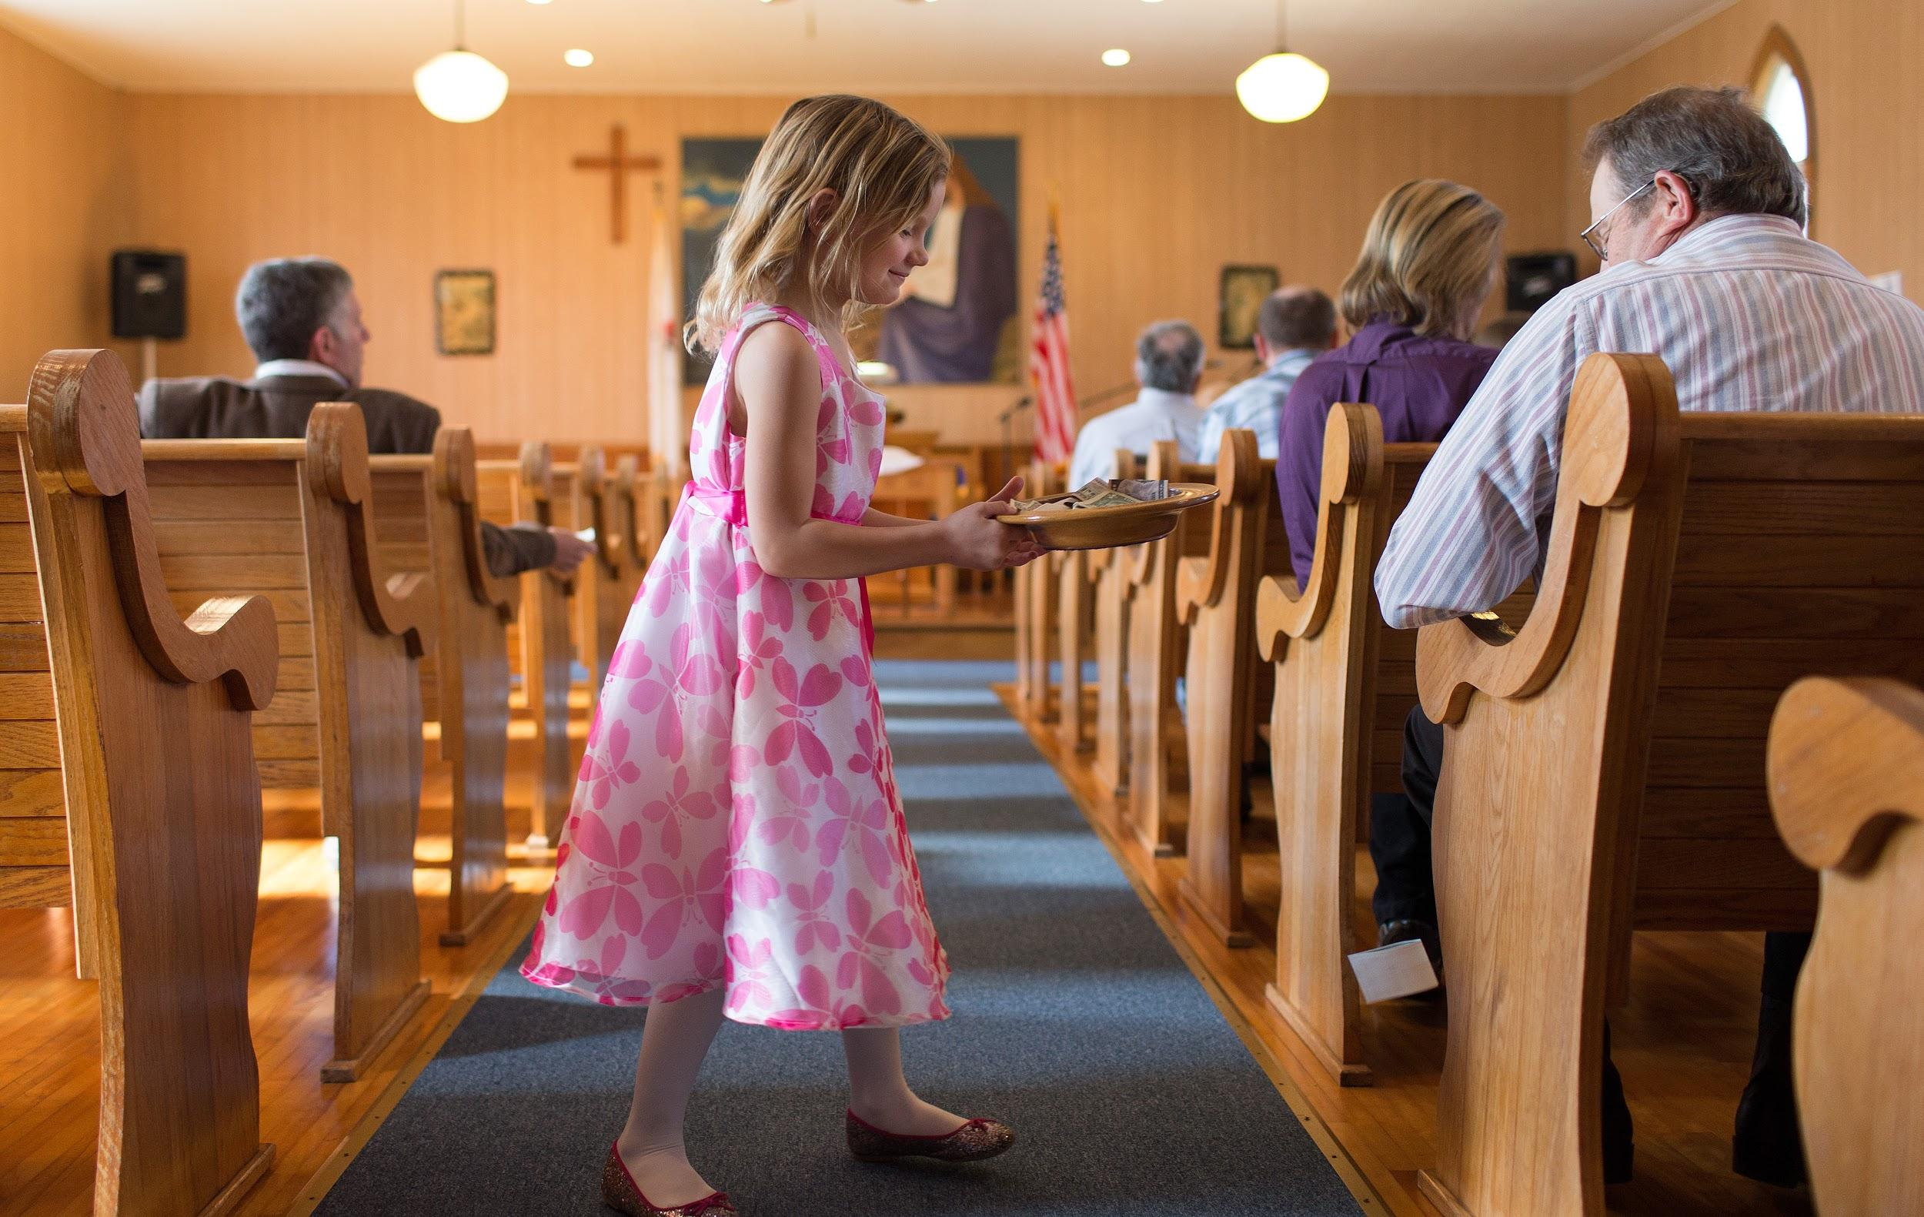
Offering
Tell the story

Slide 20
Discussion #4
In a small group discuss the following:
How do you tell the story of what giving gifts means to you as a congregation?
Do you inspire generosity or project scarcity?

Slide 21
What does it mean to be a strong small church?

Slide 22
Discussion #5
In a small group discuss the following:
What does it mean to be a strong small church?

Slide 23
Look back at your list of three things you wrote down as we started.
How do you share these values with others?
Is there any you would change?

Slide 25
One: Go! Go from this place and be witnesses to the resurrected Christ.
Go! Go to kneel and wash the feet of those with whom you serve.
Go! Go to bring comfort to those who have found no comfort.
Go! Go to share the everlasting love of Christ to all of those who cross your path.
Go! And carry with you the Holy Spirit who empowered you at your baptism, the love of Christ as found in bread and wine made new, and the strength and wisdom of the Creator God.
Go! And make disciples for the transformation of the world.
All: Alleluia and Amen!

Slide 26
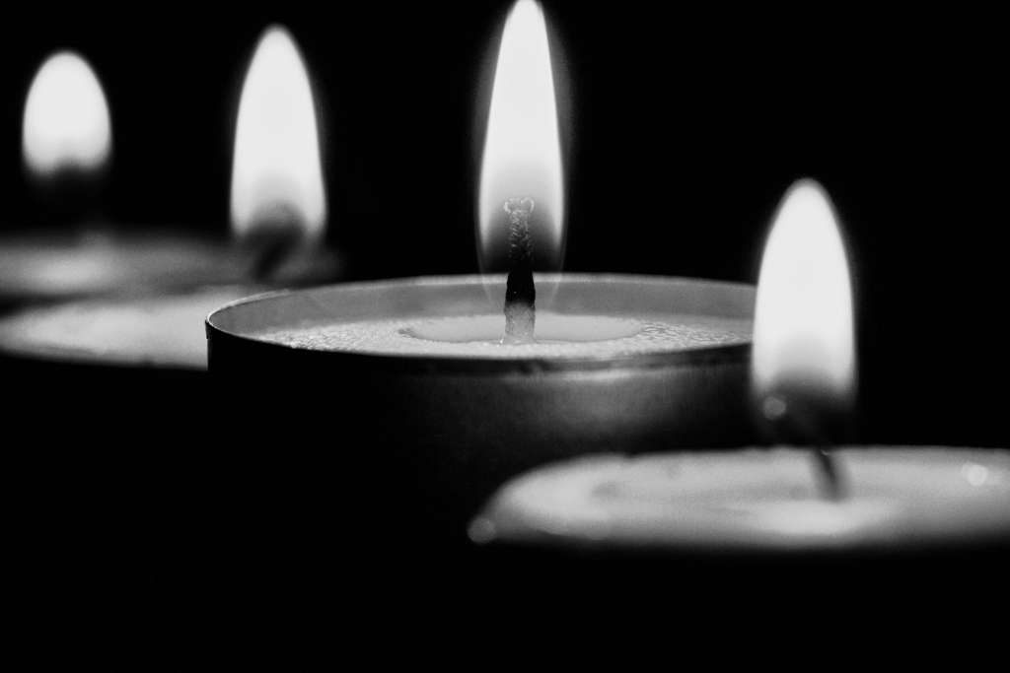
Build on your story, your gifts, and the community of your small congregation and enjoy wonderful worship!

