Slide 1
Singing voices and choir in worship
Pastor Lan Wilson
CrossPoint Church, Harrisburg, PA

Slide 2
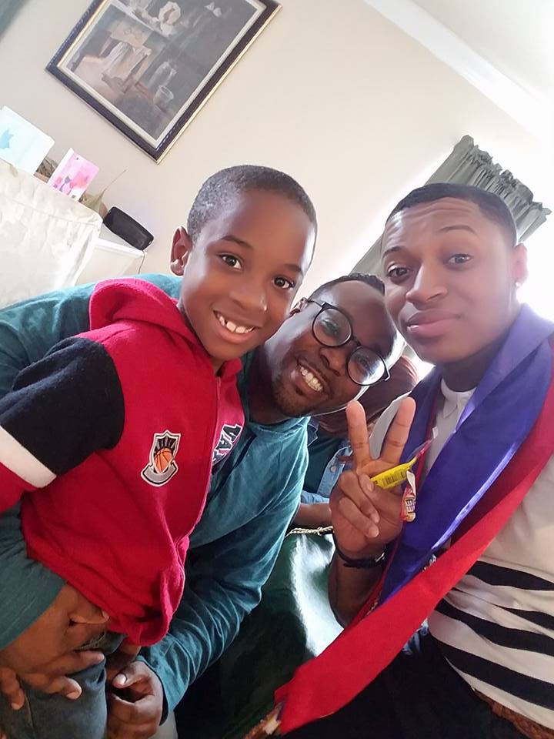
15 seconds of fame…yeah right
Started playing congregational hymns at granddaddy’s church at 6
Playing at mom and dad’s home church at 10
Music minister at dad’s church at 12, district conference music minister at 12
Harambee (gospel) choir at high school at 13
Proud dad of two of the coolest dudes on the planet
Successor of the dude of dudes – Eric “The” Drew
Get to hang out in the worship pastor’s office at CrossPoint (shhh…don’t tell)

Slide 3
The Goal
So my buddy Haroon says to me, “Ok so this Jesus you believe in, died on hill and came back to life and had all of these guys (disciples) that followed him around right?
Me: Yeah, what’s up?
Haroon: So where does all the singing and music come from?
Me: Dude…let me ‘xplain!
-To get you confident that people enjoy singing (whether they’re good at it or not) and you have what it takes to get them to
- To give you insight on the impact of participational (I made this word up) singing in worship and ways to make it fun and interesting

Slide 4
Why is this a challenge?

Slide 5
Get in their heads
Try playing a recorded version of new stuff before and after services a couple weeks ahead a couple weeks ahead of time
Make sure the people you have on stage (choir, worship team, etc.) is comfortable enough with new music before you present it in worship.
Babies know when people are nervous holding them, and worshippers know when the one steering the ship is getting shaky at the wheel...
If you’re even the list bit techy or super techy:
Try creating a streaming account (like Spotify) that people can follow.

Slide 6
Set the Atmosphere & consider your flow
Ok seriously….let’s talk about the problems with the flow in your worship service for just a minute.
Everything doesn’t always fit!
Everything doesn’t always fit!
Stop trying to just complete your checklist when you put your worship service together
Consider the mood everything placed in worship.
Consider how inviting everything is for people to join in!
Make is possible for them to participate - worship folders, screens, large print, etc. and if you don’t have any of that…then still keep them involved. Both the Europeans and the Africans (and I’m Just using those two because I’m black-irish) have been lining out hymns and doing call and response style worship for years and years and years!

Slide 7
Make it possible for them to join in
What are some ways we can do this?

Slide 8
Consider the crowd
Consider the fact that just because they’re older doesn’t mean they like traditional music and young doesn’t mean they like contemporary music. Music is the song of the heart.
Be inclusive of the cultures represented in your culture….but don’t be EXclusive. Be open to bringing in other cultural influences into your worship services.
Not just cultures, but be open to different styles.
Good Friday we did Lifeway’s Power of the Cross which was a cantata written for choir and orchestra. We also added handbell choir and pipe organ to it. Involved the congregation in on the arrangement of When I Survey. Added a couple congregational hymns and it closed with a contemporary worship tune and then a celtic hymn).
What are some of the styles you incorporate in your service?

Slide 9
Switch things up a little
“new” can sound traditional and “old” can sound contemporary
Get creative – You’d be surprised how little things like changing chords in harmony can give a song new life, or how changing the tempo of sound can give new life to things
Love for writers that do different harmony styles and tonality.
How else can we switch things up?
https://www.youtube.com/watch?v=eAPGs933Wps
Even Me
William Bradbury
Arr. Patrick Lundy
Notes:
Use The Only Name and Blessed Assurance as examples for tempo change and rhythm adjustments.
Play Even Me video

Slide 10
Don’t believe the rumor..all 7/11’s ain’t bad!
Powerful words and emotions are amplified in repetition! If you don’t believe me, check out Psalm 136!
Notes:
Give examples like it Is Well, and For He that is Mighty
Heavy content is fine but make sure it’s placed appropriately. Typically, if I do something heavy content and a lot of lyrics on a Sunday morning: 1)The words are always on the screen and/or printed in the worship folder. 2) or it’s the pre-sermonic song that ties directly with the LifeTalk/sermon. 3) And sometimes we just save that heavy stuff for concerts, (requiems on Sunday mornings aren’t always the greatest idea…impressive but not inclusive)

Slide 11
requiems on Sunday mornings aren’t always the greatest idea…impressive but not inclusive
If your new tune is wordy and it’s during congregational singing, try teaching the congregation the chorus first quickly so they don’t feel left out. (This goes for hymns too!)
Heavy content is fine but make sure it’s placed appropriately. Typically, if I do something heavy content and a lot of lyrics on a Sunday morning: 1)The words are always on the screen and/or printed in the worship folder. 2) or it’s the pre-sermonic song that ties directly with the LifeTalk/sermon. 3) And sometimes we just save that heavy stuff for concerts.

Slide 12
So what will you change???

Slide 13
Suggested Music Sites
www.praisecharts.com – for orchestrations, lead sheets, piano/vocal scores, tracks, and chord charts
www.ntimemusic.com – gospel music arrangements
http://www.lifeway.com/Article/Red-Box-worship-music - for the monthly RedBox of music

