Slide 1



Slide 2
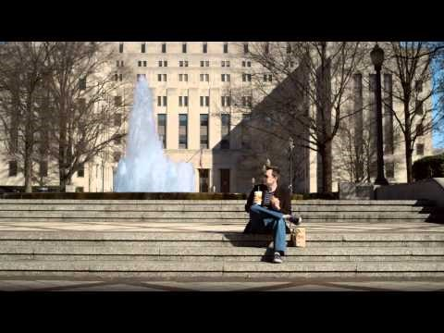
“YOU CAN’T DO IT BY YOURSELF”
HIGHLANDS CHURCH
SMALL GROUPS
PROMOTIONAL VIDEO

Slide 3
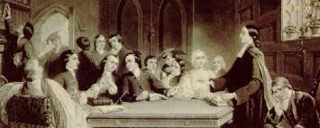

JOHN WESLEY AND SMALL GROUPS
“Holy Club”
Lay-driven Small Group Ministries
Vital

Slide 4
Hebrews 10:24-26 (CEB)
²⁴ And let us consider each other carefully for the purpose of sparking love and good deeds. ²⁵ Don’t stop meeting together with other believers, which some people have gotten into the habit of doing. Instead, encourage each other, especially as you see the day drawing near.

Slide 5
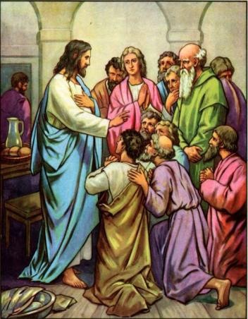
JESUS AND SMALL GROUPS
Chose and worked closely with 12 Disciples
Sent out teams of 2
The Raising of Lazarus
Notes:
.

Slide 6
From the Book of Discipline of the United Methodist Church:
¶256.1
In each local church there shall be a variety of small group ministries, including the church school, for supporting the formation of Christian disciples focused on the transformation of the world, These small groups make concentrate on teaching and learning, fellowship, support, community ministries, and accountability. Members of faith, The United Methodist Church and the societal context in which the church finds itself. In addition, small groups, including the church school, shall provide people with opportunities, spiritual discernment, Bible study, theological reflection, prayer, community building, service with the poor and marginalized, and advocacy for peace and justice....

Slide 7
GNJUMC STRATEGIC MINISTRY PLAN
“Vital congregations evidence their vitality through
the number of disciples in small groups for learning
and faith formation.”
“To be achieved by 2018 – increase the percentage
of worshipers in small groups from 43% to 75%.”

Slide 8
Small Groups Ministry Bring Vitality Because:
It Deepens Relationships with People and God
  Builds Christian Community
  Builds Support Networks

Slide 9
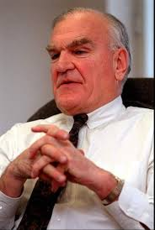
“Americans are among the loneliest people in the world.”
- George Gallup, Jr

Slide 10
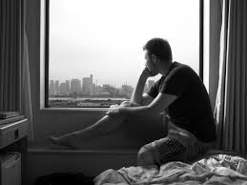
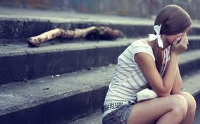
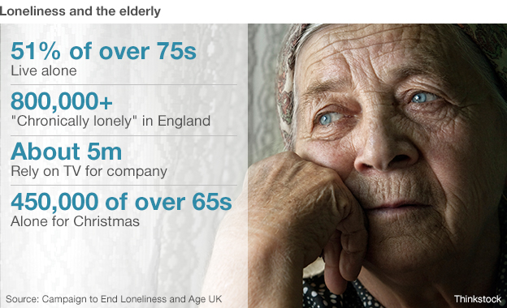
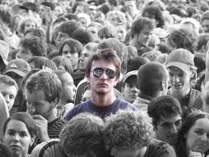
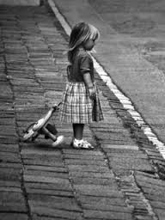

Slide 11

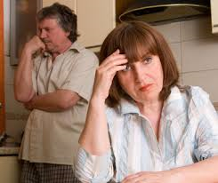

Slide 12
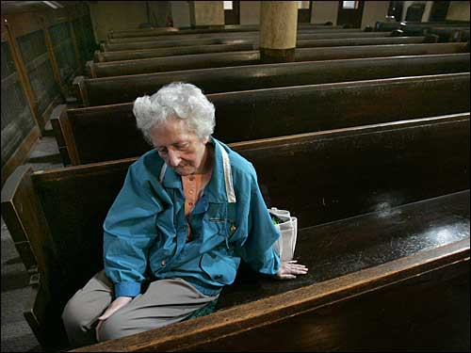
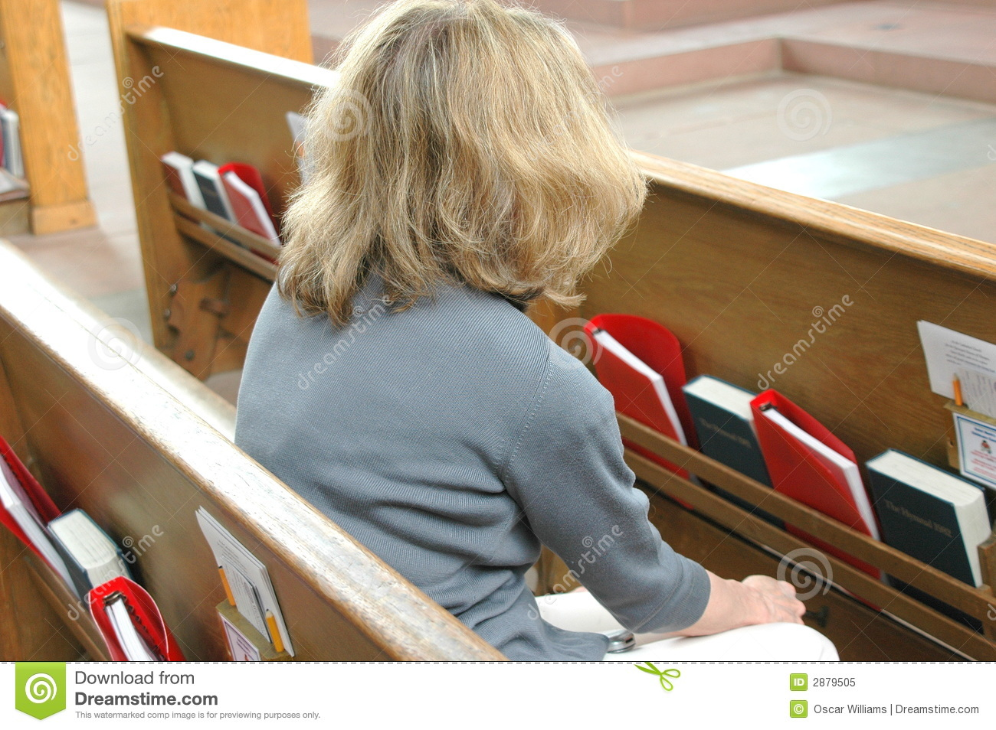


Slide 13
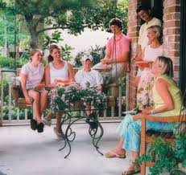
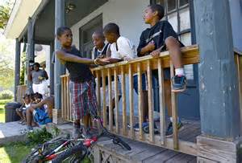
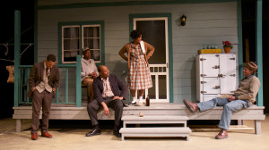
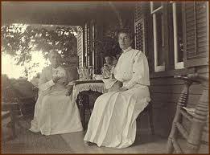

Slide 14
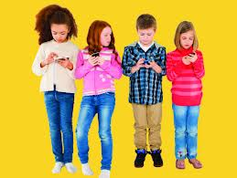



Slide 15


Acquaintance = Friendship
Our Culture Craves Relationships

Slide 16
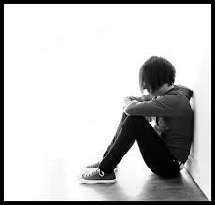
Most Spiritually Vulnerable when Isolated

Slide 17
We Were Created to be in Relationship
“Let us make humanity in our image” - Genesis 1:26
“It is not good for the man to be alone.” - Genesis 2:18
Jesus wanted us to be as one like He and the Father so that we would witness to Him – Good Community is part of our Mission as the church John 17:20-23
Notes:
The Trinity is portrayed as supporting one another, deferring, empowering one another, loving one another.
Small Groups offer oppt to meet together consistently and to share our lives wisdom and knowledge with one another
As the church we are to model togetherness, oneness as part of our witness to Christ

Slide 18
Small Groups Ministry Bring Vitality Because:
It Deepens Relationships with People and God
  Builds Community
  Builds Support Networks
  Enhances Prayer Lives
  Increases Engagement with God’s Word
  Encourages Accountability
  Offers Opportunity to Discover and Utilize Spiritual Gifts

Slide 19
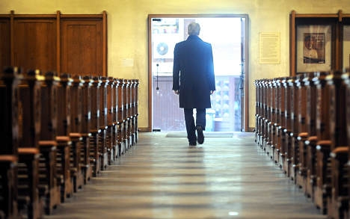
50% of adult Christians believe there should be more to Christian Life.

Slide 20

Millennials want substance.

Slide 21

  SMALL GROUPS ENCOURAGE SPIRITUAL GROWTH

Slide 22
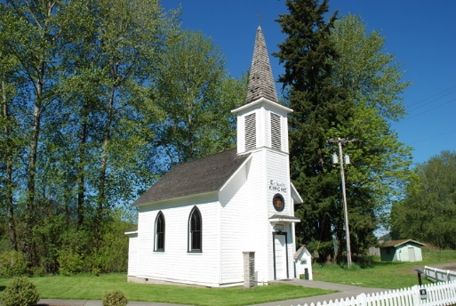
“But we’re a small church, we already are a small group.”
What more can you be doing to grow deeper disciples and community?

Slide 23
What is Small Group Ministry?
Small groups are groups of people who gather together on a regular basis with the goal of becoming more faithful disciples of Jesus Christ, through an intentional process of learning, mutual support and accountability, and/or service to the world.

Slide 24
The Most Successful Small Groups:
Are gatherings of up to 15 people
Are intentionally planned for growing disciples’ faith, spirituality and engagement in the world.
Meet at least twice a month
Are rooted in prayer
Are conversationally driven
Involve study and/or outreach.
Each member becomes a teacher and learner through a facilitated sharing.

Slide 25
TYPES OF SMALL GROUPS
LONG TERM & SHORT TERM
Bible Study
Study Topic
Accountability
Ministry
Support
Online
Interests & Hobbies
Other
Vital

Slide 26
*Sunday School classes, music ministry teams and other church groups may, or may not be a small group, depending on how their meetings are structured when considering the above factors.​

Slide 27
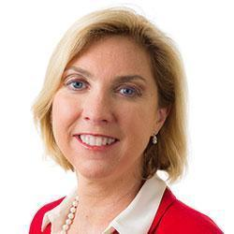
YOU ARE NOT ALONE!
The CONFERENCE is here to support you!
BETH CAULFIELD
Director of Small Groups
(908) 938-1379
bcaulfield@gnjumc.org
Vital
Notes:
This is in NCD churches.

Slide 28
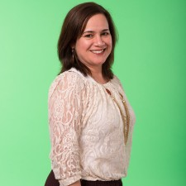
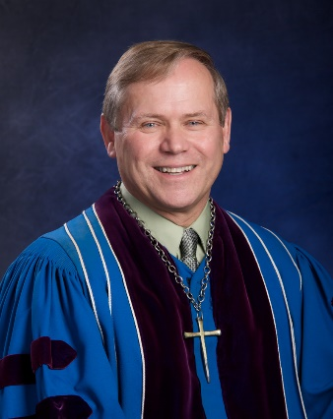
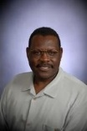
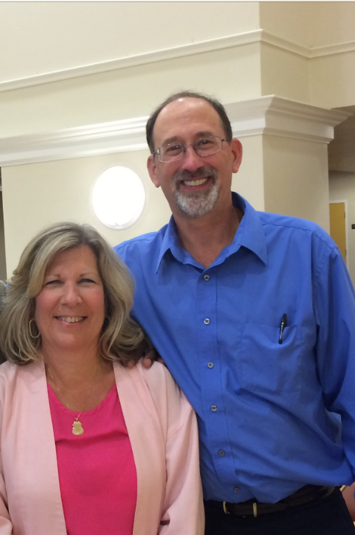
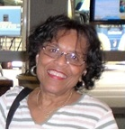
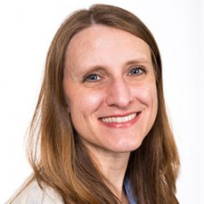
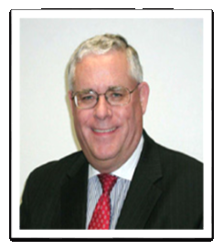
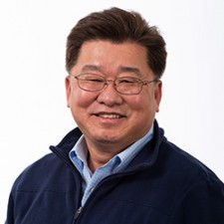
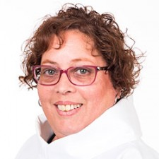
Small Group Resource Team
Clergy
Laity
Rev. Mike Bill
Rev. Eunice Vega-Perez
Rev. Brandon Cho
Rev. Deb DeVos
Rev. Jenny Smith-Walz
Dr. Frank Fowler
Dale and John Sims
Art Harrel
Jack Scharf
Shirley Swindell
Bruce Hilner

Slide 29
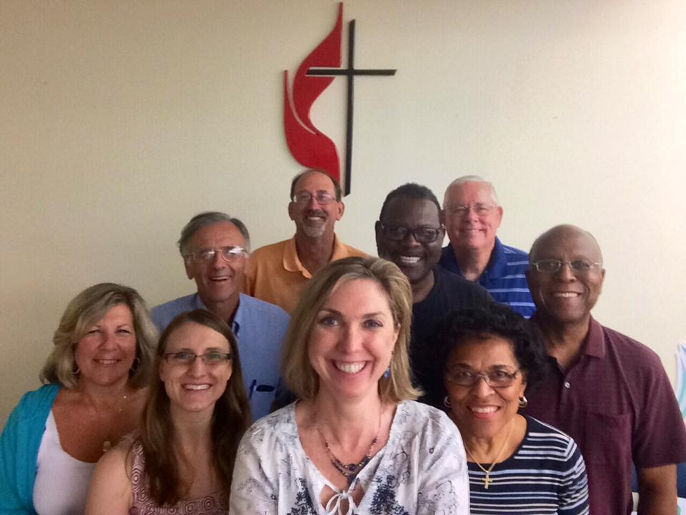
Small Groups Webpage
Small Group Ministry Resource Team
Small Groups Resources
Small Groups Upcoming Events
Suggested Reading List
Suggested Curriculum Advisor
http://www.gnjumc.org/smallgroups

Slide 30
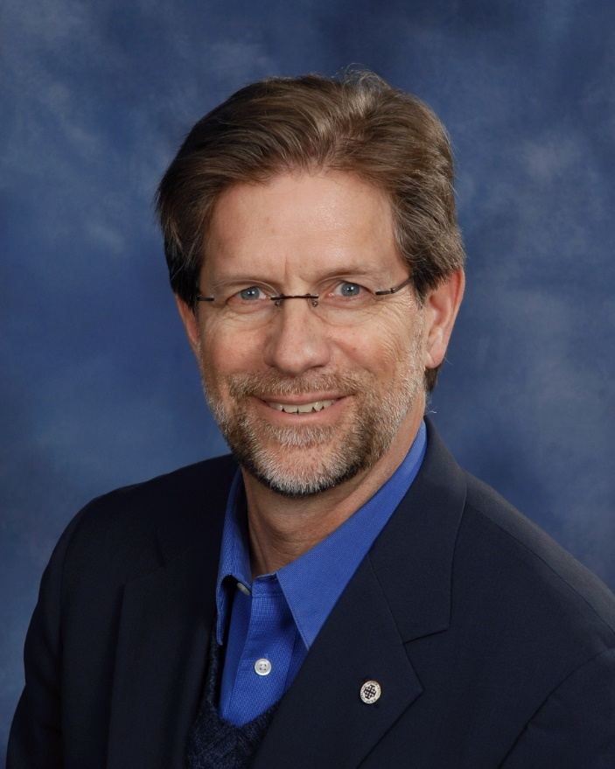

Discipleship Ministries
Steven W. Manskar
Director, Wesleyan Leadership

Slide 31
Covenant
Discipleship
Groups
Wesleyan Disciple-Making
Small groups that focus on mutual accountability and support
for discipleship are the “method” of Methodism. These groups
have their roots firmly planted in the Wesleyan tradition. The
roots go even deeper when you consider that John Wesley
described Methodism as his attempt to re-tradition “primitive”
Christianity. He said, “The soul and the body make a [person],
and the spirit and discipline make a Christian.”
Notes:
Let me tell the story now of Blairstpwn UMC which in Sussex County. Blairstown is a mid-size church which currently has a Sunday attendance of about 75 people.

Slide 32

EMPOWERING LAITY TO LEAD
LAY ACADEMY III
Vital
Creating Vital and Growing Small Group Ministries
Notes:
Well, good afternoon – our next subject is the Power of Small Groups - which the research shows is a necessary although not sufficient condition for achieving church vitality and growth.

Slide 33
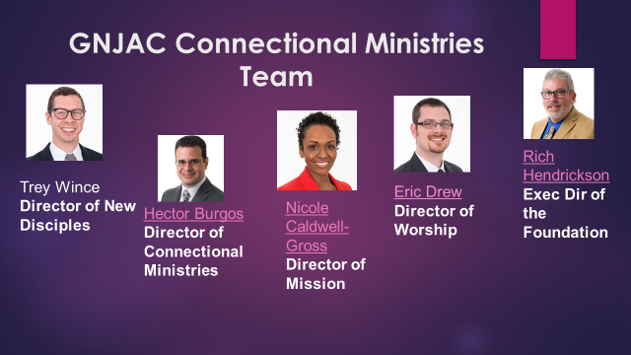

Slide 34
