Slide 1
Church and Clergy Taxes

Slide 2
Agenda
Church Taxes:
Tax Exempt Status
Employment Taxes
Reporting & Remittance
Form 941 Instructions
Clergy example of W-2
Housing Allowances / Housing Exclusions
Rental of Property
Clergy Taxes:
Form W-2
Employment Status
Federal & State withholdings
Housing Allowances
Professional Expenses
UMPIP Contributions
Salary Reductions
Spousal Travel
Other Church-related Income

Slide 3
Church Taxes

Slide 4
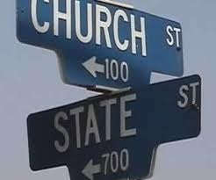
Tax Exempt Status
UMC is Tax Exempt Religious Organization under
Section 501(c)(3) of tax code
Group Tax Exemption ruling granted to GCFA in 1974
Exempt from Federal Income Tax
Generally exempt from filing Form 990 (Return for Organizations Exempt from Income Tax)
Donors may deduct contributions on tax returns (timely acknowledgement required)
All GNJ churches / ministries covered by group ruling
Churches may request a specific IRS inclusion letter. Process is automated http://www.gcfa.org/services/legal-services/group-ruling/
Churches may elect to be included on GuideStar, a database of IRS-recognized Not-for-profits.

Slide 5
Employment Taxes
Must know difference between an “employee” & “independent contractor”
Significant back taxes, fines and penalties for improper classification
How the individual wants to be classified is irrelevant
IRS 20 Questions Test: (Google “IRS 20 Questions Test”)
Work hours. Do you set the worker’s hours? (Independent contractors work when they want)
Instructions. Do you have the right to give the worker instructions about when, where, and how to work? (This shows control over the worker.)
Services rendered personally. Must the worker provide the services personally, as opposed to delegating tasks to someone else? (This indicates that you are interested in the methods employed, and not just the results.)
Must withhold & remit Federal, State, Local & Social Security taxes for:
Secretary & other lay employees
Organist
Sexton
Child-care providers (e.g. nursery care during church services)
Use of outside payroll vendor (ADP, Paychex, etc) or software program that is updated regularly is highly recommended. Ensures current withholding rates are used & that quarterly payroll records are accurate.

Slide 6
Employment Taxes
A. Ordained, commissioned, or licensed ministers have dual tax status:
Clergy are “employees” for tax reporting purposes (MUST BE ISSUED A W-2, NOT A 1099)
Clergy are “self-employed“ for Social Security tax purposes
B. There is no mandatory income tax withholding for clergy (may be done voluntarily)
C. Social Security taxes are never to be withheld for clergy. This is because clergy make Social Security & Medicare contributions via the “Self-employment” system.
D. Clergy should be making quarterly estimated payments of Federal, State, Local and self-employment taxes. Self-employment taxes must include value of a Housing Allowance or parsonage.
The self-employment tax rate is 15.3%. The rate consists of two parts: 12.4% for social security (old-age, survivors, and disability insurance) and 2.9% for Medicare (hospital insurance).
E. Move Costs:
The Tax Cut and Jobs Act of 2017 suspended both the tax exclusion and the deduction related to moving expenses for taxable years 2018 until 2025.
Reimbursement (or direct payment) of move costs now taxable to the recipient.
Must be reported on W-2

Slide 7
Tax Reporting and Remittance
Payroll Taxes:
A. Withhold taxes, file forms and comply with deposit requirements
1. Federal Social Security & Medicare taxes
2. Federal Income tax
3. State and Local income tax (requirements vary from state to state)
B. Quarterly Filing Requirements
1. Federal: Form 941 due by last day of month following the end of each quarter (i.e. April 30th, July 31st, October 31st & January 31st)
2. State equivalent form (may vary from state to state)
C. Annual Filing Requirements: By January 31st:
1. Form W-2 provided to employees
2. Form W-3 filed with Social Security Administration
3. Form 1099-MISC supplied to individuals (compensation of $600 or more)
4. Form 1096 & 1099-MISC filed with the IRS

Slide 8
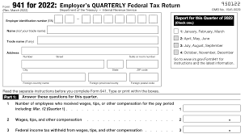
Form 941 Instructions
IRS Form 941 is called the “Employer’s Quarterly Federal Tax Return”
Form 941 reports the number of employees and the amount of Social Security, Medicare and Federal wages and taxes withheld each quarter
It is the IRS’s position that a church with only clergy and no other staff on payroll need not file a Form 941. However, if clergy elect to have Federal income tax voluntarily withheld, a Form 941 filing is required.
Line 1: Number of employees
Line 2: Total amount of quarterly wages and other compensation paid to all employees that are subject to federal income tax. Amount should exclude salary reduction pension contributions, housing or utility allowances, health insurance premiums paid by the church and accountable reimbursement payments.
Lines 5a-5c: No information should be supplied for clergy as they are not to have Social Security or Medicare taxes withheld.
If the IRS questions why wages reported on lines 5a-5c (which exclude clergy) are inconsistent with total compensation (which includes clergy), state that clergy are considered self employed under IRS Code 3121(b)(8)(A).

Slide 9
Example of Form W-2 for Clergy
A GNJ pastor lived in a parsonage furnished by her church and:
she received a cash salary of $40,000;
her church properly designated $5,000 of her $40,000 cash salary as a housing (or parsonage furnishing and utilities) exclusion;
she made a voluntary, pre-tax, salary reduction contribution of $900 to the United Methodist Personal Investment Plan (UMPIP);
she made salary reduction contributions of $3,500 through a cafeteria plan for her share of her medical insurance premiums and for a Flexible Spending Account (FSA);
she received a non-accountable travel allowance of $3,000;
her church paid $14,000 on her behalf for medical insurance premiums;
she received reimbursements from her church of $2,500 for travel expenses pursuant to an accountable plan;
her church made a $5,000 contribution to the Clergy Retirement Security Program (CRSP) on her behalf.
She made salary reduction contributions of $1,200 for Dependent Care
She moved and her new church paid $5,000 directly to the moving company

Slide 10
Example of Form W-2 for Clergy
Boxes a –f: Self explanatory.
Box 1: (1) – (2) – (3) – (4) + (5) + (10) = $40,000 – $5,000 – $900 – $3,500 + $3,000 + $5,000 = $38,600. Note: Items (6) (7) & (8) are not included in Box 1.
Box 2: Leave blank. (We assume the pastor did not request voluntary federal income tax withholding by the church.)
Boxes 3 – 6: Leave blank.
Box 10: Enter the $1,200 for the Dependent Care FSA
Box 12: Enter E for the Code and $900 for the UMPIP contribution
Box 13: Check the Box labeled “Retirement plan” for the UMPIP contribution
Box 14: Enter “Housing Exclusion $5,000.”
Boxes 15-20: Complete according to your own state’s requirements.
Note: NJ does not allow you to exclude from wages amounts you contribute to deferred compensation and retirement plans other than 401(k) Plans. UMPIP is a 403(b) plan; hence, the contribution cannot be excluded.
Note: The $3,500 FSA contribution is not required to be reported on a W-2
Note: Contributions to an “HSA” (must be enrolled in a High Deductible Health Plan) are reportable in Box 12, code “W” as “Employer contributions”

Slide 11
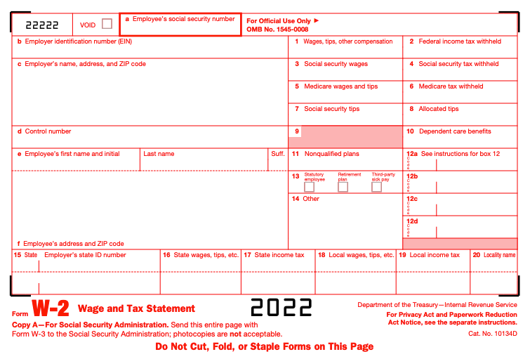
Example of Form W-2 for Clergy
111-22-1111
12-3456789
$38,600
St. Paul’s UMC
123 Main St.
Teaneck, NJ 07605
$1,200
Thomas
Watson
E
$900
45 Millbank Rd
Teaneck, NJ 07605
✓
Housing Exclusion $5,000
NJ
12-3456789
$39,500

Slide 12
Housing Allowance / Housing Exclusion
Churches are required to provide housing to clergy either in the form of a parsonage or a Housing Allowance.
Per IRS rules, clergy are not taxed on housing including the value of parsonages, housing allowances and / or housing expenses.
A Housing Allowance is cash that is paid to the pastor, in addition to salary. It is usually paid when no parsonage can be provided.
A Housing Exclusion is an amount of salary that the pastor designates to treat as non-taxable because it relates to housing. It is not paid to the pastor but instead deducted from income for W-2 purposes.
If a pastor is provided a parsonage with the church paying all associated expenses, it would be unusual for the pastor to have a large Housing Exclusion.
A Housing Exclusion must be signed by the pastor and the church prior to the income being earned that is being excluded.
Generally speaking, a pastor and church should sign the Housing Exclusion prior to January 1st of each year (or July 1st if being reappointed).

Slide 13
Housing Allowance / Housing Exclusion Examples
 | Pastor A | Pastor B
Salary (a) | $40,000 | $40,000
Parsonage (b) | Yes | No
Housing Allowance (c) | None | $10,000
Housing Exemption* (d) | $2,000 | $5,000
Total Payments (a+c) | $40,000 | $50,000
Taxable W-2 Income (a-d) | $38,000 | $35,000
Taxable Self-employment income | $40,000 + rental value of parsonage | $50,000 (a+c)
The following resources are available at: wespath.org/retirement-investments/clergy-taxes-housing-allowance
Housing Allowance Q&A’s
Housing Allowance Exclusion Worksheet
Housing Allowance Resolution
* Represents housing costs paid by the pastor personally such as furniture

Slide 14
Rental of Property
Tax-free status:
Rental of real property by a church does not jeopardize the church’s tax-free status.
Many churches rent steeples to telecommunication companies & facilities to outside groups.
As long as income is used for 501c3 purpose (religious activities) & rental income does not constitute primary source of income, rentals are allowed.
Creation of leases and use of terms such as landlord / tenant / rent is not problematic.
Income Taxes:
Outside income is usually subject to UBIT (unrelated business income tax)
Exemption for the rental of real property.
If there is no debt on property, all rental income is excluded from UBIT and not taxable.
If there is debt, income may be subject to UBIT if less than 85% is used for exempt (church) purposes. (Speak to tax professional if unsure)
Rental of parking lots is not considered rental of real property and is taxable
Property Taxes:
Churches should assume that any property rented (to any organization) will be put back onto tax rolls. Ex: Space rented to a preschool that is not affiliated with the church.
Example - if church rents two floors of a three story education building to a preschool that is not affiliated with the church, the municipality could make the case that 2/3rds of the building is taxable.
Approvals:
Any property leased for a term of more than 30 days must comply with approval requirements of ¶ 2540 & 2541 of The Book of Discipline.

Slide 15
Clergy Taxes

Slide 16
Clergy: Tax Basics
Form W-2:
Clergy should receive a W-2 from the church, which provides wage and tax information to the pastor, the Social Security Administration, the Internal Revenue Service, and state and local governments.
Employment Status:
Clergy serving local churches are employees of the local church for Federal and state income tax purposes, and are self-employed for purposes of Social Security taxes. This distinction means that clergy income is reported on the W-2 in Box 1 (Federal wages), Box 16 (state wages), and Box 18 (local wages), as applicable but not reported in Box 3 (Social Security wages) or Box 5 (Medicare wages).
Churches should never withhold Social Security taxes from clergy or pay an employer share of Social Security taxes for clergy. However, clergy who have elected to have Federal income taxes withheld may have additional tax amounts withheld to prepay their estimated self-employment tax liability.

Slide 17
Clergy: Tax Basics (continued)
Federal and State Income Tax Withholding:
There is no mandatory withholding of Federal and state income taxes for clergy. However, Federal and state income taxes may be withheld at the request of the clergyperson. Amounts withheld should be reported in Boxes 2 and 17 of Form W-2 as applicable.
Housing Allowances:
Housing allowances must be approved prospectively (before the income is earned) and may be increased without a corresponding increase in the pastor’s total compensation.
Clergy housing allowances or the fair rental value of a church-provided parsonage, must be included in income when calculating self-employment Social Security taxes.
Housing allowances received by clergy in excess of actual qualified housing expenses incurred should be reported by clergy as other income on Line 21 of Form 1040.
Pension payments paid by Wespath are designated as a housing allowance for retired clergy. However, these payments do not qualify as a housing allowance for surviving spouses of retired clergy.

Slide 18
Clergy: Tax Basics (continued)
Professional Expenses:
Professional expenses paid to clergy under the accountable reimbursement method are not taxable and should not be reported on Form W-2.
Professional expenses paid to clergy under the allowance method are taxable and must be reported as wages in Box 1 of Form W-2.
Churches should not pay unused reimbursement amounts at the end of the year to avoid the possibility of the reimbursement being treated as a taxable allowance.
Example 1: Church reimburses pastor for amounts spent on church-related activities in accordance with Professional Fees budget of $6,000 per year. Reimbursements are only made upon submission by pastor of a written request with supporting receipts. Payment is not taxable to clergy.
Example 2: Church pays pastor an allowance of $500 per month for amounts spent on church-related activities in accordance with Professional Fees budget of $6,000 per year. Church does not require supporting documentation for amounts spent. Payment is taxable to clergy.

Slide 19
Clergy: Tax Basics (continued)
United Methodist Personal Investment Plan (UMPIP) Contributions:
Salary reduction contributions to 403(b) church plans, such as UMPIP, are not subject to self-employment tax. This rule does not apply to lay employee contributions to 403(b) church plans.
Salary Reduction in Lieu of Tithing:
Pastors should not reduce their salary to tithe or make other gifts to the church to obtain tax advantages because of concerns related to constructive receipt, the availability of itemized deductions for charitable contributions, the reduction of pension benefits, irrevocable refusal to accept salary, permanent loss of compensation, & theological issues.
Spousal Travel Expenses:
In most instances, clergy spousal travel expenses are not considered deductible business expenses. In addition, reimbursement of such expenses is generally considered compensation and therefore taxable income to the pastor reported in Box 1 of Form W-2.

Slide 20
Clergy: Tax Basics (continued)
Other Church-related Income:
Many pastors receive other church-related income in addition to their regular compensation paid by the church. Examples include honorariums (e.g., weddings), love offerings, and other gifts of cash (e.g., at Christmas).
Honorariums are always taxable.
Love offerings and other gifts of cash are taxable to the pastor when paid by the local church and should be included on the donor’s annual giving statement prepared by the local church and reported in Boxes 1, 16, and 18, as applicable, of Form W-2. Love offerings and other gifts of cash received directly from individuals are not taxable to the pastor provided these amounts are not included on the donor’s annual giving statement.

